Slide 1
NCPCA
January Meeting
January 8th, 2026

Slide 2
Agenda
7:30 - Consent to Record, Call to Order, Agenda Approval, Minutes Approval
7:35 - Officer Reports
7:50 - Hollywood Shopping Center Q&A Review and Discussion
8:10 - Unscheduled Motions and Announcements
8:20 - Motion to Adjourn

Slide 3
Motion to Approve
Minutes
I move to approve the December minutes as posted on the NCPCA website and provided to members before this meeting.

Slide 4

President Report
NCPCA Coffee Socials - Sunday before the monthly meeting at Proteus Brews. Next meeting: February 8th.
Treasurer, Development, and Events committee vacancies.
Please send any interest for open positions or general inquiries to NCPCivic@gmail.com
Shopper’s and College Park Market Place Talking Points & Follow-up
Affordable Grocery Advocacy Questions
College Park Affordable Grocery Talking Points

Slide 5
President Report
College Park Community Corner
Education Advisory Committee
Purpose is to support, strengthen, and promote the schools that College Park students attend.
Goals are broadly tied to informing community of education issues and facilitating UMD involvement.
At least 9 members; residency not required; 3 year term.
Meeting every Third Monday, 7:30PM, City Hall
Staff Liaison: Kiaisha Barber
Email: kbarber@collegeparkmd.gov

Slide 6
Vice President Report
Continue checking your email for NCPCA updates.
Email us any questions, concerns, or needs! Help us make this meeting the most meaningful it can be.
NCPCA Association (ncpcivic@gmail.com)

Slide 7
Treasurer Report
Activities
MailChimp monthly upgrade: $13
New Treasurer - Seeking a replacement to start training in the new year
SECU Checking Account*
Available Balance | $1,182.76
Recent transactions: mailchimp
SECU Savings Account*
Available Balance | $336.53
Interest Paid YTD | $1.09
Recent Transactions
Interest Credits 11/30 | $0.10
*As of 7:00PM EST 12/11/2025

Slide 8
Secretary Report
Please be sure to state your name when addressing the membership, putting forward a motion, or seconding a motion to facilitate note-taking.
For those on Zoom: Please enter your full name into the chat to facilitate recording attendance.

Slide 9
Developments Committee Director Report
WSSC plans to repair a water service at 4714 Hollywood Road 12/10/25 if weather conditions allow. Work will be pushed one day if there is inclement weather. There may be temporary traffic impacts as work is completed.
Notes:
Hollywood Rd sidewalk - I think still some striping to do
PSA - Pedestrians walking in bike lane along northbound Rhode Island Ave

Slide 10
Developments Committee Director Report
Position is currently vacant.
Send email to NCPCivic@gmail.com if interested. Include a small blurb about your experience and why you’re interested in filling the vacancy.
Department of Planning & Community Development
City Projects
College Park Development Dashboard
Notes:
Hollywood Rd sidewalk - I think still some striping to do
PSA - Pedestrians walking in bike lane along northbound Rhode Island Ave

Slide 11

Events Committee Director Report
North College Park Events
Hollywood Farmers Market - Saturday, 10am-2pm, Mom’s Parking Lot
Food & produce vendors
Arts & crafts
Music
Local businesses

Slide 12
Events Committee Director Report
North College Park Events
NCPCA Potluck Thursday, December 11th, 8:30pm, Davis Hall
Continuing our annual tradition of celebrating North College Park during the holiday season. We’ll have food, drinks, and light refreshments. Swing by, say hi, grab some food, and mingle with members of our wonderful community.

Slide 13
City Events
College Park RCV Day - Wednesday, January 21st, 7:00 pm - 9:00 pm at Board & Brew
Want more information on RCV? Have any concerns or questions you’d like addressed? Curious to know more? Stop by and follow-up the NCPCA’s previous RCV discussion by chatting with the presenters themselves. These subject matter specialists will be there to discuss, learn, and explore all things RCV related!

Slide 14

City Events
Celebrate the Legacy of Dr. Martin Luther King Jr.
Donate non-perishable, unexpired food items
to support the College Park Community Food Bank.
Drop-off at City Hall (7401 Baltimore Ave.) and
Davis Hall (9217 51st Ave.), Jan. 2–30.

Slide 15
City Events
Lunar New Year Celebration - Saturday, February 21st, 10:00 am - 1:00 pm at City Hall Community Room
Celebrate the vibrant culture and contributions of our Asian American community. This event will feature traditional music, demonstrations, lion dancing, food samples, fun giveaways, and more. Parking is free at the Downtown College Park Parking Garage.

Slide 16
City Events
Social Activities for Older Adults Launched by WISE Connect
From coffee meetups to board games to art sessions, this group is free to join and welcomes you!
WISE Connect (www.wisecities.us) was founded by UMD alumni to foster connection, engagement, and fulfillment all life long. This year, the City of College Park is partnering with WISE Connect to offer social and recreational activities for residents over age 55.
The initiative engages local businesses to host the group, offering discounts and age-friendly setups. Participating businesses starting September include Proteus Brews, The Greene Turtle, The Board & Brew, Sardi's, Dog Haus Biergarten, Shop Made in MD, Bowlero, Ledo Pizza, with more to come. Have a favorite spot to meet? Let the team know!
Social connection is key to good health! Come meet new people, get special discounts, explore new places, and have fun! Rides to events will be arranged as needed to ensure transportation is not a barrier to participating.
The calendar of upcoming events can be found at https://wiseconnect.us/ or in the Facebook group at https://www.facebook.com/groups/cpwiseevents, as well as in the attached PDF.
To sign up or ask questions, contact Marie Brodsky by email (marie@wiseconnect.us) or phone (571-354-6626).
WISE Events Portal - College Park

Slide 17
Events Committee Director
Position is currently vacant.
Send email to NCPCivic@gmail.com if interested. Include a small blurb about your experience and why you’re interested in filling the vacancy.

Slide 18
Hollywood Shopping Center Q&A Review and Discussion

Slide 19
Background
Hollywood Shopping Center was built in 1967 and located at 9805 Rhode Island Avenue.
Shopping center is 49.193 square feet, has 13 stores, and a 200 space parking lot. A State of MD Department of Labor Licensing and Regulation building also sits on the property. Seasonally, the property hosts the Hollywood Farmers Market.
10/13 properties are currently occupied with three vacancies.
Rhode Island Ave ADT = 14,851; ADT (Average Daily Traffic) is the average number of vehicles using a road section over a 24-hour period, making this an indicator of potential foot traffic i.e. the potential for the shopping center to be busy.
Further Info: https://klnb.propertycapsule.com/p/retail-real-estate/College+Park-MD-20740/hollywoodshoppingcenter

Slide 20
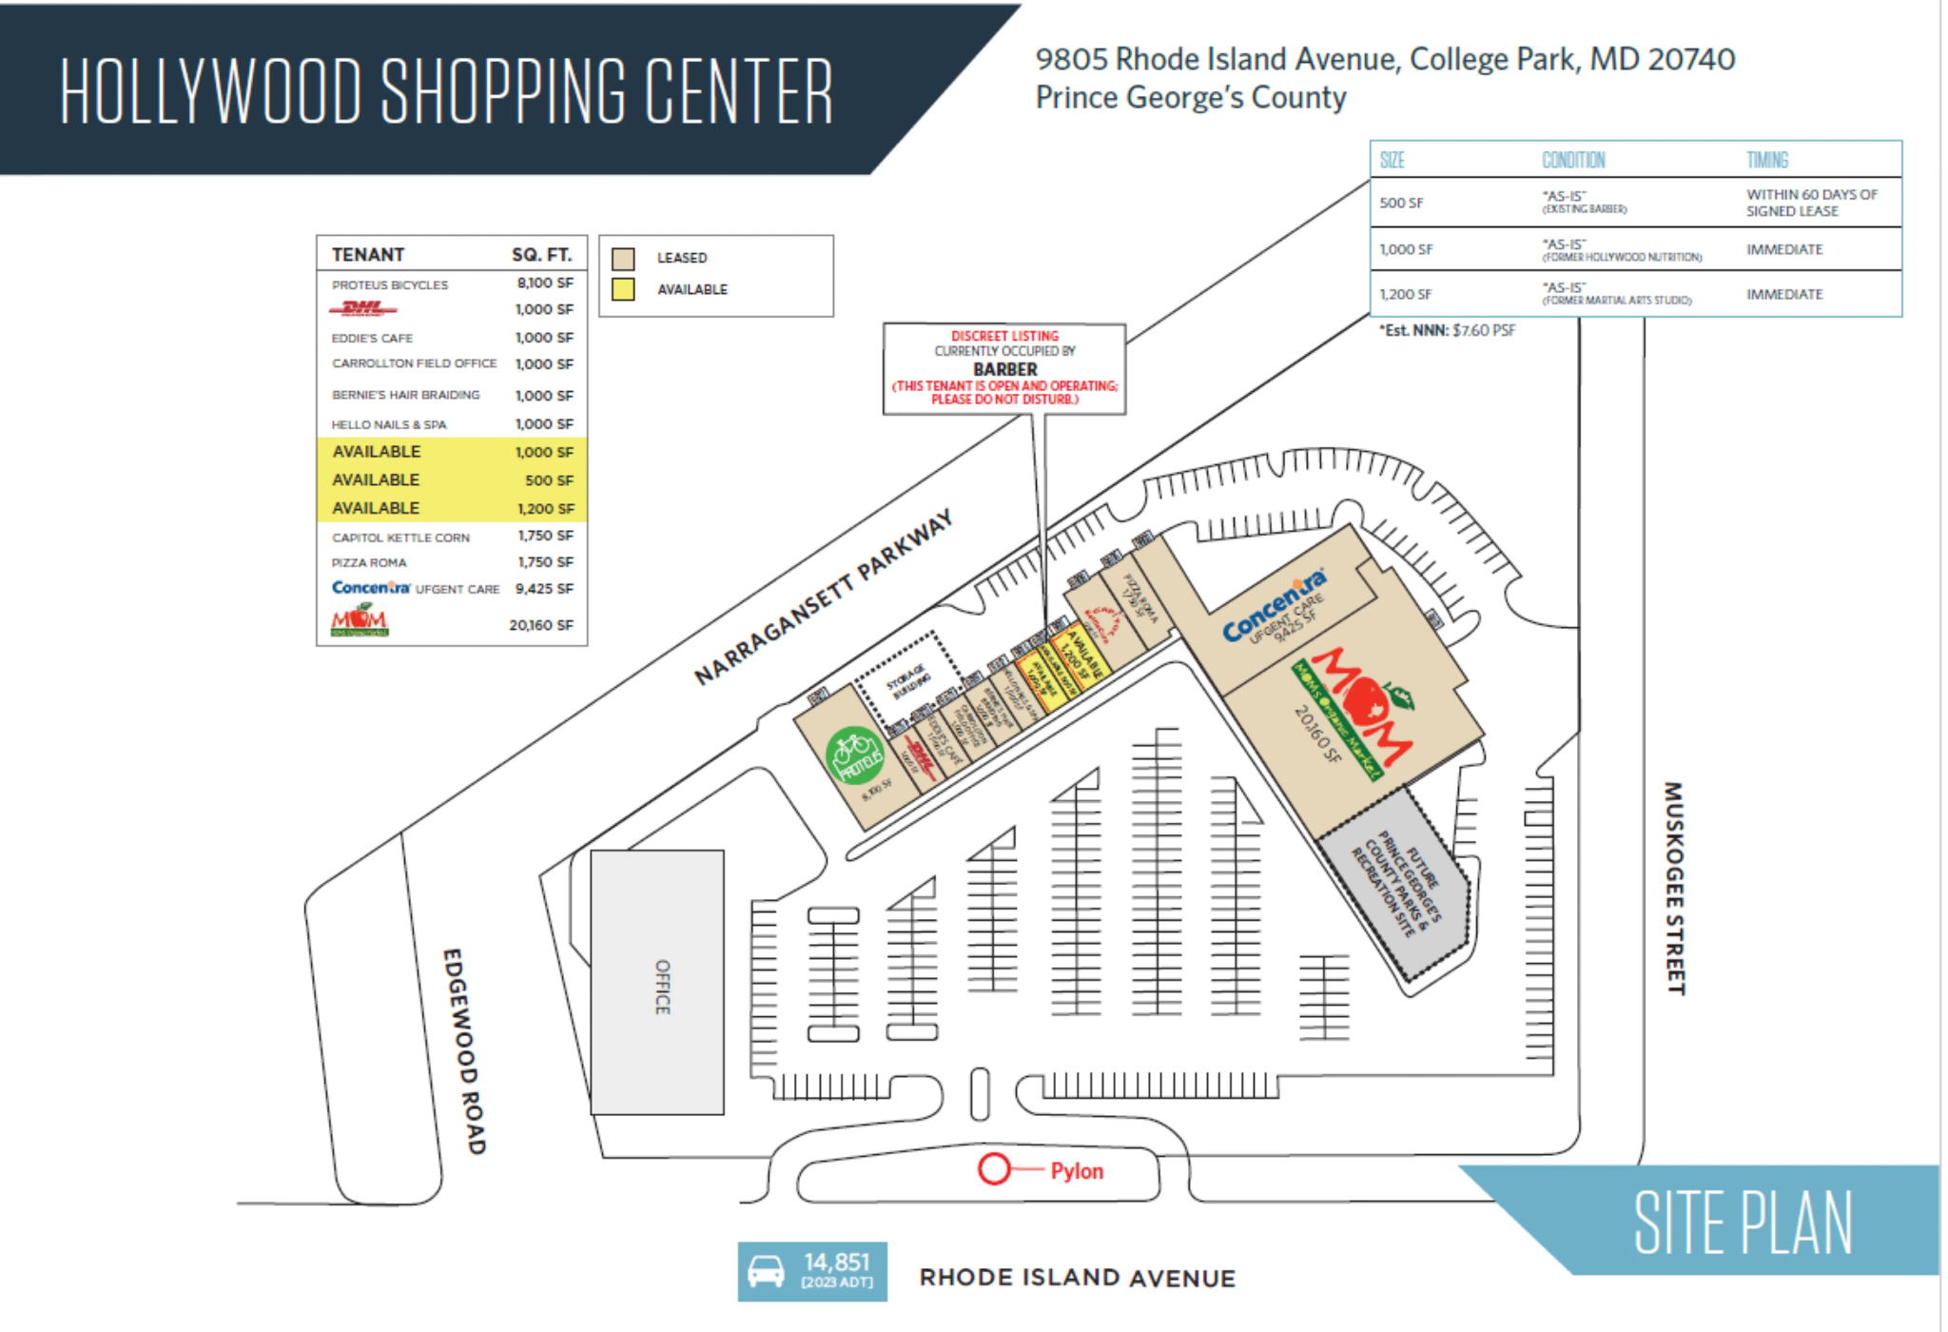

Slide 21
Outreach
Reached out to KLNB who manages the property and spoke with Vice President Mai Vo.
Asked several common questions tied to the shopping center.
KLNB simply works with the landlord, but ultimately, despite managing the property, the landlord holds final decision making authority.

Slide 22
Hollywood Shopping Center Q&A
How is interest in the shopping center in terms of interested tenants? Any obstacles?
We have regular interest in the center from a variety of local mom & pop tenants. The challenges with leasing (any shopping center) are typically lack of experience & capital from prospective tenants or competitive landscape in other retail spaces in the College Park trade area, closer to other retail businesses where a majority of national or regional tenants may want to be.
Multiple new business have moved in over the past year. What has been successful in attracting them?
We have a solid system within our research & marketing teams at KLNB and we believe having a grocery anchor and newly opened Concentra have also help shape the center and enhance traffic.
How many vacancies are there currently?
Please refer to the flyer which highlights the vacancies: https://klnb.propertycapsule.com/p/retail-real-estate/College+Park-MD-20740/hollywoodshoppingcenter
(3 vacancies per site plan)

Slide 23
Hollywood Shopping Center Q&A
Any future plans for renovations or changes to the shopping center?
These are ongoing conversations with the Landlord but TBD.
Does KLNB have any contact or involvement with the State of Maryland building also sharing the property?
We do not but that may change in the future pending on our client (the Landlord’s) needs
Is there a specific type of business you try to attract or otherwise target?
A variety of fast casual restaurants, specialty coffee shops (halal/middle eastern)… in general anything that is a void in the center would be welcomed and considered, pending the prospective Tenant’s experience, business plan, & financial strength
What can we do as a community to support the shopping center?
Keep shopping at the center and supporting the existing tenants
Any other information you’d like to share?
In general, you can refer to our flyer to see if there are any changes to the site plan for new leases signed. Commercial real estate leases are a long and tough process as all parties want to ensure long term success for all sides. We work very hard to vet out and prospect future tenants on a regular basis.

Slide 24
Hollywood Shopping Center Q&A
Open for discussion
Any additional questions for KLNB regarding Hollywood Shopping Center can be sent to ncpcivic@gmail.com

Slide 25
Motion
I move that . . .

Slide 26
Unscheduled Motions and Announcements

Slide 27

Our Next Meeting: February 12, 2026
… and we’re so excited to see you then!

