Slide 1
NCPCA
February Meeting
February 12th, 2026

Slide 2
Agenda
7:30 - Consent to Record, Call to Order, Agenda Approval, Minutes Approval
7:35 - Officer Reports
7:45 - Property on the corner of Edgewood and Route One across from Gateway Park Q&A
8:05- 48th Place Sidewalk Project Q&A
8:25- Unscheduled Motions and Announcements
8:30 - Motion to Adjourn

Slide 3
Motion to Approve
Minutes
I move to approve the January minutes as posted on the NCPCA website and provided to members before this meeting.

Slide 4

President Report
NCPCA Coffee Socials - Sunday before the monthly meeting at Proteus Brews. Next meeting: March 8th.
Treasurer, Development, and Events committee vacancies.
Please send any interest for open positions or general inquiries to NCPCivic@gmail.com
Hollywood Shopping Center Follow-up: Concerns regarding dated appearance of shopping center, safety hazards (fading parking lines, lack of traffic signage, congested entry/exit way), lack of cooperation with owner, potential environmental impacts to surrounding wooded area (trash, etc.)
Ranked Choice Voting support letter sent to Mayor and Council’s office 2/9.

Slide 5
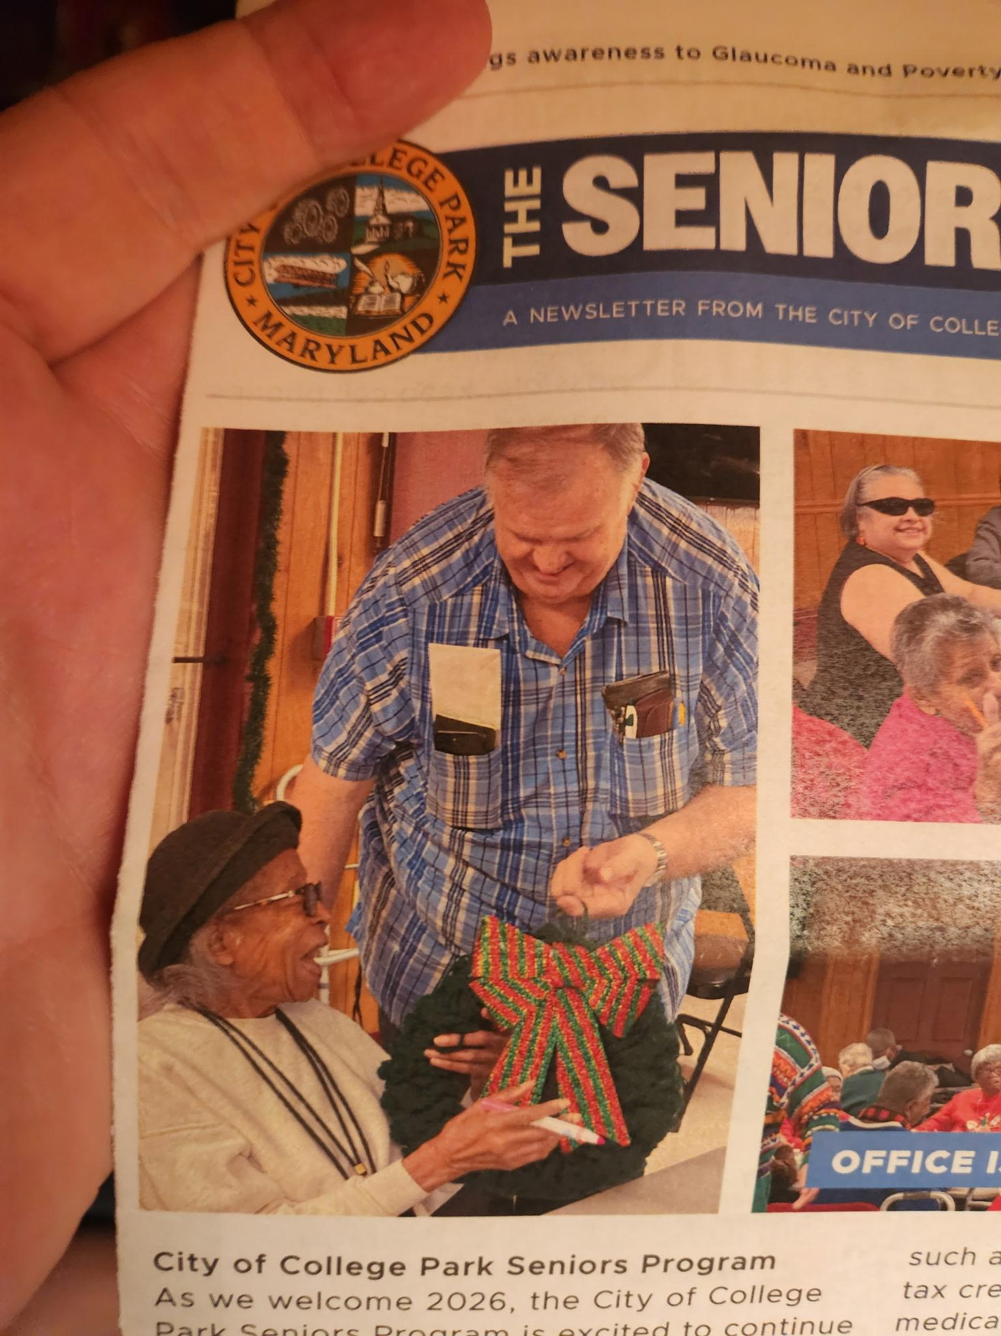
President Report
Belated announcement: A special thanks to the College Park Seniors for creating new ornaments this holiday season for the North College Park Community Tree.
An additional thank you to Dave Turley for not only coordinating this, but also for taking the time to teach Seniors how to create holiday wreaths, an enriching and inclusive activity that was a hit with our broader Senior community.

Slide 6
President Report
College Park Community Corner
Ethics Commission
Governs the ethical standards of conduct by City officials and employees accomplished via disclosure requirements.
City code establishes the role and authority of the commission.
7 members; ; 3 year term.
Meetings are as needed.
Staff Liaison: Yvette Allen
Email: yallen@collegeparkmd.gov

Slide 7
Vice President Report
Continue checking your email for NCPCA updates.
Email us any questions, concerns, or needs! Help us make this meeting the most meaningful it can be.
NCPCA Association (ncpcivic@gmail.com)

Slide 8
Treasurer Report
Activities
MailChimp monthly upgrade: $13
New Treasurer - Seeking a replacement to start training in the new year
SECU Checking Account*
Available Balance | $1,155.98
Recent transactions: mailchimp
SECU Savings Account*
Available Balance | $336.73
Interest Paid YTD | $0.20
Recent Transactions
Interest Credits 1/31 | $0.10
*As of 7:00PM EST 2/12/2025

Slide 9
Secretary Report
State your name when speaking to facilitate the official minutes. If on Zoom, enter your first and last name in the chat.
Pilot “NCPCA Update” email Monday after meeting:
  39.1% open rate similar to other NCPCA emails
  11.4% click rate considerably higher than other NCPCA emails.
  Good way to engage those not attending meetings?

Slide 10
Developments Committee Director Report
Hollywood Plaza shopping center (New York Deli, Koite Grill, etc.) has continue progressing in it’s renovation. New signage has been installed for New York Deli and work on the facade of the shopping center has begun.
Repairs are much needed, as the shopping center has been in a state of disrepair for many years. Indirectly a part of a broader effort to reinvigorate and improve the intersection and adjoining Hollywood Streetscape.
Notes:
Hollywood Rd sidewalk - I think still some striping to do
PSA - Pedestrians walking in bike lane along northbound Rhode Island Ave

Slide 11
Developments Committee Director Report
Position is currently vacant.
Send email to NCPCivic@gmail.com if interested. Include a small blurb about your experience and why you’re interested in filling the vacancy.
Department of Planning & Community Development
City Projects
College Park Development Dashboard
Notes:
Hollywood Rd sidewalk - I think still some striping to do
PSA - Pedestrians walking in bike lane along northbound Rhode Island Ave

Slide 12

Events Committee Director Report
North College Park Events
Hollywood Farmers Market - Saturday, 10am-2pm, Mom’s Parking Lot
  Food & produce vendors
  Arts & crafts
  Music
  Local businesses

Slide 13
Events Committee Director Report
North College Park Events
NCPCA Potluck Thursday, December 11th, 8:30pm, Davis Hall
Continuing our annual tradition of celebrating North College Park during the holiday season. We’ll have food, drinks, and light refreshments. Swing by, say hi, grab some food, and mingle with members of our wonderful community.

Slide 14
City Events
College Park Community Book Club - Thursday, February 12th, 7:00 pm - 8:30 pm, College Park Community Library
Meets the second Thursday of each month at the same time listed unless otherwise noted.
February’s Book: The Unpassing by Chia Lin.
March’s Book: The Thursday Murder Club by Richard Osman.

Slide 15
City Events
Book Club on Zoom! - Tuesday, February 17th, 7:00 pm - 8:30 pm, College Park Community Library (held on Zoom)
Meets the third Tuesday of each month at the same time unless otherwise noted.
Focus on female writers.
February’s Book: The Arbonaut: A Life Discovering the Eighth Continent in the Trees Above Us by Meg Lowman.
More info here.
If interested, email info@cpae.org

Slide 16
City Events
Lunar New Year Celebration - Saturday, February 21st, 10:00 am - 1:00 pm at City Hall Community Room
Celebrate the vibrant culture and contributions of our Asian American community. This event will feature traditional music, demonstrations, lion dancing, food samples, fun giveaways, and more. Parking is free at the Downtown College Park Parking Garage.

Slide 17
City Events
Frevo Dance for Kids - Saturday, February 21st, 1:00 pm - 2:00 pm, Old Parish House (4711 Knox Rd.)
Brazilian dance featuring high energy movements, vibrant music, and a perfect medium to expose kids to new cultures.
The event is free.
More info can be found here.

Slide 18
City Events
Friday Night Live! - Friday, May 8, 6:00 pm - 8:30 pm at City Hall Plaza
Join us on the Plaza at City Hall for College Park's favorite summer concert series, Friday Night LIVE! On select Fridays from May through August, live bands will take the stage with bold beats from diverse musical genres. From funky grooves to rock anthems, we've got the soundtrack for your Friday night.
Admission is free and free parking will be available at the Downtown Parking Garage at the corner of Yale Ave. and Knox Road during the event.

Slide 19
City Events
Spring Street Fair - Sunday, May 17, 12:00 pm - 4:00 pm at Davis Hall
Join us for a vibrant afternoon of fun, food, and creativity at the second annual Spring Street Fair in College Park!
On Sunday, May 17th, from 12:00 PM to 4:00 PM, celebrate the season with your community at 9217 51st Ave, College Park, MD 20740.
This family-friendly event will feature a variety of exciting activities for all ages!

Slide 20
City Events
Social Activities for Older Adults Launched by WISE Connect
From coffee meetups to board games to art sessions, this group is free to join and welcomes you!
WISE Connect (www.wisecities.us) was founded by UMD alumni to foster connection, engagement, and fulfillment all life long. This year, the City of College Park is partnering with WISE Connect to offer social and recreational activities for residents over age 55.
The initiative engages local businesses to host the group, offering discounts and age-friendly setups. Participating businesses starting September include Proteus Brews, The Greene Turtle, The Board & Brew, Sardi's, Dog Haus Biergarten, Shop Made in MD, Bowlero, Ledo Pizza, with more to come. Have a favorite spot to meet? Let the team know!
Social connection is key to good health! Come meet new people, get special discounts, explore new places, and have fun! Rides to events will be arranged as needed to ensure transportation is not a barrier to participating.
The calendar of upcoming events can be found at https://wiseconnect.us/ or in the Facebook group at https://www.facebook.com/groups/cpwiseevents, as well as in the attached PDF.
To sign up or ask questions, contact Marie Brodsky by email (marie@wiseconnect.us) or phone (571-354-6626).
WISE Events Portal - College Park

Slide 21
Events Committee Director
Position is currently vacant.
Send email to NCPCivic@gmail.com if interested. Include a small blurb about your experience and why you’re interested in filling the vacancy.

Slide 22
48th Place Sidewalk Project Q&A
(Presenters: City Engineer Steve Halpern & GIS Coordinator Jacob Vassalotti)

Slide 23
Property on the corner of Edgewood and Route One across from Gateway Park Q&A
(Presenter: Property Owner Abdullah Hijazi)

Slide 24
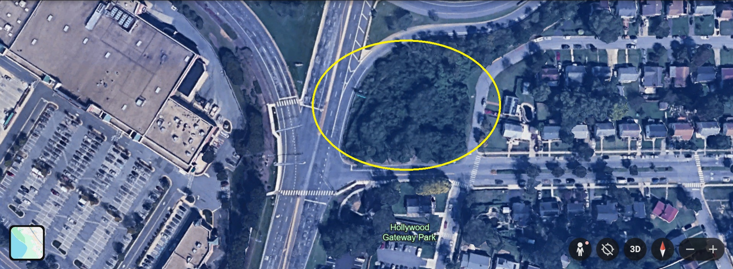
Property on the corner of Edgewood and Route One across from Gateway Park Q&A

Slide 25
Property on the corner of Edgewood and Route One across from Gateway Park Q&A
What is the development plan for the property?
There is no development plan at this time.
What action has been taken toward those plans?
Nothing since the property was purchased.
Are you aware of the people residing in the woods and if so, do you have any more information?
I found out from the City, and I cooperated with the City and the Police to have the people relocated or removed. My understanding is that nobody has returned to the site since then.
Have there been any discussion regarding infrastructure improvements (i.e. the busy intersection and surrounding exit)? Yes, but the City Administrator was against using public funds for widening the right of way of Edgewood and 47th Place even though the areas needed for widening were given to the City by the former owner almost 20 years ago.

Slide 26
Motion
I move that . . .

Slide 27
Unscheduled Motions and Announcements

Slide 28

Our Next Meeting: March 12, 2026
… and we’re so excited to see you then!

