Slide 1
NCPCA
March Meeting
March 12th, 2026

Slide 2
Agenda
7:30 - Consent to Record, Call to Order, Agenda Approval, Minutes Approval
7:35 - Officer Reports
7:45 - Hollywood Commercial District Placemaking Project Presentation
8:05- NCPCA Spring Event Discussion
8:25- Unscheduled Motions and Announcements
8:30 - Motion to Adjourn

Slide 3
Motion to Approve
Minutes
I move to approve the February minutes as posted on the NCPCA website and provided to members before this meeting.

Slide 4

President Report
NCPCA Coffee Socials - Previous meeting was cancelled due to capacity. Next meeting: April 5th.
Development, and Events committee vacancies.
Please send any interest for open positions or general inquiries to NCPCivic@gmail.com
Treasurer succession plan: Susan Huemmrich has submitted her candidacy for the position. Plan to shadow current Treasurer Melissa to transition into role.

Slide 5
President Report
College Park Community Corner
Noise Control Board
Advises the City in noise control efforts and hold noise board meetings as required by City Code (Chapter 138)
Residents can submit written complaints to the board; a meeting is held with two or more residents file for a specific occurrence.
5 members w/ 2 alternates; ; 3 year term.
Meetings are as needed. $60/meeting compensation
Staff Liaison: Sharon Fletcher; Jatinder Khokar
Email: sfletcher@collegeparkmd.gov; jkhokhar@collegeparkmd.gov

Slide 6
Vice President Report
Continue checking your email for NCPCA updates.
Email us any questions, concerns, or needs! Help us make this meeting the most meaningful it can be.
NCPCA Association (ncpcivic@gmail.com)

Slide 7
Treasurer Report
Activities
MailChimp monthly upgrade: $13
New Treasurer - Seeking a replacement to start training in the new year
SECU Checking Account*
Available Balance | $1,155.98
Recent transactions: mailchimp
SECU Savings Account*
Available Balance | $336.73
Interest Paid YTD | $0.20
Recent Transactions
Interest Credits 1/31 | $0.10
*As of 7:00PM EST 2/12/2025

Slide 8
Secretary Report
State your name when speaking to facilitate the official minutes. If on Zoom, enter your first and last name in the chat.
Feb 16 NCPCA Update email:
  40.6% open rate, up from 39.1% in Jan.
  7.3% click rate, down from 11.4% in Jan.

Slide 9
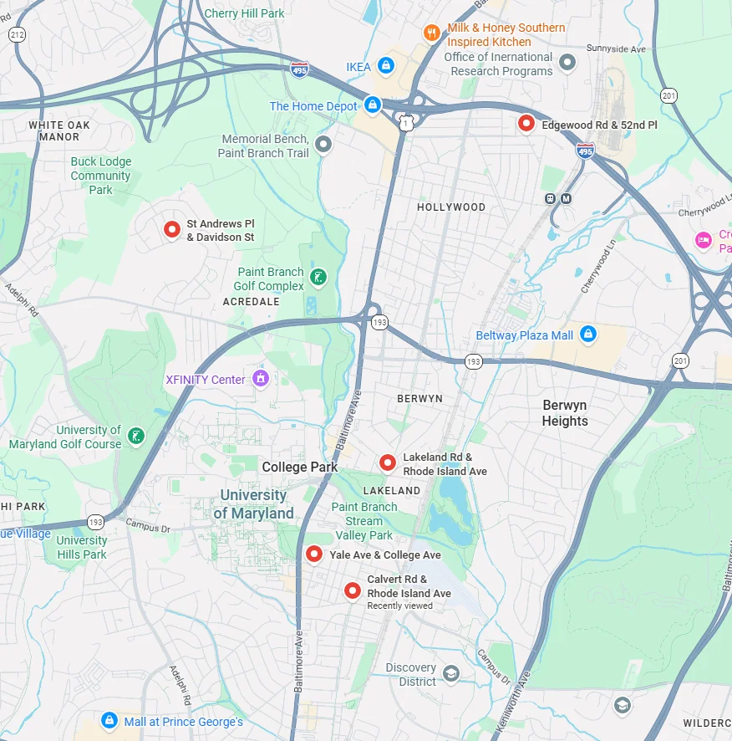
Developments Committee Director Report
Five new traffic cameras installed throughout the city. Locations are:
  Edgewood Road East at 52nd Place
  St. Andrews Place SW at Davidson Street
  Rhode Island Avenue South at Lakeland Road
  College Avenue West at Yale Avenue
  Calvert Road West at Rhode Island Avenue
Cameras as fully self-funded; no cost to the city. Enforcement begins March 16th.
City motivations were improved safety and a supplementary source of budget that did not additionally burden residents/taxpayers.
Notes:
Hollywood Rd sidewalk - I think still some striping to do
PSA - Pedestrians walking in bike lane along northbound Rhode Island Ave

Slide 10
Developments Committee Director Report
Position is currently vacant.
Send email to NCPCivic@gmail.com if interested. Include a small blurb about your experience and why you’re interested in filling the vacancy.
Department of Planning & Community Development
City Projects
College Park Development Dashboard
Notes:
Hollywood Rd sidewalk - I think still some striping to do
PSA - Pedestrians walking in bike lane along northbound Rhode Island Ave

Slide 11

Events Committee Director Report
North College Park Events
Hollywood Farmers Market - Saturday, 10am-2pm, Mom’s Parking Lot
  Food & produce vendors
  Arts & crafts
  Music
  Local businesses

Slide 12
Events Committee Director Report
North College Park Events
NCPCA Potluck Thursday, December 11th, 8:30pm, Davis Hall
Continuing our annual tradition of celebrating North College Park during the holiday season. We’ll have food, drinks, and light refreshments. Swing by, say hi, grab some food, and mingle with members of our wonderful community.

Slide 13

City Events
Breakfast with the Easter Bunny Sunday, March 29, 10:00 am - 12:00 pm, Branchville VFD (4905 Branchville Rd.)
Free admission
Easter egg hunt
Arts & crafts - kid friendly
Door prizes
Donations appreciated

Slide 14

City Events
Designer Purse Bingo Sunday, April 12, 1:00 pm (Doors Open); 2:00 pm (Bingo Starts), Branchville VFD (4905 Branchville Rd.)
Hosted by Branchville Ladies Auxillary
$40/per person
Includes 20 games
Door prizes, 50/50 raffles, and pull tabs
Food available for purchase

Slide 15
City Events
Egg Hunt EGG-STRAVAGANZA - Saturday, March 21, 10:00 am - 12:00 pm, Calvert Park (4897 Drexel Rd.)
Join us for an Egg Hunt EGG-STRAVAGANZA on Saturday, March 21, 2026, from 10am-12pm at Calvert Park (4807 Drexel Road, College Park). In addition to hunting for prize filled eggs, participants will enjoy live music, hot cocoa & cookies, crafts for kids to make and take and an opportunity to take a photo with Peter Cottontail!
Egg hunts are designed for children up to 10 years of age and will be organized by age groups. There will be two egg hunting times to choose from: 10:30am OR 11:30am
Admission is free but pre-registration will be required.
To register, go to collegeparkmd.gov/egghunt26

Slide 16

City Events
Stargazing Night - Friday, March 27th, 8:00 pm - 10:00 pm, Calvert Hills Playground (4601 Calvert Rd.)
Join staff from the Smithsonian's National Air and Space Museum for a
view of the night sky. Experienced people will help you to use different
telescopes to observe a variety of things, including planets, stars,
and the Moon. There will also be hands-on activities to explore astronomy
in new ways.

Slide 17
City Events
Friday Night Live! - Friday, May 8, 6:00 pm - 8:30 pm at City Hall Plaza
Join us on the Plaza at City Hall for College Park's favorite summer concert series, Friday Night LIVE! On select Fridays from May through August, live bands will take the stage with bold beats from diverse musical genres. From funky grooves to rock anthems, we've got the soundtrack for your Friday night.
Admission is free and free parking will be available at the Downtown Parking Garage at the corner of Yale Ave. and Knox Road during the event.

Slide 18
City Events
Spring Street Fair - Sunday, May 17, 12:00 pm - 4:00 pm at Davis Hall
Join us for a vibrant afternoon of fun, food, and creativity at the second annual Spring Street Fair in College Park!
On Sunday, May 17th, from 12:00 PM to 4:00 PM, celebrate the season with your community at 9217 51st Ave, College Park, MD 20740.
This family-friendly event will feature a variety of exciting activities for all ages!

Slide 19
City Events
Social Activities for Older Adults Launched by WISE Connect
From coffee meetups to board games to art sessions, this group is free to join and welcomes you!
WISE Connect (www.wisecities.us) was founded by UMD alumni to foster connection, engagement, and fulfillment all life long. This year, the City of College Park is partnering with WISE Connect to offer social and recreational activities for residents over age 55.
The initiative engages local businesses to host the group, offering discounts and age-friendly setups. Participating businesses starting September include Proteus Brews, The Greene Turtle, The Board & Brew, Sardi's, Dog Haus Biergarten, Shop Made in MD, Bowlero, Ledo Pizza, with more to come. Have a favorite spot to meet? Let the team know!
Social connection is key to good health! Come meet new people, get special discounts, explore new places, and have fun! Rides to events will be arranged as needed to ensure transportation is not a barrier to participating.
The calendar of upcoming events can be found at https://wiseconnect.us/ or in the Facebook group at https://www.facebook.com/groups/cpwiseevents, as well as in the attached PDF.
To sign up or ask questions, contact Marie Brodsky by email (marie@wiseconnect.us) or phone (571-354-6626).
WISE Events Portal - College Park

Slide 20
Events Committee Director
Position is currently vacant.
Send email to NCPCivic@gmail.com if interested. Include a small blurb about your experience and why you’re interested in filling the vacancy.

Slide 21
Hollywood Commercial District Placemaking Project
(Presenter: David Moore, Placemaking Team - PG County Planning Dept.)

Slide 22
NCPCA Spring Event Discussion

Slide 23
NCPCA Spring Event Discussion
Previous events include: Ice Cream Social, Spring BBQ, Ornament Making/Tree Decoration
Likely source of funding: College Park Microgrant Fund
Typical cost: $200 - $500; highest overhead tends to be food/refreshments; admission typically free
Previous Venues: VFW, Duvall Field, North College Park Community Tree
Potential Venue: Hollywood Neighborhood Park
Target date: May/June?

Slide 24
Motion
I move that . . .

Slide 25
Unscheduled Motions and Announcements

Slide 26

Our Next Meeting: April 9, 2026
… and we’re so excited to see you then!

