Slide 1
NCPCA
April Meeting
April 9th, 2026

Slide 2
Agenda
7:30 - Consent to Record, Call to Order, Agenda Approval, Minutes Approval
7:35 - Officer Reports
7:45 - College Park Community Urban Farm & Food Forest Presentation
8:05- Developments Director Nomination & Vote
8:25- Unscheduled Motions and Announcements
8:30 - Motion to Adjourn

Slide 3
Motion to Approve
Minutes
I move to approve the March minutes as posted on the NCPCA website and provided to members before this meeting.

Slide 4

President Report
NCPCA Coffee Socials - Previous meeting was cancelled due to capacity. Next meeting: May 10th. May be rescheduled (Mother’s Day)
Events committee vacancy.
Please send any interest for open positions or general inquiries to NCPCivic@gmail.com
Treasurer succession plan; Development Director onboarding.
Motion to adjourn.

Slide 5
President Report
College Park Community Corner
Restorative Justice Commission
Charged with the development and implementation of a successful process of restorative justice through community engagement.
Focus on Lakeland community.
Engaging with city on restorative plans to address displacement and systemic inequity.
20 members; 3 year term. Meets third Thursday of each month.
Staff Liaison: Racial Equity Liaison
Email: racialequity@collegeparkmd.gov

Slide 6
Vice President Report
Continue checking your email for NCPCA updates.
Email us any questions, concerns, or needs! Help us make this meeting the most meaningful it can be.
NCPCA Association (ncpcivic@gmail.com)

Slide 7
Treasurer Report
Activities
MailChimp monthly upgrade: $13
New Treasurer - Seeking a replacement to start training in the new year
SECU Checking Account*
Available Balance | $1,155.98
Recent transactions: mailchimp
SECU Savings Account*
Available Balance | $336.73
Interest Paid YTD | $0.20
Recent Transactions
Interest Credits 1/31 | $0.10
*As of 7:00PM EST 2/12/2025

Slide 8
Secretary Report
State your name when speaking to facilitate the official minutes. If on Zoom, enter your first and last name in the chat.
March 16 NCPCA Update email:
38.5% open rate, up from 40.6% in Feb.
5.7% click rate, down from 7.3% in Feb.

Slide 9
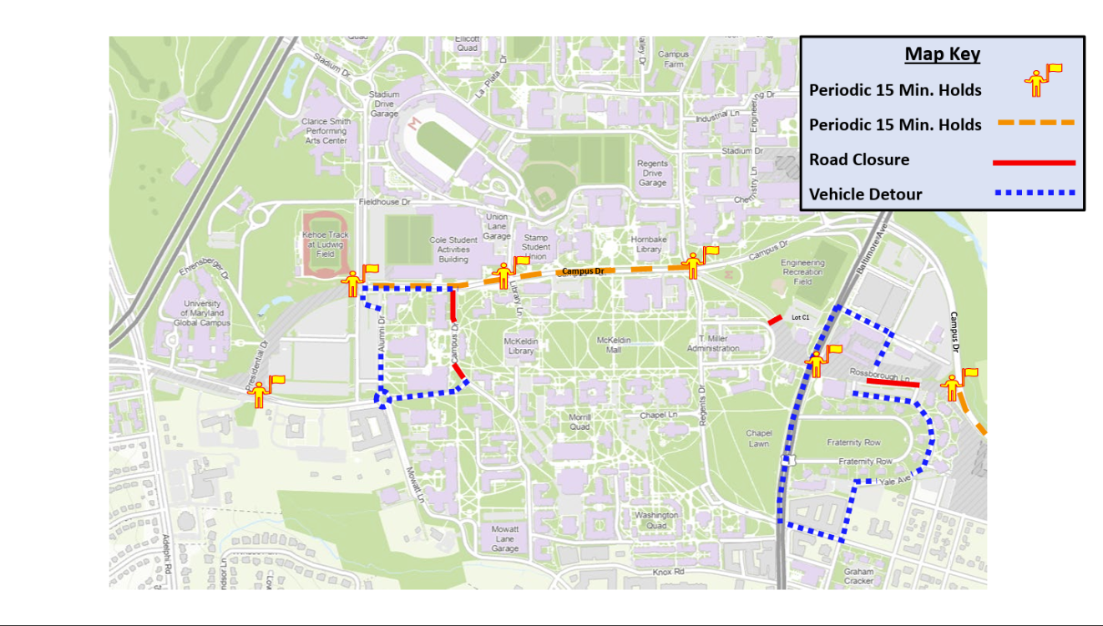
Developments Committee Director Report
Purple line testing began the week of March 23rd, including Baltimore Avenue/campus.
Track construction completion at 89%.
Trains traveled from College Park Metro station onto Campus Drive and then through Rossborough Lane and across Route 1 before moving across campus and ending at the University of Maryland Global Campus station.
Testing will occur nightly from 10 p.m. to 6 a.m.
Notes:
Hollywood Rd sidewalk - I think still some striping to do
PSA - Pedestrians walking in bike lane along northbound Rhode Island Ave

Slide 10
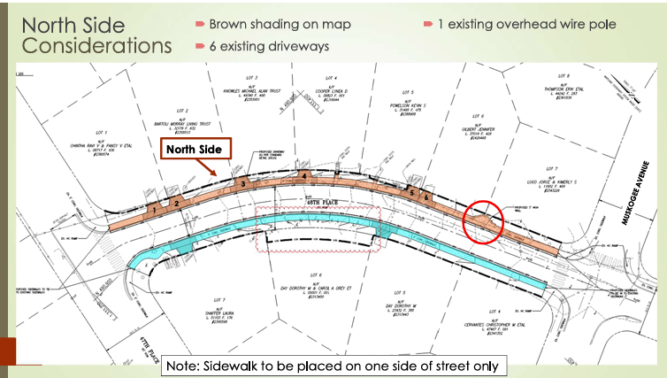
Developments Committee Director Report
48th Pl Sidewalk Project on Consent Agenda and presented at most recent council meeting (4/7)
Selection of alignment for the project.
Public comment recorded.
Based on two surveys and two, presentations at the NCPCA (10/1/25, 2/2/26), residents preferred the sidewalk to go on the north side of the street along the frontage of the odd numbered houses.
$325,000 cost.
Aim to make city more accessible; promote walkability.
Staff recommendation: Construct on north side.
Notes:
Hollywood Rd sidewalk - I think still some striping to do
PSA - Pedestrians walking in bike lane along northbound Rhode Island Ave

Slide 11
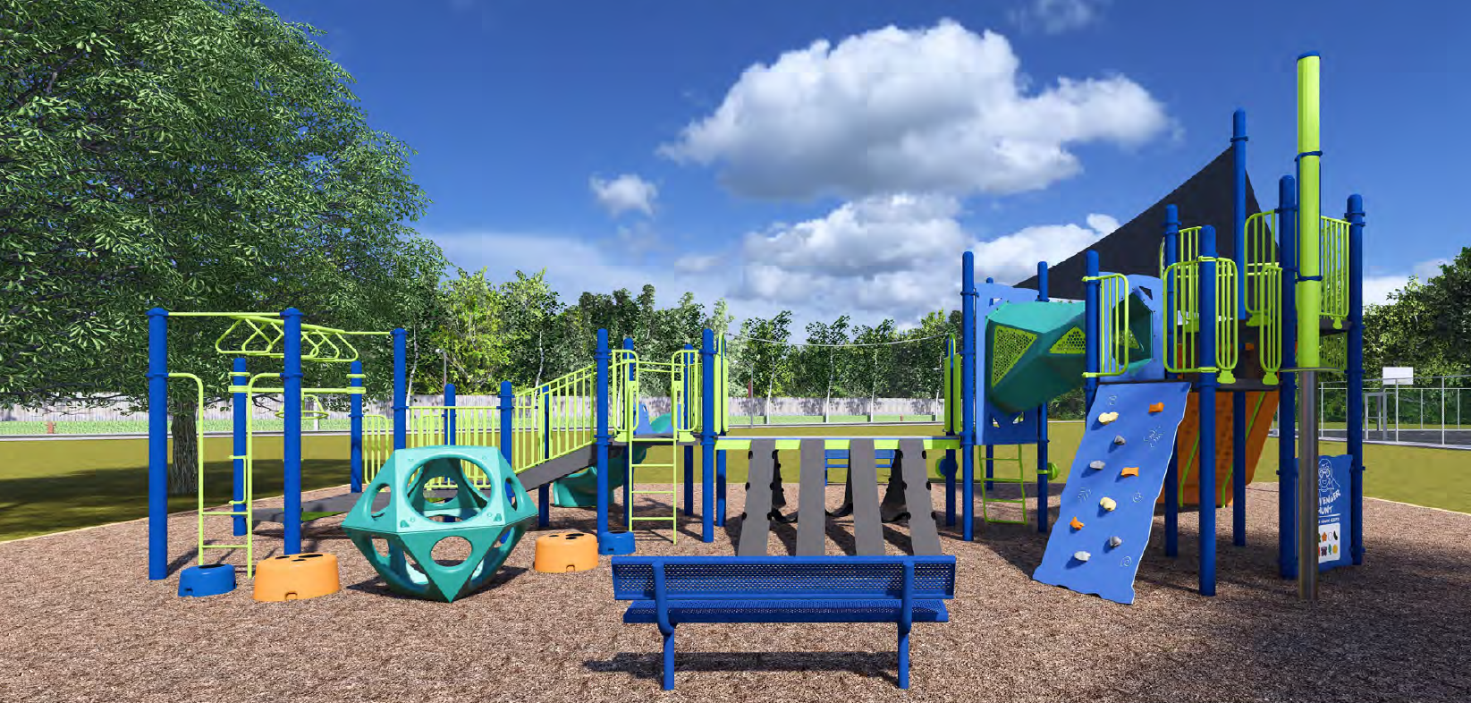
Developments Committee Director Report
Ribbon cutting for Calvert Hills playground occurred on 3/27 at 6pm.
Improvements aimed to bring more accessibility (drop down elevator, accessible monkey bars, etc), including new climbing structures, a spinner, a tunnel, multiple slides, and additional benches.
Swing area remains with added toddler swings.
Funded through Project Open Space (MD DNR) with $118,200.00 in funding from the Maryland Department of Natural Resources through the FY25 Community Parks and Playgrounds Grant Program, the Calvert Hills playground received a new school-age play area and a refreshed swing bay. The total project cost was $193,200.00, including $75,000.00 in City matching funds. The project was developed over approximately eighteen months and included multiple phases of community engagement.
Notes:
Hollywood Rd sidewalk - I think still some striping to do
PSA - Pedestrians walking in bike lane along northbound Rhode Island Ave

Slide 12
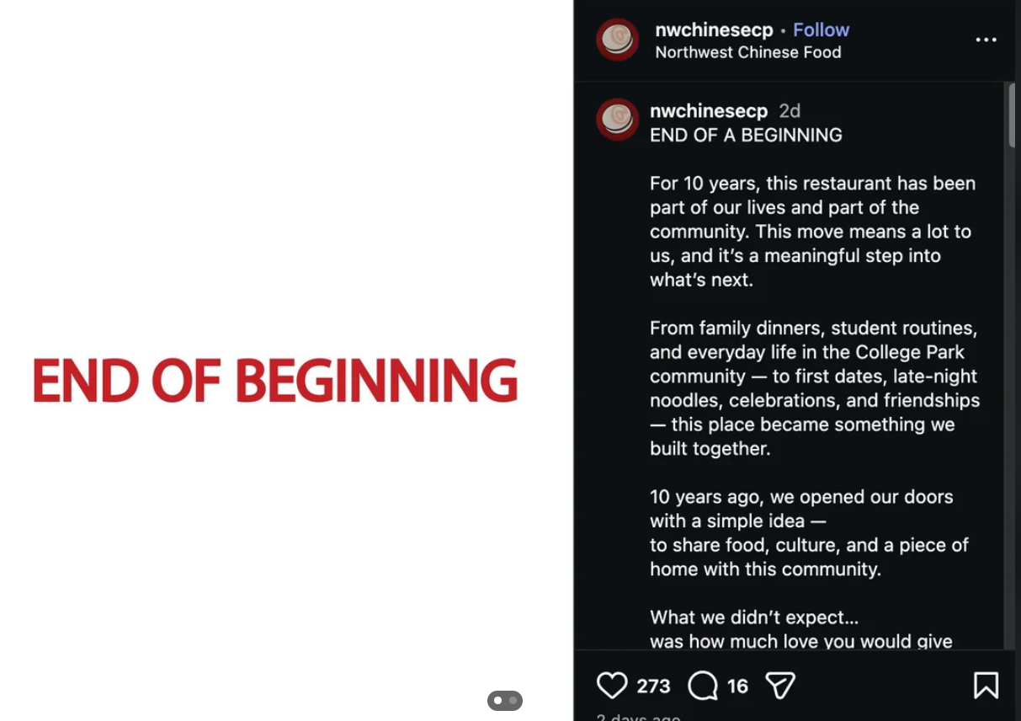
Developments Committee Director Report
Northwest Chinese closed on 3/28 at current location on Rt.1 in the retail space across the street from College Park Shopping Center.
Displaced due to development of high rise apartments.
Plans to reopen July in a “nearby location.”
DMV Top 100 restaurant nominee multiple times.
Owners had expressed frustration toward the city regarding forced relocation after their investment in College Park over the years, including the opening of sister restaurant Li Chun Cafe adjacent to City Hall. Multiple social media posts and local articles asking the city to intervene.
Notes:
Hollywood Rd sidewalk - I think still some striping to do
PSA - Pedestrians walking in bike lane along northbound Rhode Island Ave

Slide 13
Developments Committee Director Report
Position is currently vacant.
Send email to NCPCivic@gmail.com if interested. Include a small blurb about your experience and why you’re interested in filling the vacancy.
Department of Planning & Community Development
City Projects
College Park Development Dashboard
Notes:
Hollywood Rd sidewalk - I think still some striping to do
PSA - Pedestrians walking in bike lane along northbound Rhode Island Ave

Slide 14

Events Committee Director Report
North College Park Events
Hollywood Farmers Market
Returns Saturday, April 11th
Saturday, 10am-2pm, Mom’s Parking Lot
Food & produce vendors
Arts & crafts
Music
Local businesses

Slide 15
Events Committee Director Report
North College Park Events
NCPCA Potluck Thursday, December 11th, 8:30pm, Davis Hall
Continuing our annual tradition of celebrating North College Park during the holiday season. We’ll have food, drinks, and light refreshments. Swing by, say hi, grab some food, and mingle with members of our wonderful community.

Slide 16
City Events
Friday Night Live! - Friday, May 8, 6:00 pm - 8:30 pm at City Hall Plaza
Join us on the Plaza at City Hall for College Park's favorite summer concert series, Friday Night LIVE! On select Fridays from May through August, live bands will take the stage with bold beats from diverse musical genres. From funky grooves to rock anthems, we've got the soundtrack for your Friday night.
Admission is free and free parking will be available at the Downtown Parking Garage at the corner of Yale Ave. and Knox Road during the event.

Slide 17
City Events
Spring Street Fair - Sunday, May 17, 12:00 pm - 4:00 pm at Davis Hall
Join us for a vibrant afternoon of fun, food, and creativity at the second annual Spring Street Fair in College Park!
On Sunday, May 17th, from 12:00 PM to 4:00 PM, celebrate the season with your community at 9217 51st Ave, College Park, MD 20740.
This family-friendly event will feature a variety of exciting activities for all ages!

Slide 18
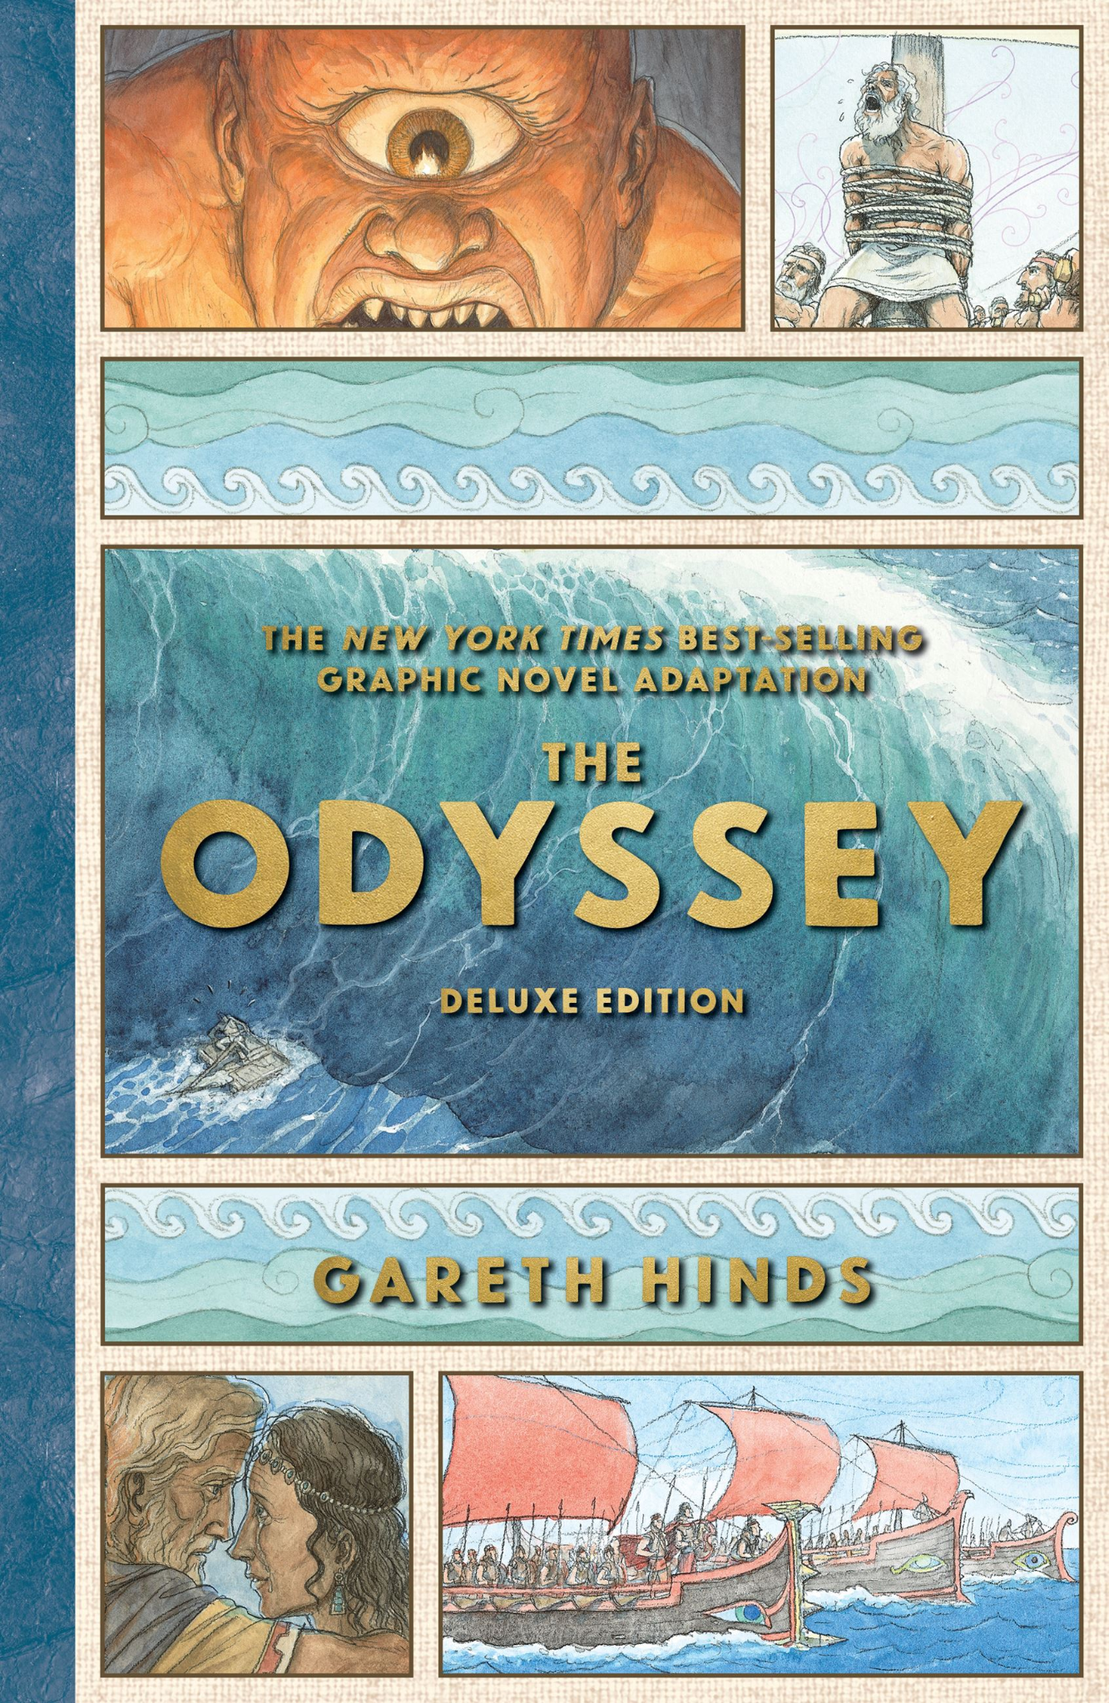
City Events
Graphic Novelist Gareth Hinds Talk & Live Illustration Demo - Thursday, May 21, 7:00 pm - 8:00 pm at City Hall (Council Chambers)
The City of College Park is excited to welcome local illustrator and graphic novelist Gareth Hinds for a special evening of art, storytelling, and live demonstration.
Hinds is widely known for bringing classic literature to life through richly illustrated graphic novels. His acclaimed works include adaptations of Beowulf, King Lear, stories by Edgar Allan Poe, and The Odyssey—his best-selling title. His work has become especially popular in classrooms, making classic texts more accessible to middle and high school readers.
During the event, Hinds will share insights into his creative process, discuss his current and upcoming projects—including a deluxe edition of The Odyssey releasing May 12, 2026, and his forthcoming adaptation of The Aeneid (Spring 2027)—and present a live drawing demonstration. The City of College Park will be giving away some of Hinds work during the program.
A longtime contributor to the vibrant arts community along the Route 1 corridor, Hinds now calls Hyattsville home and continues to draw inspiration from the area’s creative energy.

Slide 19
City Events
Social Activities for Older Adults Launched by WISE Connect
From coffee meetups to board games to art sessions, this group is free to join and welcomes you!
WISE Connect (www.wisecities.us) was founded by UMD alumni to foster connection, engagement, and fulfillment all life long. This year, the City of College Park is partnering with WISE Connect to offer social and recreational activities for residents over age 55.
The initiative engages local businesses to host the group, offering discounts and age-friendly setups. Participating businesses starting September include Proteus Brews, The Greene Turtle, The Board & Brew, Sardi's, Dog Haus Biergarten, Shop Made in MD, Bowlero, Ledo Pizza, with more to come. Have a favorite spot to meet? Let the team know!
Social connection is key to good health! Come meet new people, get special discounts, explore new places, and have fun! Rides to events will be arranged as needed to ensure transportation is not a barrier to participating.
The calendar of upcoming events can be found at https://wiseconnect.us/ or in the Facebook group at https://www.facebook.com/groups/cpwiseevents, as well as in the attached PDF.
To sign up or ask questions, contact Marie Brodsky by email (marie@wiseconnect.us) or phone (571-354-6626).
WISE Events Portal - College Park

Slide 20
Events Committee Director
Position is currently vacant.
Send email to NCPCivic@gmail.com if interested. Include a small blurb about your experience and why you’re interested in filling the vacancy.

Slide 21
College Park Community Urban Farm & Food Forest
(Presenter: Alec Lynde; Dedicated Neighbors for a Sustainable Future)

Slide 22
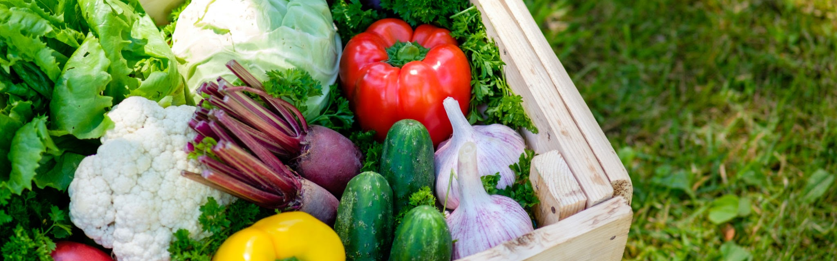
College Park
Community Urban Farm
& Food Forest
A Vision for Sustainable Community Food Production, Education, and Connection
Presented by Dedicated Neighbors for a Sustainable Future

Slide 23
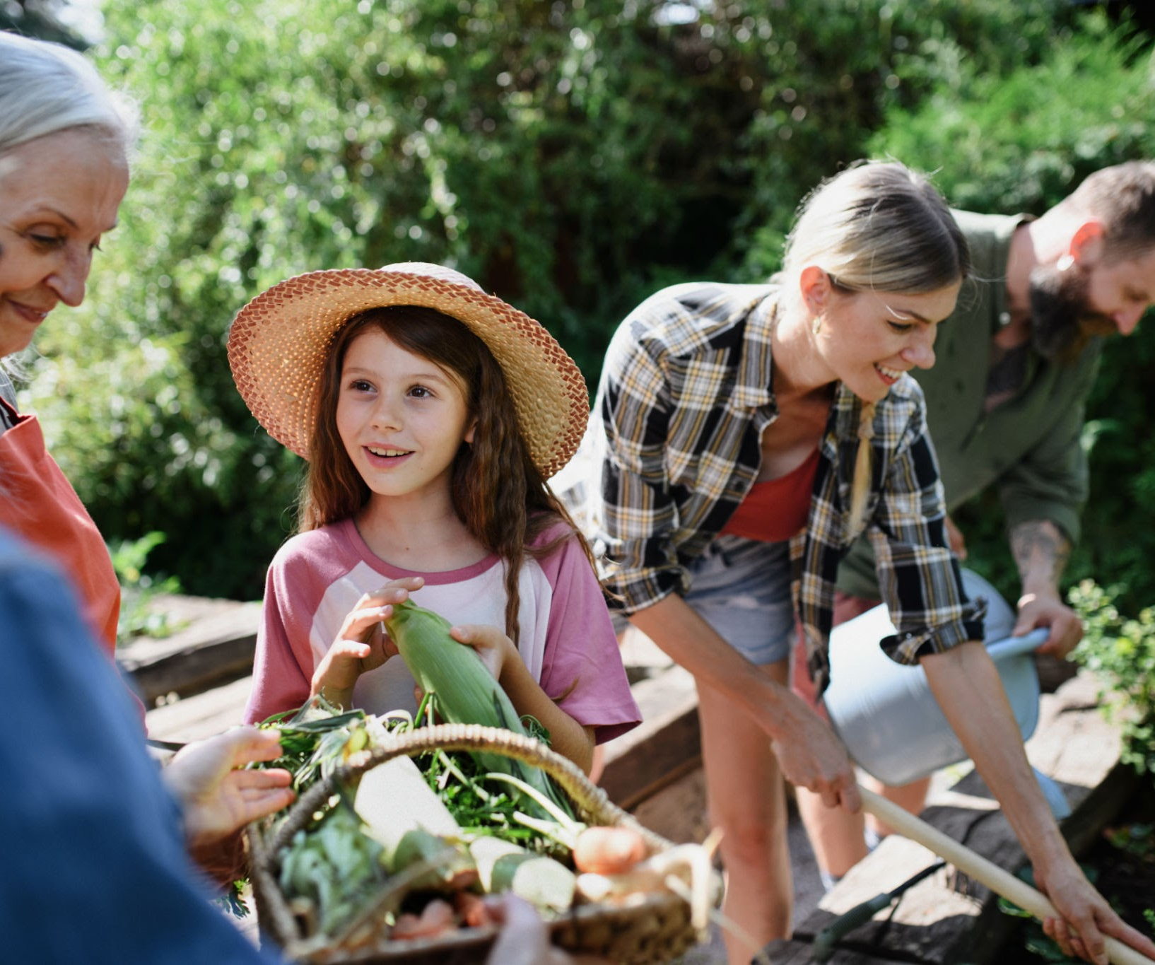
Transforming a Vacant Site into Community Value
City-owned one-acre property near Trolley Trail
Currently underutilized land with invasive species
Exceptional opportunity to address multiple community needs:
Green space and habitat
Food security and access
Environmental education
Community gathering and social connection
Volunteer-driven model requiring minimal long-term municipal investment

Slide 24
TABLE OF CONTENTS
Our Vision
Site Concept & Design
Community Benefits
Implementation & Approach
Building the Foundation This Year
Funding & How to Get Involved

Slide 25
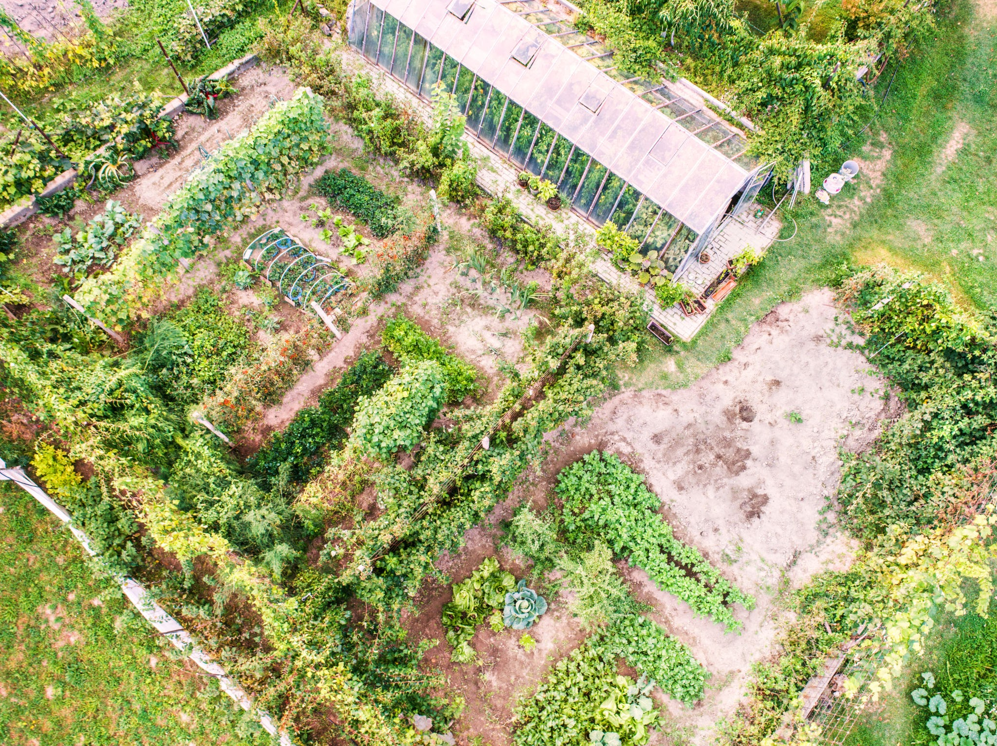
Our Vision
A Native Plant-Focused
Community Hub
A space that feels like a public park as much as a garden
Sustainable food production site
Multi-generational gathering space
Educational hub and outdoor classroom
Community-led, volunteer-driven management
Supports College Park's sustainability goals

Slide 26
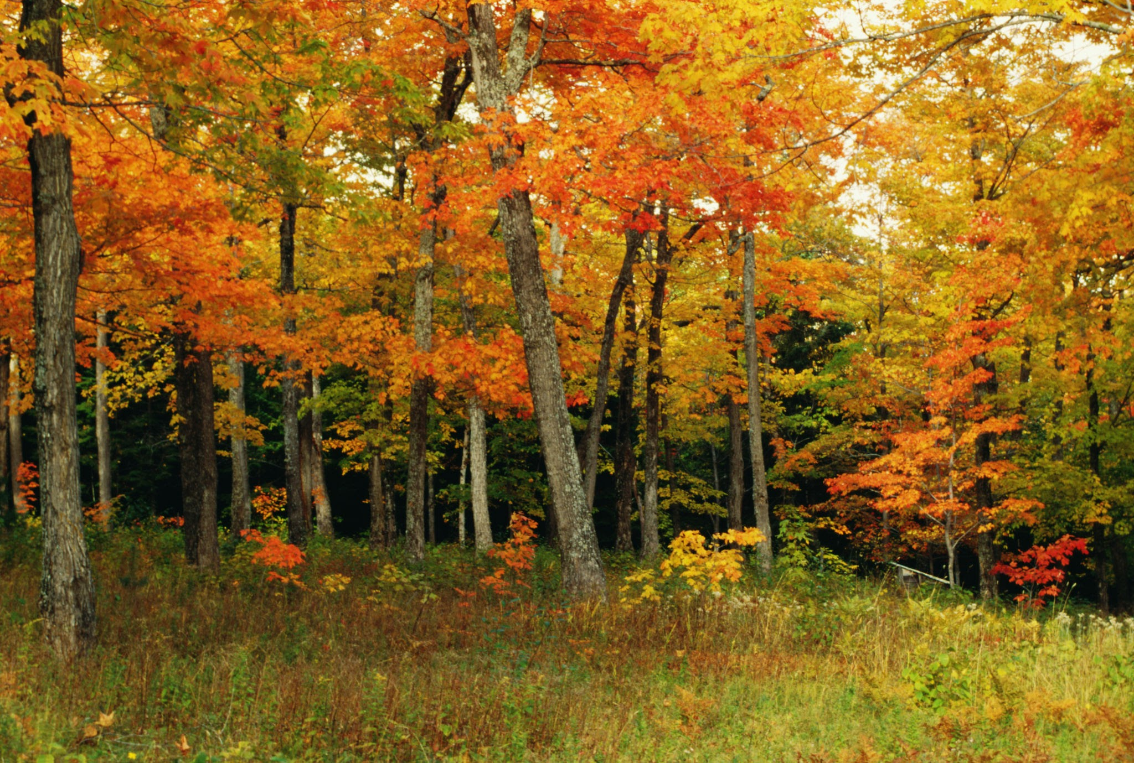
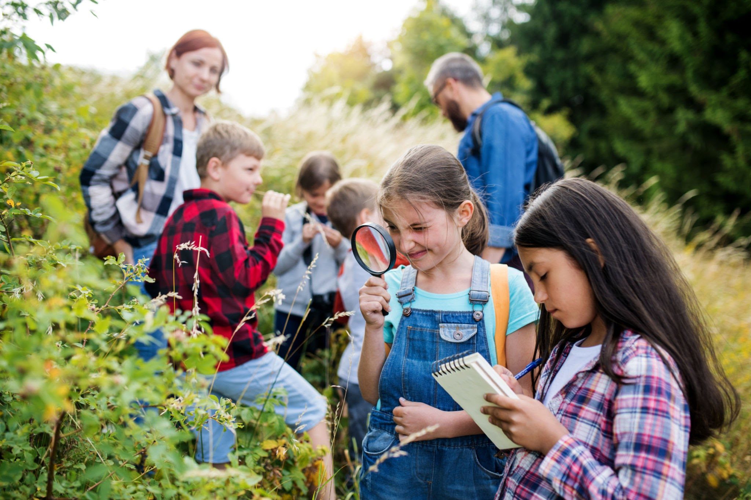
Site Concept & Design
Food Forest Backbone
Annual Growing Area
Community & Education Zone
Native trees, fruit/nut trees, berry patches, wildflower/pollinator areas
Raised beds and vegetable gardens for easy, productive crops
Outdoor classroom, gathering space, 1-2 room community building

Slide 27
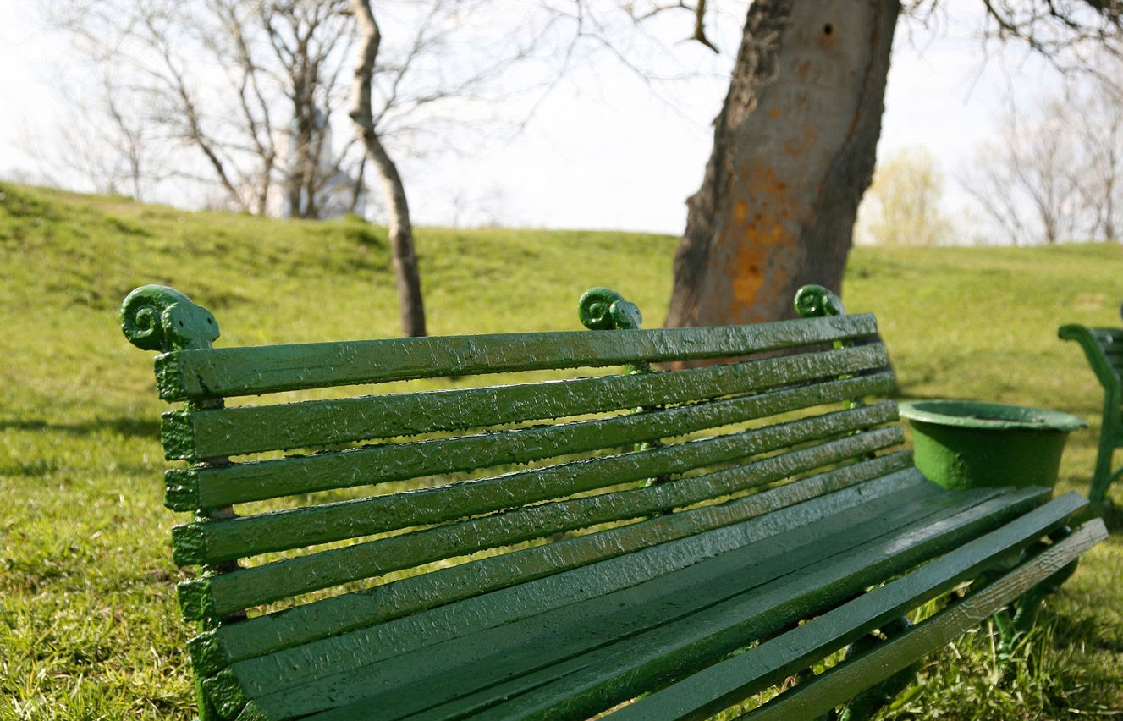
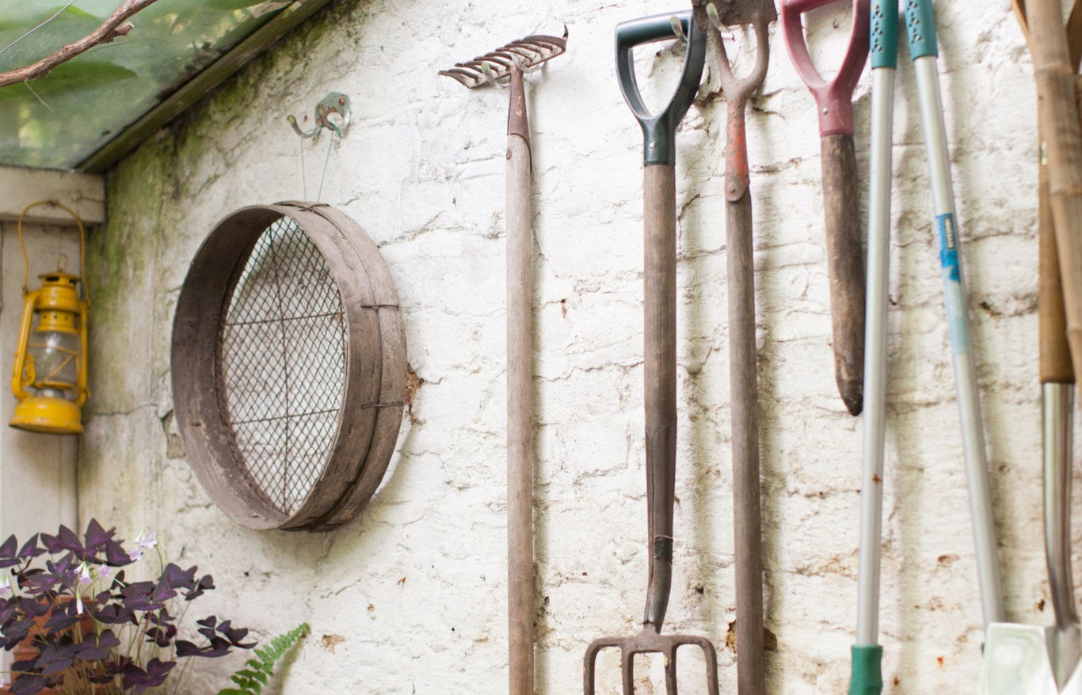
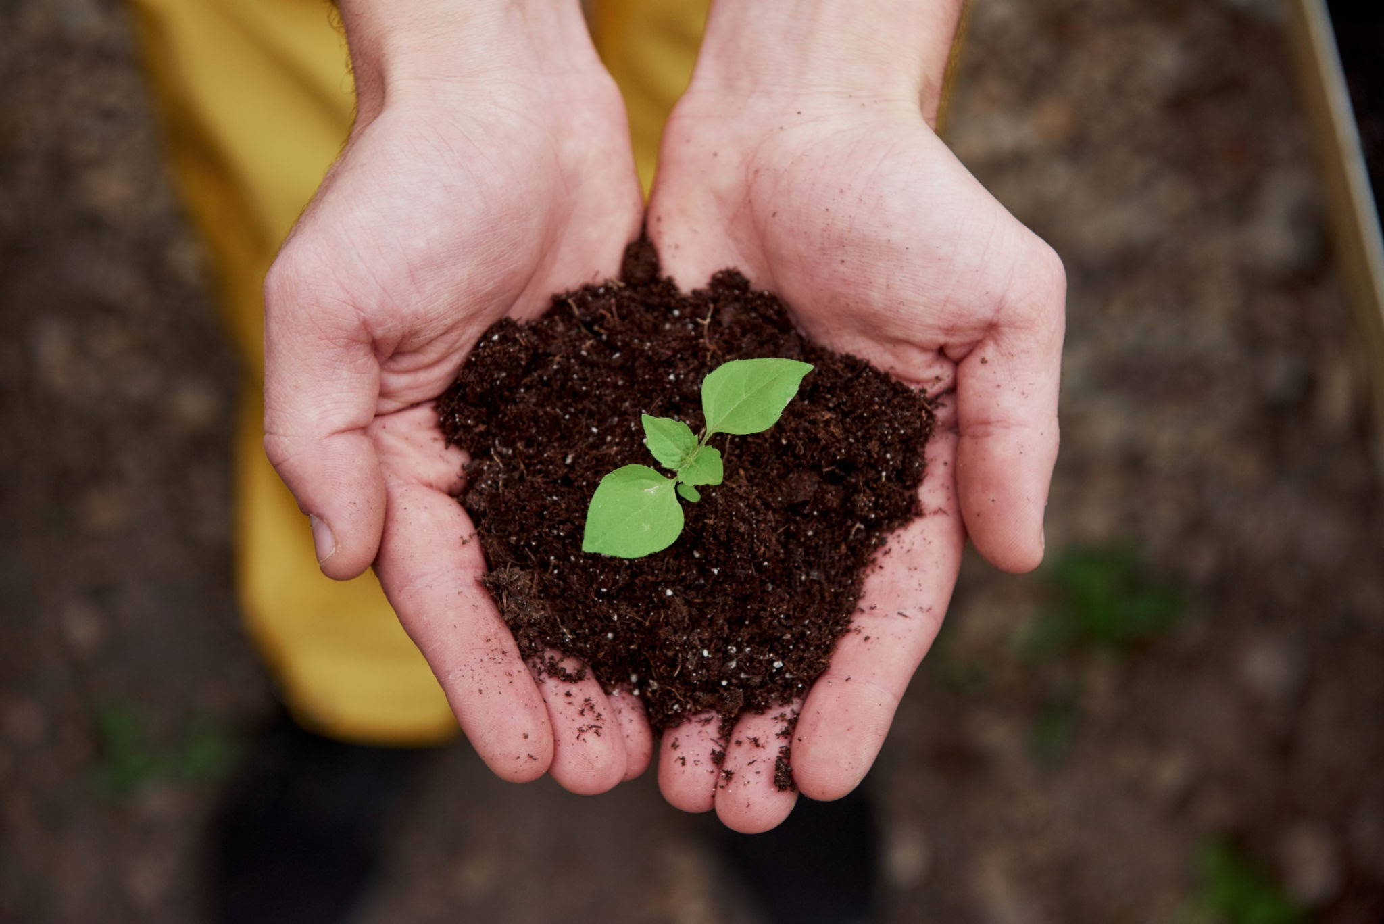
Site Concept & Design
Open Flexible Space
Infrastructure
Phased Implementation
Lawn areas (minimal) for events, play, and social gathering
Clear paths, shed, composting/decomposition areas, water access
Start simple (invasive removal, tree planting) and grow over time

Slide 28
Community Benefits
Environmental & Ecological
Food Security & Production
Education & Skill Building
Community Building
Pollinator habitat
Stormwater management
Urban tree canopy
Demonstrate sustainable practices
Fresh vegetables, fruits, & herbs accessible to the community
Perennial food sources
Seed saving
Outdoor classroom
Workshops
Partnerships with schools
Empowers residents
Gathering spaces
Regular events (harvest festivals)
Accessible to all residents
Fosters civic engagement

Slide 29
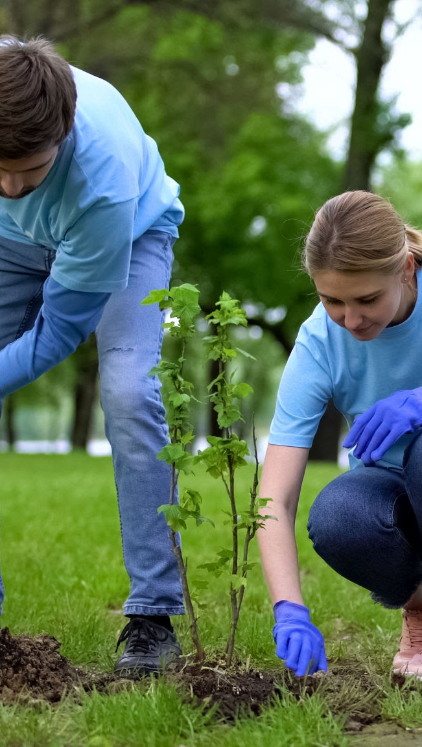
Implementation & Approach
Volunteer-Driven Approach
Strong Community Partnerships
Timeline
2026: Stakeholder engagement, site assessments, invasive removal, tree plantings
2027: First perennial plantings, raised beds, initial programming (first harvest festival)
2028+: Greenhouse, community space, robust event calendar
Volunteer-Driven Model:
Community expertise (Master Gardeners, local organizations)
City role: water/electric infrastructure, larger building spaces, limited grass maintenance during transition
Saves City costs; no outside contractors long-term

Slide 30
Building the Foundation This Year
Site Assessment & NRI
Invasive Species Removal
Tree Plantings
Conduct comprehensive site visits to document existing conditions
Map sun/shade patterns, drainage, topography, and access points
Inventory existing trees, native plants, and invasive species locations
Soil testing for pH, nutrients, and contaminants
Identify opportunities and constraints for long-term design
Remove invasive plants
Volunteer-led workdays using ecological removal methods
Clear priority areas to prepare for tree plantings
Develop ongoing maintenance plan to prevent re-establishment
Plant native and fruit/nut trees along northern and eastern property edges
Establish long-term food forest canopy layer
Partner with City and organizations like Casey Trees or Howard EcoWorks
Begin building the perennial backbone of the site, if possible

Slide 31
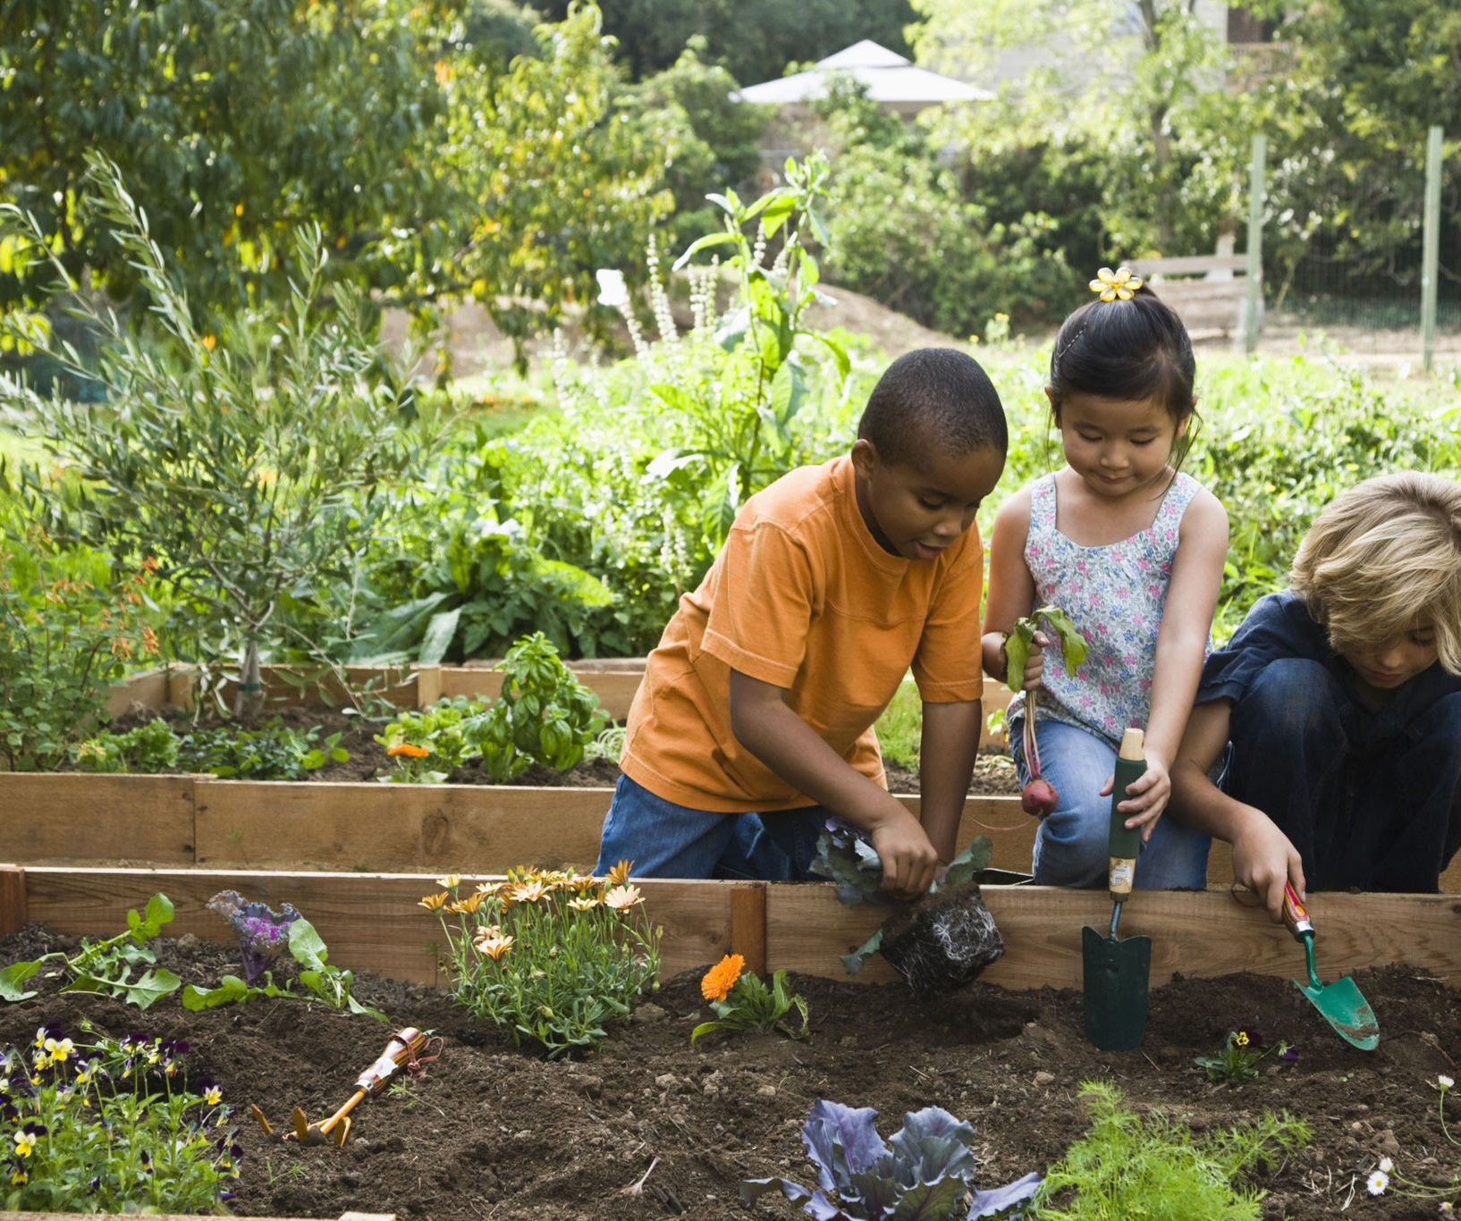
Funding & How to Get Involved
Funding Strategy:
BDCA support for grants (urban agriculture, green space, tree planting)
Municipal support (infrastructure provisioning, as needed)
How You Can Get Involved:
Individuals: ADVOCATE, attend meetings, volunteer for workdays, share your skills
Organizations: Partner on programming, provide volunteers/resources
City & Elected Officials: Support infrastructure needs, approve site use, champion the project

Slide 32
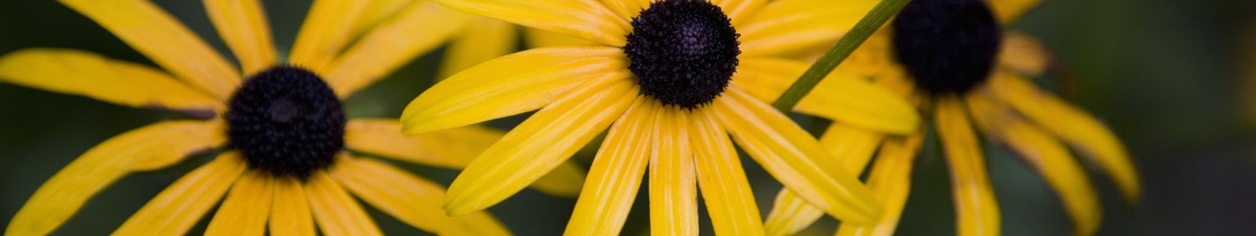
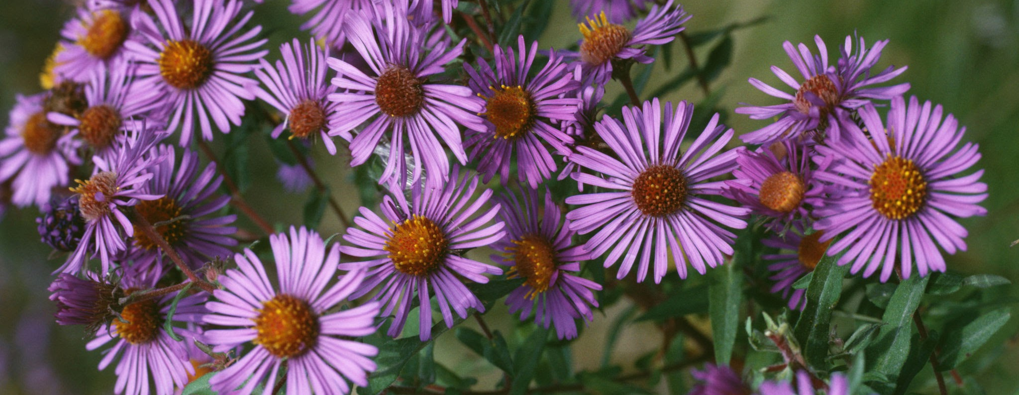
THANK YOU
Contact us at bdca-parks@myberwyn.org

Slide 33
Motion
I move that . . .

Slide 34
Developments Director Nomination & Vote
(Presenter: Justin Leary)

Slide 35
Unscheduled Motions and Announcements

Slide 36

Our Next Meeting: May 14, 2026
… and we’re so excited to see you then!

