Slide 1
NCPCA
May Meeting
May 14th, 2026

Slide 2
Agenda
7:30 - Consent to Record, Call to Order, Agenda Approval, Minutes Approval
7:35 - Officer Reports
7:50 - Open Committee Position Nominations & Vote
8:00- College Park Budget Discussion
8:55- Unscheduled Motions and Announcements
9:00 - Motion to Adjourn

Slide 3
Motion to Approve
Minutes
I move to approve the April minutes as posted on the NCPCA website and provided to members before this meeting.

Slide 4

President Report
NCPCA Coffee Socials - Previous meeting was moved up to May 3rd to avoid Mother’s Day conflict. Next meeting (final for 2026): June 7th.
Events committee vacancy. Please send any interest for open positions or general inquiries to NCPCivic@gmail.com
Treasurer succession plan; Development Director onboarding.
Past Events: College Park Clean-up & Placemaking Walkthrough
NCPCA Presents Hey, Hollywood 26’ (Saturday, May 30th)

Slide 5
President Report
College Park Community Corner
Tree and Landscape Board
Educates and encourages citizens to use safe and desirable practices to promote trees, shrubs, and ground cover in private and public lands.
Manages Tree City USA status for the city.
Advises city staff on landscape issues and remediation throughout city.
9 voting members; 3 year term. Meets third Monday of each month.
Staff Liaison: City Arborist (David Wigglesworth)
Email: arborist@collegeparkmd.gov

Slide 6
Vice President Report
Continue checking your email for NCPCA updates.
Email us any questions, concerns, or needs! Help us make this meeting the most meaningful it can be.
NCPCA Association (ncpcivic@gmail.com)

Slide 7
Treasurer Report
Activities
Old debit card expired 4/2026 and new card never arrived
Kam covered May mailchimp and zoom renewal so he will be reimbursed
New card will be picked up at a local SECU, hopefully with new treasurer to transition account
MailChimp monthly upgrade: $13
Bluehost annual renewal $143.88
Zoom renewal $170-ish?
New Treasurer - transition will start in the next month (assuming vote of acclimation today)
SECU Checking Account*
Available Balance | $958.54
Recent transactions: mailchimp, zoom, bluehost
SECU Savings Account*
Available Balance | $337.02
Interest Paid YTD | $0.49
Recent Transactions
Interest Credits 4/30 | $0.10
*As of 7:00PM EDT 5/14/2025

Slide 8
Secretary Report
State your name when speaking to facilitate the official minutes. If on Zoom, enter your first and last name in the chat.
April 13 NCPCA Update email:
193 recipients
27.5% open rate (53 opens)

Slide 9
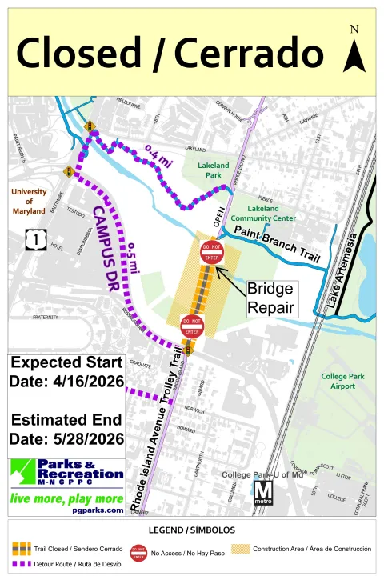
Developments Committee Director Report
PG County Department of Parks and Rec closing bridge along Rhode Island Ave and Trolley Trail between Campus Drive and Paint Branch Trail from 4/16 - 5/28.
Pedestrian bridge needs repairs; area has been fenced off.
Nearest “work around” is campus drive; underpass onto campus by Looney’s.
Notes:
Hollywood Rd sidewalk - I think still some striping to do
PSA - Pedestrians walking in bike lane along northbound Rhode Island Ave

Slide 10
Developments Committee Director Report
Additional Resources:
Department of Planning & Community Development
City Projects
College Park Development Dashboard
Notes:
Hollywood Rd sidewalk - I think still some striping to do
PSA - Pedestrians walking in bike lane along northbound Rhode Island Ave

Slide 11

Events Committee Director Report
North College Park Events
Hollywood Farmers Market
Returns Saturday, April 11th
Saturday, 10am-2pm, Mom’s Parking Lot
Food & produce vendors
Arts & crafts
Music
Local businesses

Slide 12
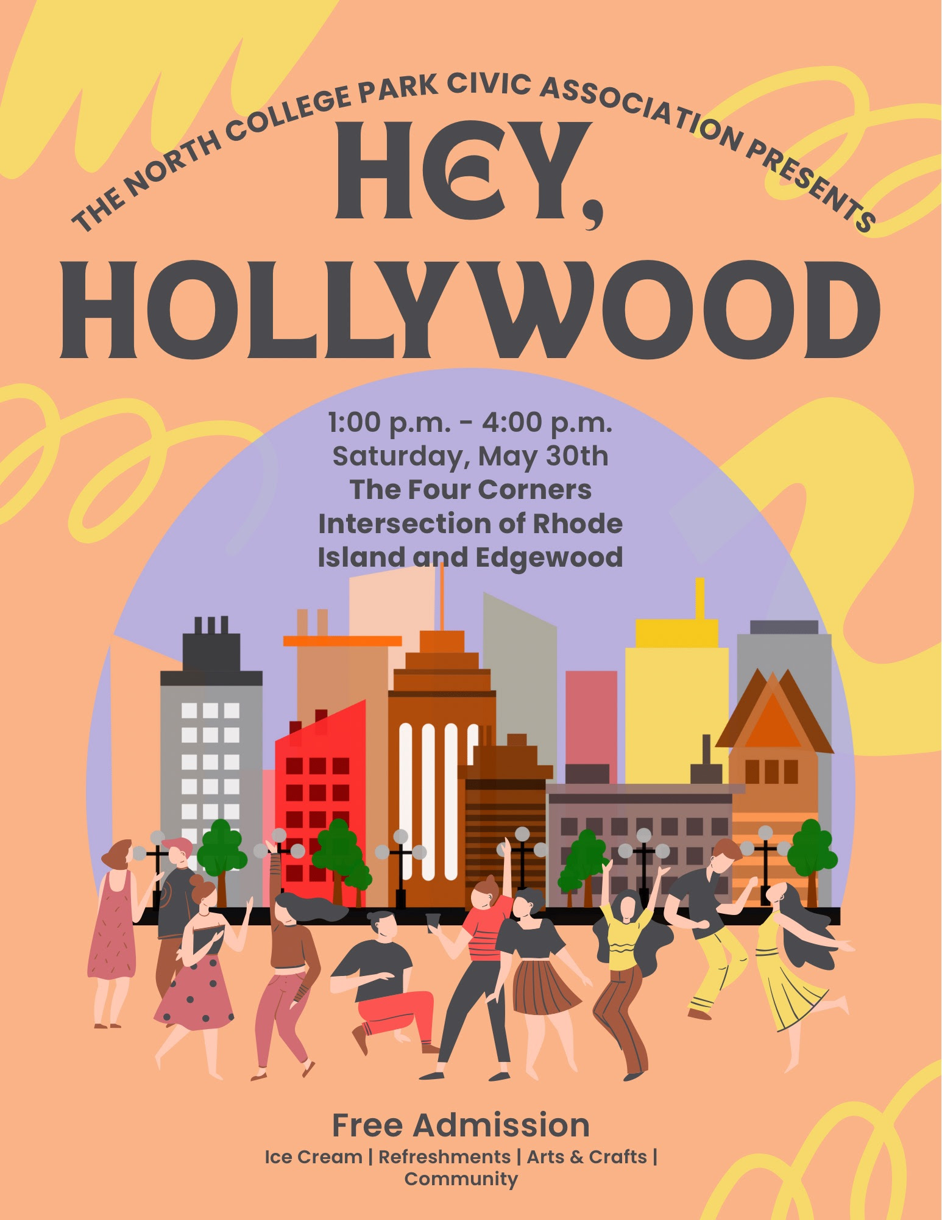
Events Committee Director Report
North College Park Events
Hey, Hollywood (Presented by the NCPCA)
Returns Saturday, May 30th
Saturday, 1:00 pm- 4:00 pm, Four Corners Intersection of Rhode Island & Edgewood
Ice Cream & refreshments
Arts & crafts
Free Admission
Come join us and your neighbors to celebrate our wonderful community!

Slide 13
Events Committee Director Report
North College Park Events
Know anyone interested in helping or volunteering services for this event (i.e. busking, poetry, demos)?
Please contact ncpcivic@gmail.com

Slide 14
Events Committee Director Report
North College Park Events
NCPCA Potluck Thursday, December 11th, 8:30pm, Davis Hall
Continuing our annual tradition of celebrating North College Park during the holiday season. We’ll have food, drinks, and light refreshments. Swing by, say hi, grab some food, and mingle with members of our wonderful community.

Slide 15
City Events
Friday Night Live! - Friday, June 12, 6:00 pm - 8:30 pm at City Hall Plaza
Performer: Dead Flowers
Join us on the Plaza at City Hall for College Park's favorite summer concert series, Friday Night LIVE! On select Fridays from May through August, live bands will take the stage with bold beats from diverse musical genres. From funky grooves to rock anthems, we've got the soundtrack for your Friday night.
Admission is free and free parking will be available at the Downtown Parking Garage at the corner of Yale Ave. and Knox Road during the event.

Slide 16
City Events
Spring Street Fair - Sunday, May 17, 12:00 pm - 4:00 pm at Davis Hall
Join us for a vibrant afternoon of fun, food, and creativity at the second annual Spring Street Fair in College Park!
On Sunday, May 17th, from 12:00 PM to 4:00 PM, celebrate the season with your community at 9217 51st Ave, College Park, MD 20740.
This family-friendly event will feature a variety of exciting activities for all ages!

Slide 17
City Events
Social Activities for Older Adults Launched by WISE Connect
From coffee meetups to board games to art sessions, this group is free to join and welcomes you!
WISE Connect (www.wisecities.us) was founded by UMD alumni to foster connection, engagement, and fulfillment all life long. This year, the City of College Park is partnering with WISE Connect to offer social and recreational activities for residents over age 55.
The initiative engages local businesses to host the group, offering discounts and age-friendly setups. Participating businesses starting September include Proteus Brews, The Greene Turtle, The Board & Brew, Sardi's, Dog Haus Biergarten, Shop Made in MD, Bowlero, Ledo Pizza, with more to come. Have a favorite spot to meet? Let the team know!
Social connection is key to good health! Come meet new people, get special discounts, explore new places, and have fun! Rides to events will be arranged as needed to ensure transportation is not a barrier to participating.
The calendar of upcoming events can be found at https://wiseconnect.us/ or in the Facebook group at https://www.facebook.com/groups/cpwiseevents, as well as in the attached PDF.
To sign up or ask questions, contact Marie Brodsky by email (marie@wiseconnect.us) or phone (571-354-6626).
WISE Events Portal - College Park

Slide 18
Events Committee Director
Position is currently vacant.
Send email to NCPCivic@gmail.com if interested. Include a small blurb about your experience and why you’re interested in filling the vacancy.

Slide 19
Open Committee Position Nominations & Vote

Slide 20
Motion
I move that . . .

Slide 21
College Park Budget Discussion

Slide 22
Unscheduled Motions and Announcements

Slide 23

Our Next Meeting: June 11, 2026
… and we’re so excited to see you then!

