Slide 1
NCPCA
June Meeting
June 11th, 2026

Slide 2
Agenda
7:30 - Consent to Record, Call to Order, Agenda Approval, Minutes Approval
7:35 - Officer Reports
7:50 - Letter of Support - Community Urban Farm & Food Forest Discussion
8:05 - Placemaking Initiative Follow-up
8:20 - School Board Candidate Forum
8:35- Dues Discussion & Vote
8:50 - Nominations and Committee Position Vote
8:55- Unscheduled Motions and Announcements
9:00 - Motion to Adjourn

Slide 3
Motion to Approve
Minutes
I move to approve the May minutes as posted on the NCPCA website and provided to members before this meeting.

Slide 4

President Report
NCPCA Coffee Socials - Previous meeting was this past Sunday, June 7th and final for this NCPCA session. Next meeting (first for 2026-2027): September 6th.
Please send any general inquiries to NCPCivic@gmail.com
Treasurer succession plan; Development Director onboarding. Potential Events Coordinator onboarding.

Slide 5
President Report
College Park Community Corner
Veterans Memorial Committee
Advises and assists the City to ensure that the Veterans Memorial is used and maintained in a manner befitting the service and memory of those who served.
9-13 members; 3 year term. Meets as needed, especially prior to Memorial and Veterans Days.
Staff Liaisons: Robert Marsili & Frank Pacifico
Email: rmarsili@collegeparkmd.gov; fpacifico@collegeparkmd.gov

Slide 6
Vice President Report
Continue checking your email for NCPCA updates.
Email us any questions, concerns, or needs! Help us make this meeting the most meaningful it can be.
NCPCA Association (ncpcivic@gmail.com)

Slide 7
Treasurer Report
Activities
MailChimp monthly upgrade: $13
New Treasurer - Seeking a replacement to start training in the new year
SECU Checking Account*
Available Balance | $1,155.98
Recent transactions: mailchimp
SECU Savings Account*
Available Balance | $336.73
Interest Paid YTD | $0.20
Recent Transactions
Interest Credits 1/31 | $0.10
*As of 7:00PM EST 2/12/2025

Slide 8
Secretary Report
State your name when speaking to facilitate the official minutes. If on Zoom, enter your first and last name in the chat.
May 16 NCPCA Update email:
  196 recipients, up from 193.
  37.2% open rate, 6.6% click rate.

Slide 9
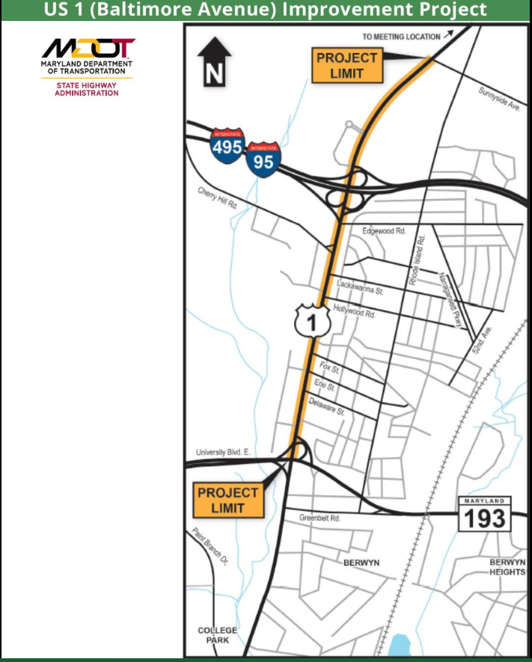
Developments Committee Director Report
The Maryland Department of Transportation State Highway Administration (MDOT SHA) is seeking public feedback on proposed improvements along US 1 (Baltimore Avenue) from MD 193 (University Boulevard) to Sunnyside Avenue.
  Public informational workshop scheduled for Wednesday, June 24, from 5 - 7pm. at Beltsville Academy.
Proposed concepts include pedestrian and bicycle accommodations, bus accessibility improvements, landscaping, and safety enhancements.
Project Webpage: https://mdot-sha-us1-md193-to-i-95-i-495-pg2535370-maryland.hub.arcgis.com

Slide 10
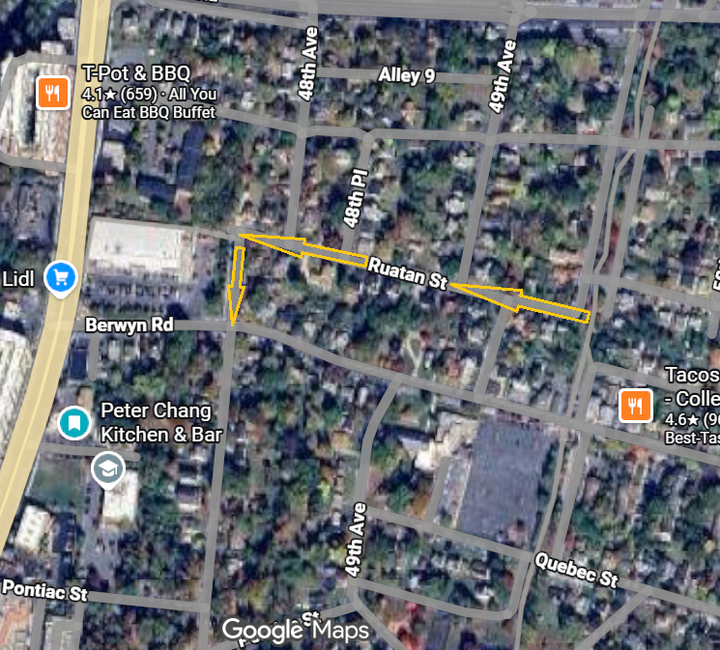
Developments Committee Director Report
Berwyn Community Space Exploration Walk & Survey at 8807–8811 Rhode Island Avenue, behind the Trolley Trail Permaculture Garden.
  Berwyn Community Site Exploration Walk Survey
On 6/1/26 City of College Park celebrated the groundbreaking of the new Monarch Preschool playground slated to arrive this summer
Ruatan Street has been converted to a one-way street in the westbound direction. As a result, 48th Avenue is one-way in the southbound direction between Ruatan Street and Berwyn Road.

Slide 11
Developments Committee Director Report
Additional Resources:
Department of Planning & Community Development
City Projects
College Park Development Dashboard

Slide 12

Events Committee Director Report
North College Park Events
Hollywood Farmers Market
Saturday, 10am-2pm, Mom’s Parking Lot
  Food & produce vendors
  Arts & crafts
  Music
  Local businesses

Slide 13
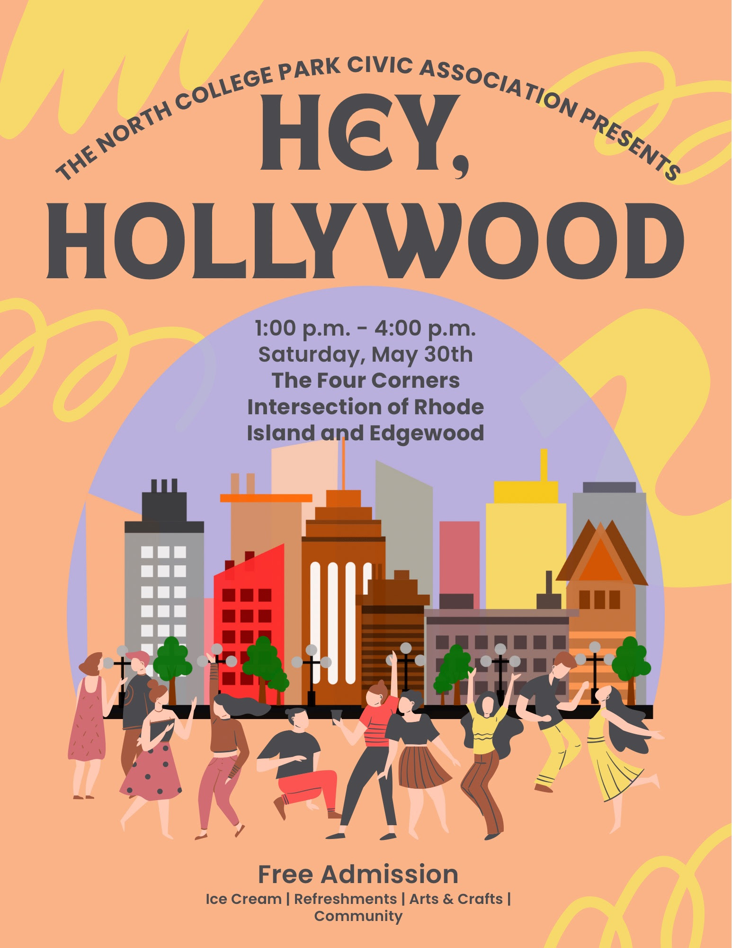
Events Committee Director Report
North College Park Past Event
Hey, Hollywood (Presented by the NCPCA)
Occurred on Saturday, May 30th
Saturday, 1:00 pm- 4:00 pm, Four Corners Intersection of Rhode Island & Edgewood
Total Cost - $273.61 to be paid by City Microgrant fund
Estimated Attendance: +/- 50.

Slide 14
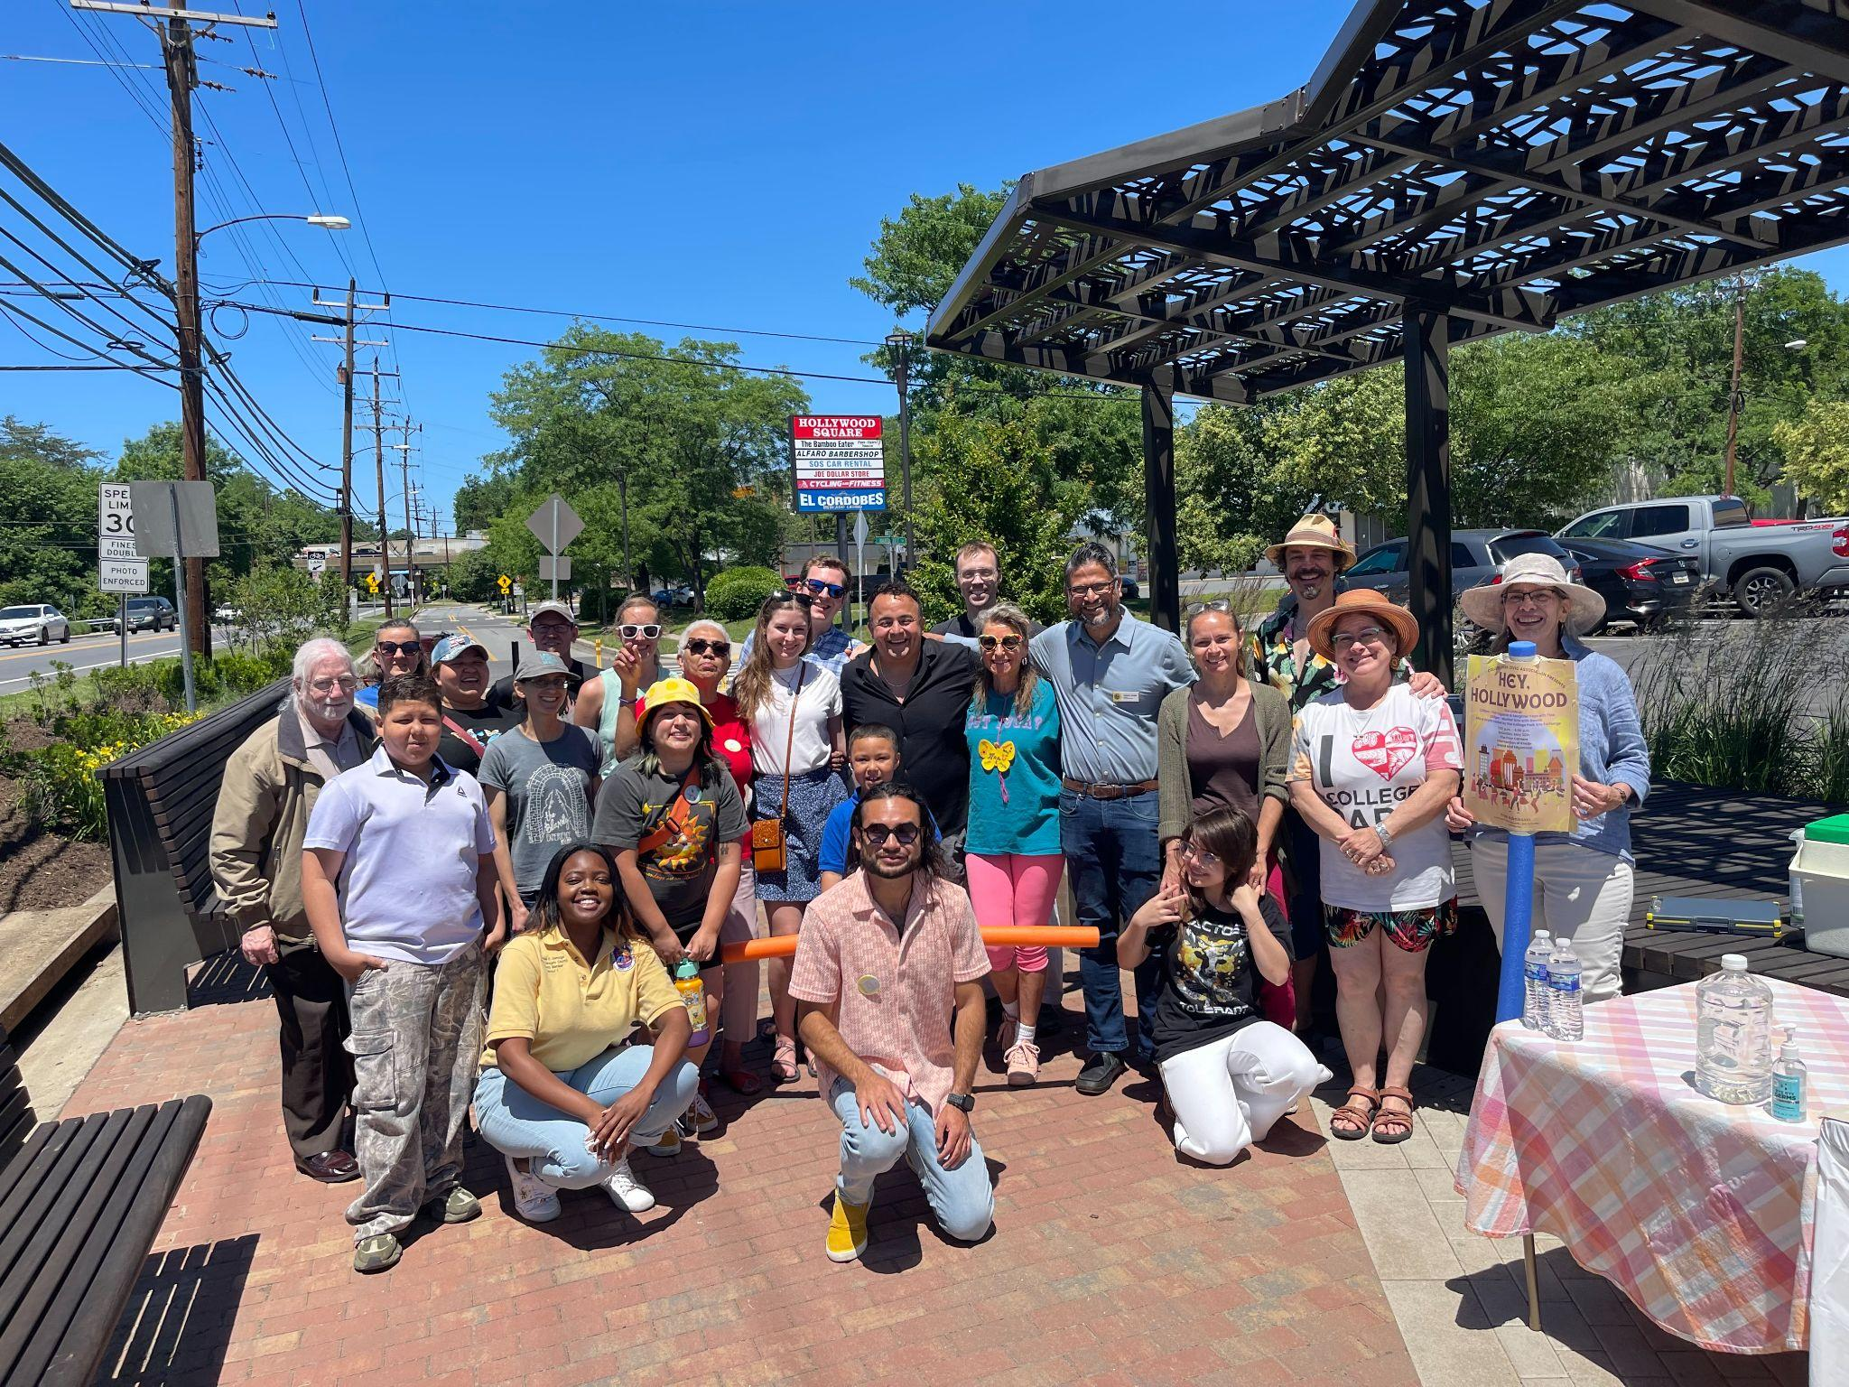
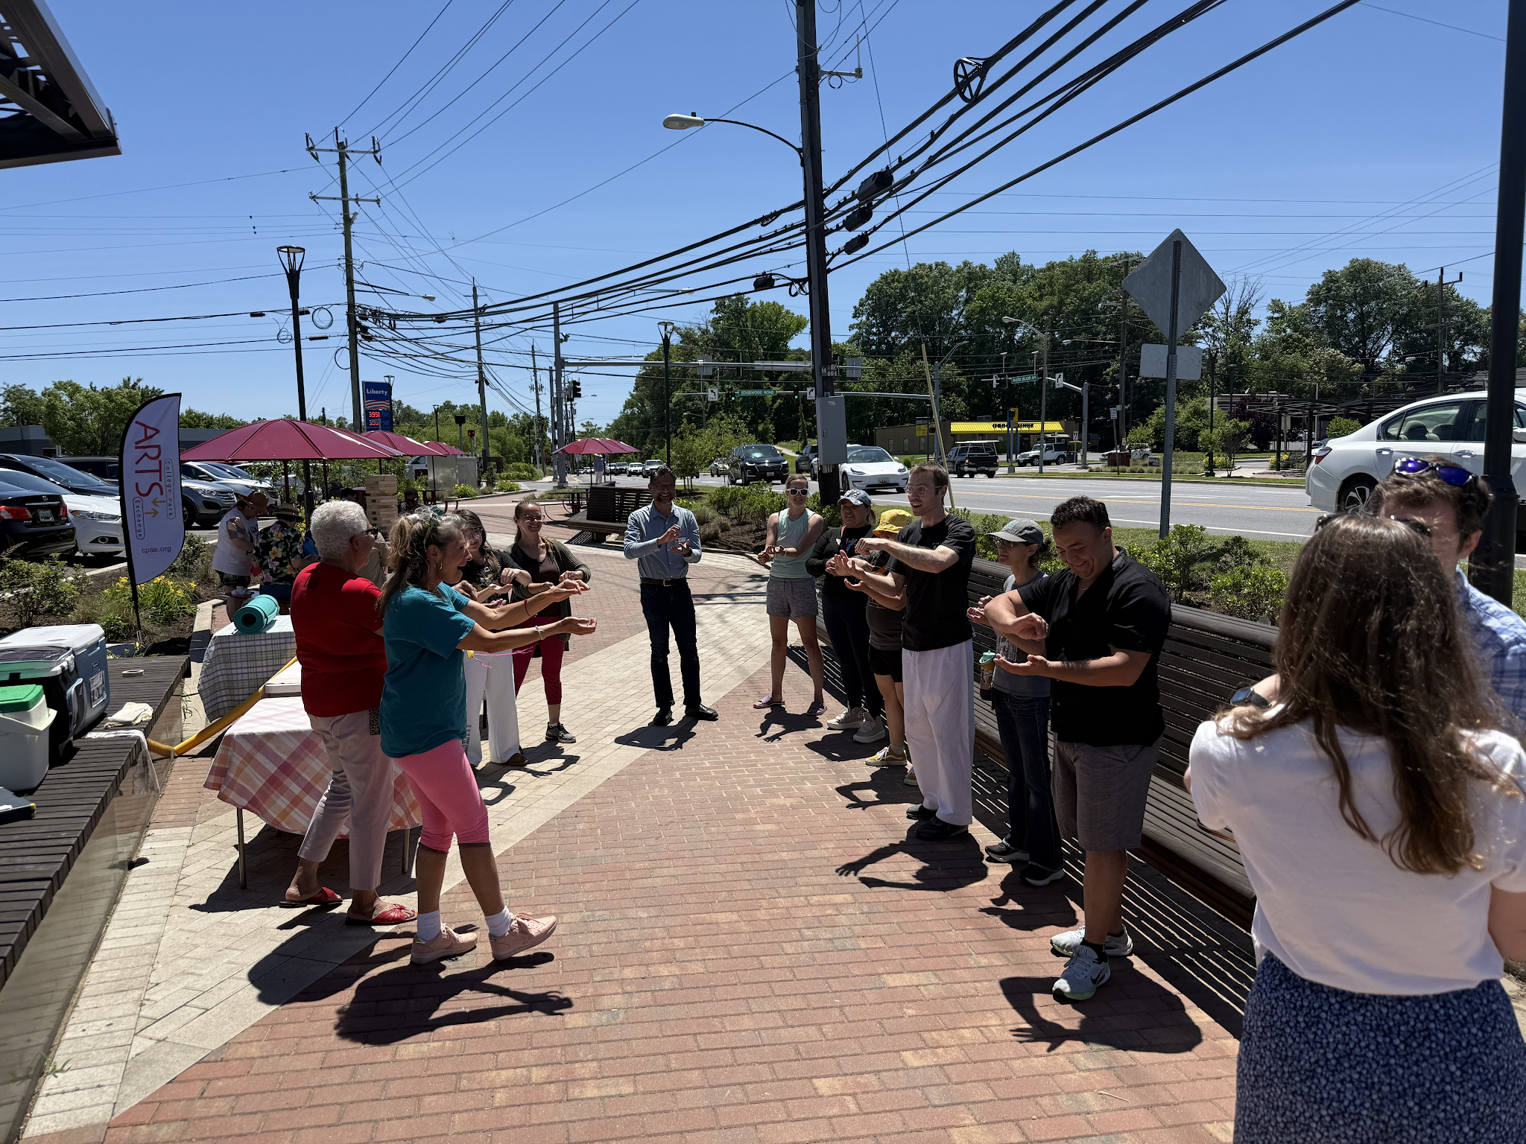
Events Committee Director Report

Slide 15
Events Committee Director Report
North College Park Events
NCPCA Potluck Thursday, December 11th, 8:30pm, Davis Hall
Continuing our annual tradition of celebrating North College Park during the holiday season. We’ll have food, drinks, and light refreshments. Swing by, say hi, grab some food, and mingle with members of our wonderful community.

Slide 16
City Events
Postponed
Rescheduled to Friday, August 28
Friday Night Live! - Friday, June 12, 6:00 pm - 8:30 pm at City Hall Plaza
Performer: Dead Flowers
Join us on the Plaza at City Hall for College Park's favorite summer concert series, Friday Night LIVE! On select Fridays from May through August, live bands will take the stage with bold beats from diverse musical genres. From funky grooves to rock anthems, we've got the soundtrack for your Friday night.
Admission is free and free parking will be available at the Downtown Parking Garage at the corner of Yale Ave. and Knox Road during the event.

Slide 17
City Events
Trolley Trail Day - Saturday, June 13, Starting at 9:00am
9:00 a.m. - College Park parkrun (@ Paint Branch Trail in College Park)
9:00 a.m. - RunnersHy & Haraka 1M, 5K, 10K Fun Run and Walk from Haraka store in Hyattsville
9:00 a.m. - College Park Bikes Patuxent Research Refuge ride from College Park Bicycles
9:00 a.m. - Slow Roll Sunday (on a Saturday) Ride from 3711 Studios in Mount Rainier
10:00 a.m. - College Park Bikes to Mount Rainier Ride from College Park Bicycles
10:00 a.m. - 3:00 p.m. Proteus Bicycles and Brews scavenger hunt!
10:30 a.m. - HVL Pride Walk from Spot Park
11:30 a.m. - Arrow Bicycles Brewery Ride from Arrow Bicycles
11:30 a.m. - Skate Instruction Trail Skate from Berwyn Business District Hub
12:30 p.m. - HVL Pride Walk from Spot Park
https://www.trolleytrailday.org/home

Slide 18

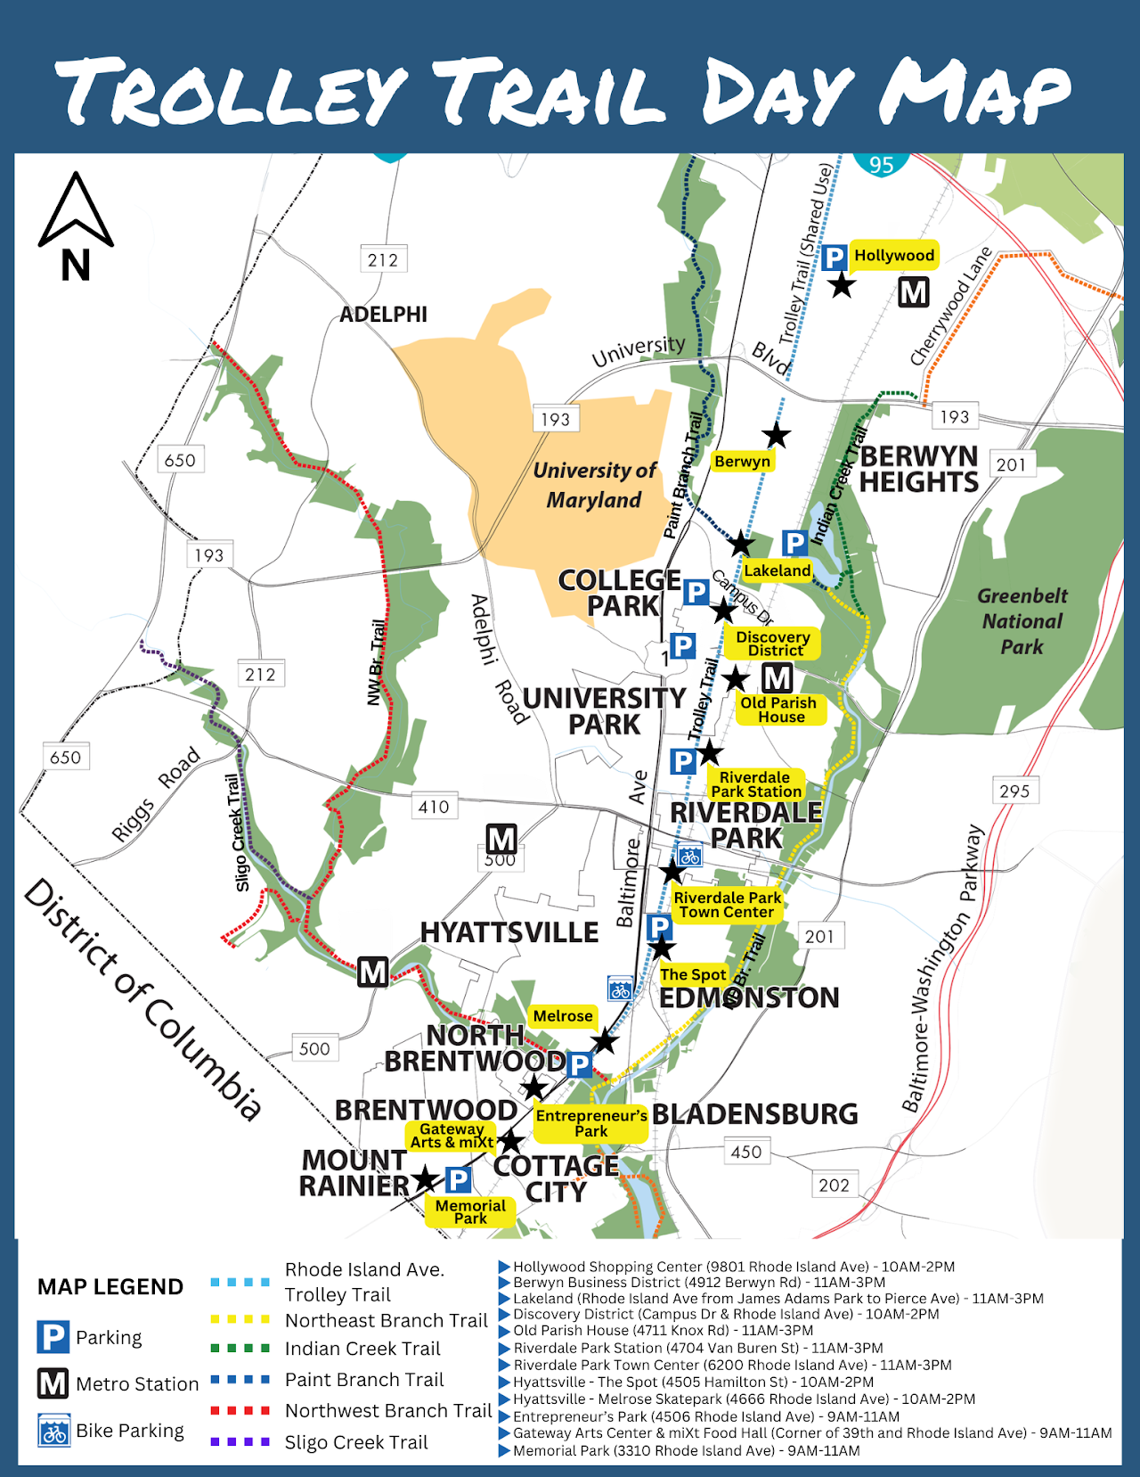
City Events
Trolley Trail Day - Saturday, June 13, Starting at 9:00am

Slide 19
City Events
Spring Street Fair - Sunday, May 17, 12:00 pm - 4:00 pm at Davis Hall
Join us for a vibrant afternoon of fun, food, and creativity at the second annual Spring Street Fair in College Park!
On Sunday, May 17th, from 12:00 PM to 4:00 PM, celebrate the season with your community at 9217 51st Ave, College Park, MD 20740.
This family-friendly event will feature a variety of exciting activities for all ages!

Slide 20
City Events
Social Activities for Older Adults Launched by WISE Connect
From coffee meetups to board games to art sessions, this group is free to join and welcomes you!
WISE Connect (www.wisecities.us) was founded by UMD alumni to foster connection, engagement, and fulfillment all life long. This year, the City of College Park is partnering with WISE Connect to offer social and recreational activities for residents over age 55.
The initiative engages local businesses to host the group, offering discounts and age-friendly setups. Participating businesses starting September include Proteus Brews, The Greene Turtle, The Board & Brew, Sardi's, Dog Haus Biergarten, Shop Made in MD, Bowlero, Ledo Pizza, with more to come. Have a favorite spot to meet? Let the team know!
Social connection is key to good health! Come meet new people, get special discounts, explore new places, and have fun! Rides to events will be arranged as needed to ensure transportation is not a barrier to participating.
The calendar of upcoming events can be found at https://wiseconnect.us/ or in the Facebook group at https://www.facebook.com/groups/cpwiseevents, as well as in the attached PDF.
To sign up or ask questions, contact Marie Brodsky by email (marie@wiseconnect.us) or phone (571-354-6626).
WISE Events Portal - College Park

Slide 21
Events Committee Director
Position is currently vacant.
Send email to NCPCivic@gmail.com if interested. Include a small blurb about your experience and why you’re interested in filling the vacancy.

Slide 22
Letter of Support - Community Urban Farm & Food Forest Discussion

Slide 23
Community Urban Farm & Food Forest Letter
During our monthly meeting on April 9, 2026, we discussed at length the feasibility of implementing the Community Urban Farm and Food Forest initiative presented by Dedicated Neighbors for a Sustainable Future. The site discussed was at the one (1) acre new City property at 8807 & 8811 Rhode Island Ave.
Members and community asked to review this draft of the proposed Letter of Support and provide feedback prior to discussion and vote.
Feedback received as of 6/7 did not have material inquiries, only suggested editorial changes.
If majority vote is in favor of Letter of Support w/ no material changes, final draft will be created, sent to council, and final copy shared with member distribution.

Slide 24
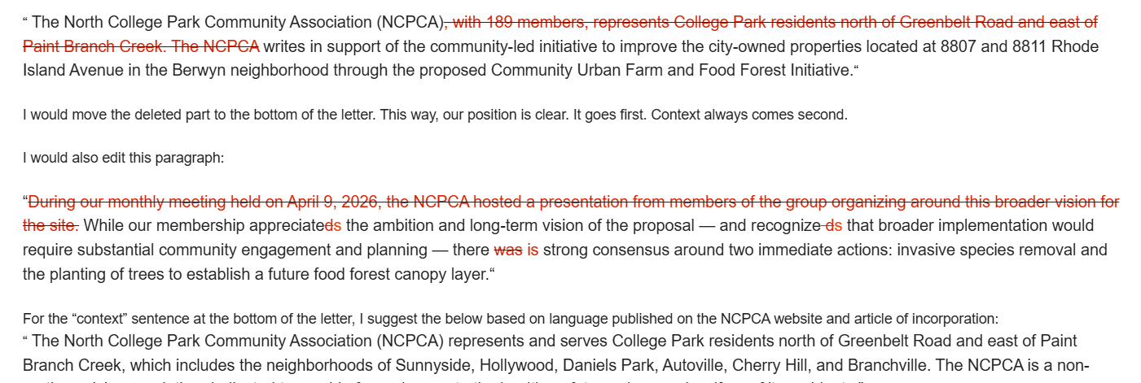
Community Urban Farm & Food Forest Letter

Slide 25
Placemaking Initiative Follow-up

Slide 26
Placemaking Initiative Follow-up
Representatives will be present at Trolley Trail Day (Saturday, 6/13) at the Hollywood Hub (streetscape).
Also present at Hollywood Farmers Market Saturday, 7/11 and 8/8.
Previously explored sites include, but are not limited to: Bus stops and areas surrounding Hollywood Shopping Center, streetscape flanking Edgewood/Rhode Island, areas surrounding Hollywood Plaza.
Any questions or feedback can be sent to ncpcivic@gmail.com or planning@collegeparkmd.gov

Slide 27
School Board Candidate Forum

Slide 28
Dues Discussion & Vote

Slide 29
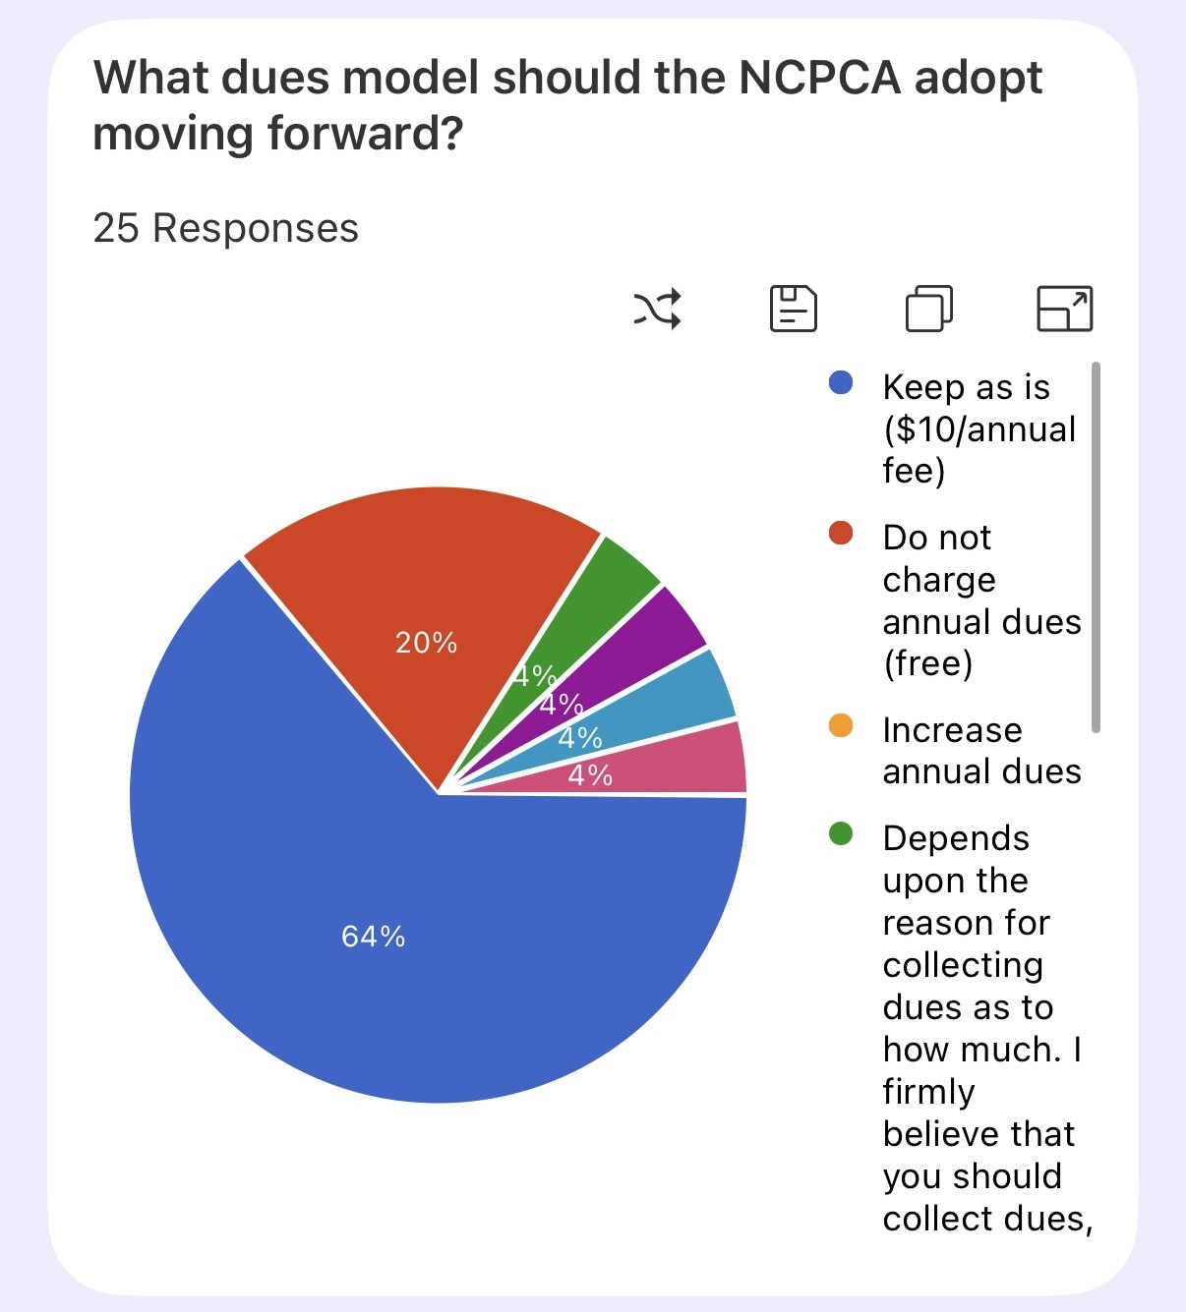
Dues Discussion & Vote
25 total votes
Majority - Keep dues at $10 (64%; 16/25 votes)
2nd - Waive dues (20%; 5/25 votes)
All other options = 4%; 1/25 votes
Additional Feedback:
Dues help incentivize attendance.
Dues can hinder attendance.
Dues gatekeep voting - good or bad?
Dues do not prevent us from fundraising.

Slide 30
Nominations and Committee Position Vote

Slide 31
Nominations and Committee Position Vote
All positions will need to be voted back in for the 2026 - 2027 NCPCA session. All positions are open for new nominations; includes existing board members interested in new roles.
Multiple communications sent out asking for new nominees.

Slide 32
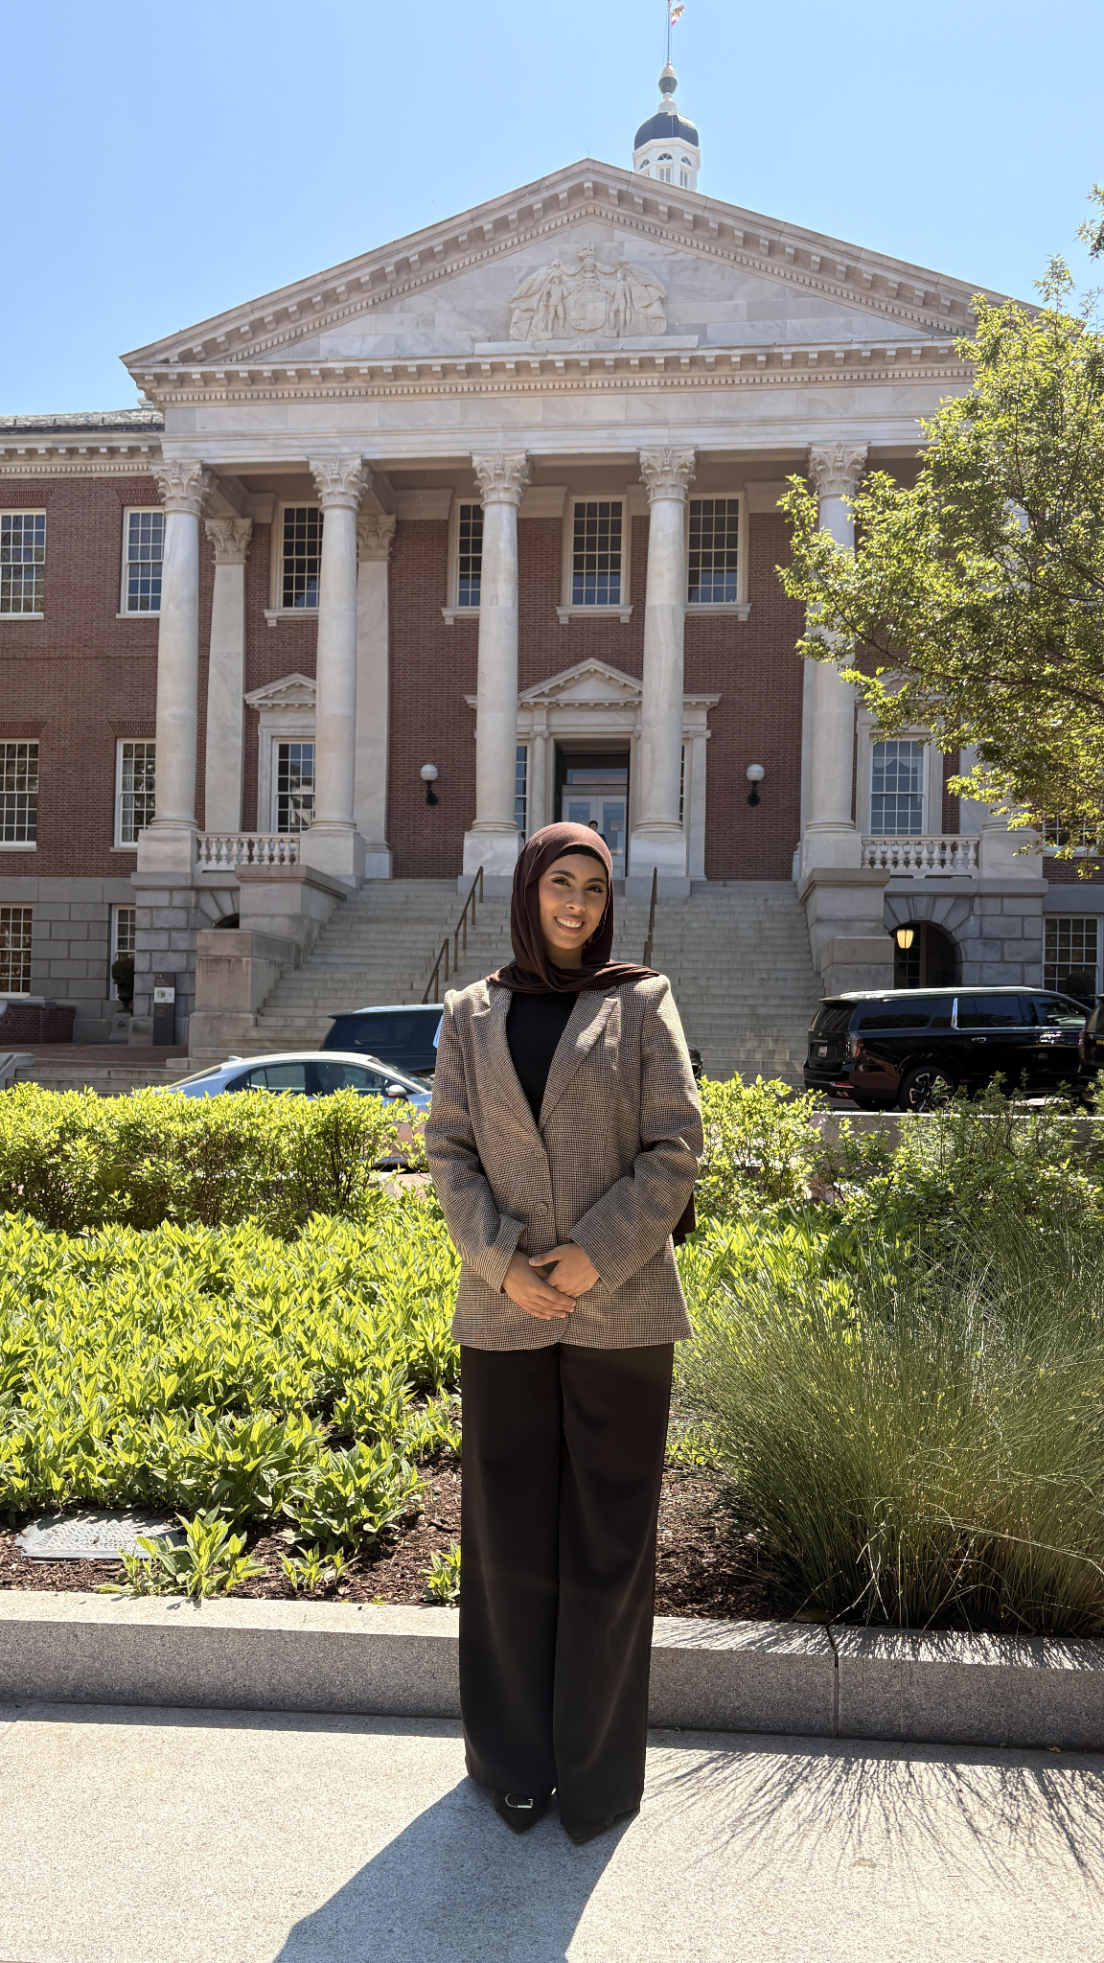
Events Coordinator Nomination
My name is Mariam I. Kamel. I am 21 years old and studying Public Policy and Media Studies. I am a North College Park (Daniels Park) resident of two years and a Muslim immigrant. My family and I moved to College Park because of the vibrant Muslim community at Dar Us Salaam, right in the heart of the city, and I will soon be transferring to the University of Maryland, College Park. I currently serve as the District 21 representative on the Central Committee, which includes North College Park, and I previously worked with PGCPS as a Youth Activity Coordinator. I also volunteer with multiple Prince George’s County coalitions and am helping facilitate the initiative to create a Youth Advisory Board with the College Park government. I have fallen in love with North College Park and am passionate about being involved in my community, bringing fresh and creative ideas to the table, and helping build a stronger sense of connection so neighbors can come together and truly know one another.

Slide 33
Motion
I move that . . .

Slide 34
Unscheduled Motions and Announcements

Slide 35

Our Next Meeting: September 10, 2026
… and we’re so excited to see you then!

