Slide 1
NCPCA
September Meeting
September 11th, 2025

Slide 2
Agenda
7:30 - Consent to Record, Call to Order, Agenda Approval, Minutes Approval
7:35 - Officer Reports
7:50 - Samosas Wine & Spirits Presentation
8:05 - Dues Status
8:25 - Unscheduled Motions and Announcements
8:30 - Motion to Adjourn

Slide 3
Motion to Approve
Minutes
I move to approve the June minutes as posted on the NCPCA website and provided to members before this meeting.
  Discussion and Vote

Slide 4

President Report
Welcome to the 25’ - 26’ NCPCA.
Developments and Events Committee vacancies.
Powerpoint decks to be posted on NCPCA website; meeting recordings available upon request.

Slide 5
President Report
College Park Community Corner
Advisory Planning Commission
Conducts hearings with respect to applications for variances from PG County Zoning Ordinance, departures from design and landscaping standards, parking and loading standards, etc.
Recommendations made to Mayor & Council on development applications.
Seven members currently. Three year terms.
Monthly meetings (First Thursday, 7:30PM)
Staff Liaison:Miriam Bader
Email: mbader@collegeparkmd.gov

Slide 6
Vice President Report
Continue checking your email for NCPCA updates.
Email us any questions, concerns, or needs! Help us make this meeting the most meaningful it can be.
NCPCA Association (ncpcivic@gmail.com)

Slide 7
Treasurer Report
Activities
MailChimp monthly upgrade: $13
NCPCA Board would like to eliminate membership dues
  There is still a place on our member signal page to donate if you wish to support our mission
  Regular costs: mailchimp, website hosting, zoom subscription
  Looking into fundraising and merch as a way to recoup our costs
Reminder: ~$1000 of money in checking account is earmarked for Welcome Wagon activities
  Is there a way to reallocate this money?
SECU Checking Account*
Available Balance | $1,357.99
Recent transactions: mailchimp, dues
SECU Savings Account*
Available Balance | $336.23
Interest Paid YTD | $1.29
Recent Transactions
Interest Credits 6/30, 7/31, 8/31 | $0.30
*As of 6:00PM EDT 9/11/2025

Slide 8
Secretary Report
Please be sure to state your name when addressing the membership, putting forward a motion, or seconding a motion to facilitate note-taking.
For those on Zoom: Please enter your full name into the chat to facilitate recording attendance.
Brian J. Roan will not be seeking re-election to the position of Secretary. Those interested should email NCPCivic@gmail.com.

Slide 9
Developments Committee Director Report
Position is currently vacant.
Send email to NCPCivic@gmail.com if interested. Include a small blurb about your experience and why you’re interested in filling the vacancy.
Department of Planning & Community Development
City Projects
Notes:
Hollywood Rd sidewalk - I think still some striping to do
PSA - Pedestrians walking in bike lane along northbound Rhode Island Ave

Slide 10
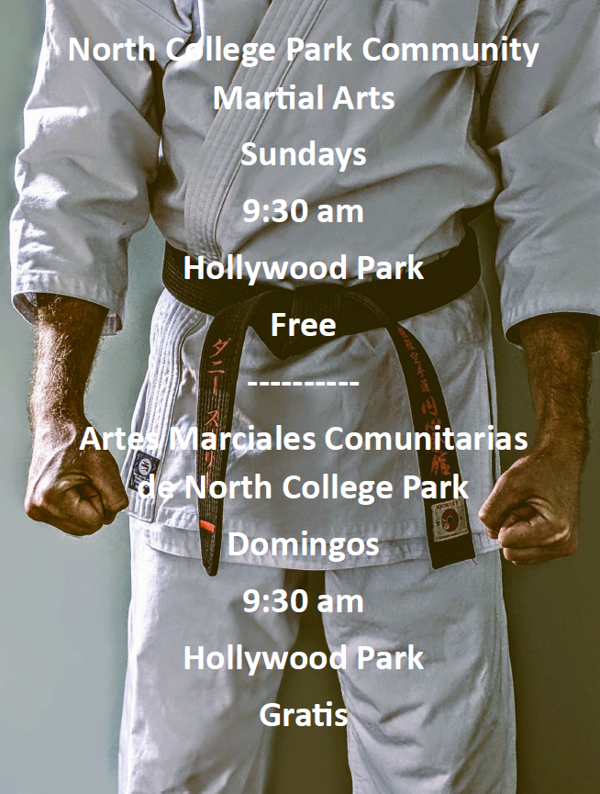
Events Committee Director Report
North College Park Events
Community Martial Arts - Every Sunday, 9:30am, Hollywood Park
Join your neighbors to practice martial arts in a friendly setting guided by two-time world championship contender, long-time instructor, and North College Park resident Donnie Scally.

Slide 11

Events Committee Director Report
North College Park Events
Hollywood Farmers Market - Saturday, 10am-2pm, Mom’s Parking Lot
  Food & produce vendors
  Arts & crafts
  Music
  Local businesses

Slide 12
City Events
Bailamos! - Friday, September 19th, 7:30pm, College Park Woods Clubhouse.
Celebrate Hispanic Heritage Month.
Live music, kid-friendly activities, food trucks, and community exhibitors.
Public Safety Meeting - Monday, October 6th, 7:00pm, City Hall Community Room
Discuss City-wide crime statistics, incidents of public interest, and other safety related topics with elected officials and police.
College Park Day - Saturday, October 18th, 12:00pm
College Park’s signature event. Come celebrate the city with food vendors/trucks, live music, inflatables, and activities for all ages.

Slide 13
City Events
Social Activities for Older Adults Launched by WISE Connect
From coffee meetups to board games to art sessions, this group is free to join and welcomes you!
WISE Connect (www.wisecities.us) was founded by UMD alumni to foster connection, engagement, and fulfillment all life long. This year, the City of College Park is partnering with WISE Connect to offer social and recreational activities for residents over age 55.
The initiative engages local businesses to host the group, offering discounts and age-friendly setups. Participating businesses starting September include Proteus Brews, The Greene Turtle, The Board & Brew, Sardi's, Dog Haus Biergarten, Shop Made in MD, Bowlero, Ledo Pizza, with more to come. Have a favorite spot to meet? Let the team know!
Social connection is key to good health! Come meet new people, get special discounts, explore new places, and have fun! Rides to events will be arranged as needed to ensure transportation is not a barrier to participating.
The calendar of upcoming events can be found at https://wiseconnect.us/ or in the Facebook group at https://www.facebook.com/groups/cpwiseevents, as well as in the attached PDF.
To sign up or ask questions, contact Marie Brodsky by email (marie@wiseconnect.us) or phone (571-354-6626).
WISE September Events Schedule (College Park)

Slide 14
Events Committee Director
Position is currently vacant.
Send email to NCPCivic@gmail.com if interested. Include a small blurb about your experience and why you’re interested in filling the vacancy.

Slide 15
Samosas Wine & Spirits

Slide 16
Member Dues
Currently $10/member annually.
Options include changing the amount charged and/or frequency, moving to a donation based system, removing dues altogether, or a combination of multiple options.
Examine the impact on membership and participation.

Slide 17
Motion
I move that . . .

Slide 18
Unscheduled Motions and Announcements

Slide 19

Our Next Meeting: October 9th, 2025
… and we’re so excited to see you then!

