Slide 1
NCPCA
September Meeting
September 10th, 2026

Slide 2
Agenda
7:30 - Consent to Record, Call to Order, Agenda Approval, Minutes Approval
7:35 - Officer Reports
7:50 - NCPCA 25’ - 26’ Recap & Future Goals
8:05 - College Park Raccoon Incidents Presentation & Discussion
8:20 - Unscheduled Motions and Announcements
8:30 - Motion to Adjourn

Slide 3
Motion to Approve
Minutes
I move to approve the June minutes as posted on the NCPCA website and provided to members before this meeting.

Slide 4

President Report
NCPCA Coffee Socials - Previous meeting was this past Sunday, September 6th and first for this NCPCA session. Next meeting: Sunday, October 4th.
Retirement of College Park Community Corner segment.
Open Committee Positions: Developments Director, Director of Communications
Please send any general inquiries to NCPCivic@gmail.com

Slide 5
President Report
Summer in the City Recap
June 24th - US Rt.1/Baltimore Ave Improvement Workshop
July 31st - Duvall Field Reopening
August 8th - Placemaking Walkthrough (#2)
August 27th - Pre-Application Meeting on Aviation Landing Development

Slide 6
Vice President Report
Continue checking your email for NCPCA updates.
Email us any questions, concerns, or needs! Help us make this meeting the most meaningful it can be.
NCPCA Association (ncpcivic@gmail.com)

Slide 7
Treasurer Report
Activities: June, July & August, 2026
Checking:
Total Withdrawals: $ 87.39
Bluehost 08/15/26 $49.00
Mailchimp 8/13/26 $13.39
MD-Dept Tx 06/26/26 $25.00 (Change of Resident Agent Processing)
Total Deposits: $ 29.09
Transfers from Stripe: $19.09
Deposit Dues $10.00
Savings: Interest for three months $0.30
Deposited $10 dues into Savings vs Checking.
(Error by Treasurer)
SECU Checking Account*
Available Balance $936.30
SECU Savings Account*
Available Balance | $347.22
Interest Paid (June, July, Aug ‘26) | $0.30
Recent Transactions
Dues Deposited | $10.00
*As of 7:00PM EST 2/12/2025

Slide 8
Secretary Report
State your name when speaking. If on Zoom, enter your first and last name in the chat.
NCPCA Update summer emails:
  June 15: 203 recipients, 75 opened, 16 clicked
  July 15: 203 recipients, 71 opened, 14 clicked
  August 25: 211 recipients, 83 opened, 26 clicked

Slide 9
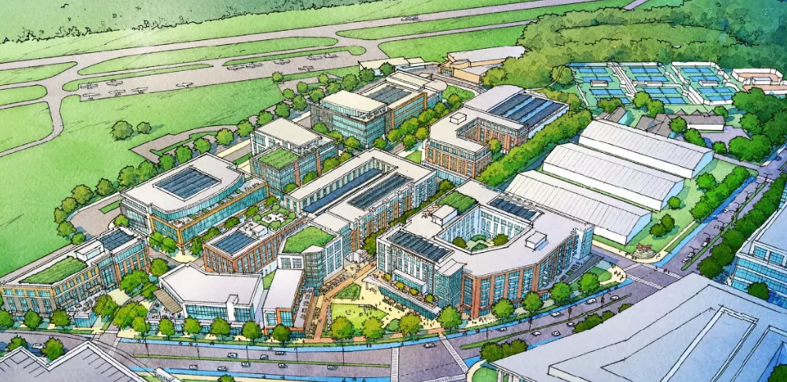
Developments Committee Director Report
Aviation Landing: A proposed mixed-use redevelopment near College Park Airport that could bring up to 1,400 residential units, retail and commercial space, and affordable housing to the area.
  Originally announced in 2022, the project has experienced delays related to stormwater infrastructure.
  A community meeting was held August 27 to present updated plans and gather community feedback and concerns.
4916 Tecumseh Street: The City is pursuing the purchase of the vacant property for $144,000, with potential future uses including affordable housing or open space. Final approval is pending a September 21 public hearing and Council action.
  https://www.collegeparkmd.gov/m/newsflash/Home/Detail/956

Slide 10
Developments Committee Director Report
Additional Resources:
Department of Planning & Community Development
City Projects
College Park Development Dashboard

Slide 11

Events Committee Director Report
North College Park Events
Hollywood Farmers Market
Saturday, 10am-2pm, Mom’s Parking Lot
  Food & produce vendors
  Arts & crafts
  Music
  Local businesses

Slide 12
Events Committee Director Report
North College Park Events
NCPCA Potluck Thursday, December 11th, 8:30pm, Davis Hall
Continuing our annual tradition of celebrating North College Park during the holiday season. We’ll have food, drinks, and light refreshments. Swing by, say hi, grab some food, and mingle with members of our wonderful community.

Slide 13

City Events
College Park Day - Saturday, October 3rd, 12:00 pm - 6:00 pm
Held at College Park Aviation Museum & Airport
Live music and performers
Food trucks and vendors
Artists, activities, and games
Helicopter and plane fly-in
Free museum entry

Slide 14

City Events
Branchville Fire Dept. Open House - Sunday, October 11th, 11:00 am - 3:00 pm
Free admission; fun for the whole family
Kids activities
Fire truck rides
Live fire demos
Safety handouts
Vendor booths & food

Slide 15

City Events
Bull Roast Fundraiser - Saturday, October 24th, 1:00 pm - 6:00 pm
Hosted by Branchville Ladies Auxillary
Held at Branchville Fire Company
$60 admission
Silent auction
50/50 raffles
Liquor wheel
Extensive food menu
Reserve your tickets at
branchvilleco11aux@gmail.com

Slide 16
City Events
Spring Street Fair - Sunday, May 17, 12:00 pm - 4:00 pm at Davis Hall
Join us for a vibrant afternoon of fun, food, and creativity at the second annual Spring Street Fair in College Park!
On Sunday, May 17th, from 12:00 PM to 4:00 PM, celebrate the season with your community at 9217 51st Ave, College Park, MD 20740.
This family-friendly event will feature a variety of exciting activities for all ages!

Slide 17
City Events
Social Activities for Older Adults Launched by WISE Connect
From coffee meetups to board games to art sessions, this group is free to join and welcomes you!
WISE Connect (www.wisecities.us) was founded by UMD alumni to foster connection, engagement, and fulfillment all life long. This year, the City of College Park is partnering with WISE Connect to offer social and recreational activities for residents over age 55.
The initiative engages local businesses to host the group, offering discounts and age-friendly setups. Participating businesses starting September include Proteus Brews, The Greene Turtle, The Board & Brew, Sardi's, Dog Haus Biergarten, Shop Made in MD, Bowlero, Ledo Pizza, with more to come. Have a favorite spot to meet? Let the team know!
Social connection is key to good health! Come meet new people, get special discounts, explore new places, and have fun! Rides to events will be arranged as needed to ensure transportation is not a barrier to participating.
The calendar of upcoming events can be found at https://wiseconnect.us/ or in the Facebook group at https://www.facebook.com/groups/cpwiseevents, as well as in the attached PDF.
To sign up or ask questions, contact Marie Brodsky by email (marie@wiseconnect.us) or phone (571-354-6626).
WISE Events Portal - College Park

Slide 18
Events Committee Director
Position is currently vacant.
Send email to NCPCivic@gmail.com if interested. Include a small blurb about your experience and why you’re interested in filling the vacancy.

Slide 19
NCPCA 25’ - 26’ Recap & Future Goals

Slide 20
NCPCA 25’ - 26’ Recap
Three new officers; four of five primary committee positions filled.
Two letters in support of member/community lead initiatives sent to City Council (RCV; Community Urban Food Forest/Farm).
Creation of NCPCA Newsletter as a meeting follow-up; decks posted online and meeting recordings available to dues paying members
Voted to maintain current dues status ($10/annual membership to be voting member).
Hosted 2nd annual Hey, Hollywood event.
Pivoted toward a presentation focused meeting set-up.
Decorating and maintaining the North College Park Community Tree.

Slide 21
NCPCA 26’ - 27’ : Future Goals
Increased focus on advertising/promotion of the group to increase member base and participation.
Development of more materials i.e. promo materials (business cards/notecards, “swag,” sandwich board and other namesake items)
Increased community outreach; ideas include additional events, leveraging the association for community forums, etc.
Filling remaining Committee positions.
Focus on ensuring majority of attendees are dues paying members so they are able to vote on NCPCA agenda items.
Continued member outreach via surveys, solicitation of feedback, etc.
Any other ideas?

Slide 22
College Park Raccoon Incidents
(Presenter: Ofc. Rebecca Bailey
Senior Animal Control Officer)

Slide 23
Motion
I move that . . .

Slide 24
Unscheduled Motions and Announcements

Slide 25
From the County
District 1 Community Shred Days
Our team will be holding the last two District 1 Community Shred Days of Council Member Dernoga’s tenure. There will be a three-box limit per person. No registration is required.
  Saturday, September 12 at Beltsville Academy, 4300 Wicomico Avenue, Beltsville 20705, 9 AM to 10:30 AM (or until the truck is full)
  Saturday, September 19 at Montpelier Elementary, 9200 Muirkirk Road, Laurel 20708, 9 AM to 10:30 AM (or until the truck is full)
View the flyers: https://tinyurl.com/D1ShredDays2026
Coffee with a Cop - Prince George’s Police Department District 1
Join the District 1 PGPD for coffee, conversation, and community.
This will be held on Monday, September 21, from 10 AM to 12 PM, at McDonald’s, 6219 Greenbelt Road, Berwyn Heights, MD 20740.
View the flyer: https://tinyurl.com/D1PGPDCoffee

Slide 26
From the County
District 1 Town Hall with the County's Cannabis Reinvestment & Restoration Board
This Town Hall will provide residents with an opportunity to help shape recommendations for how Community Reinvestment and Repair Fund resources are invested throughout Prince George’s County.
The Board was established to develop recommendations for the distribution of cannabis-related reinvestment funds, with a focus on addressing the lasting impacts of cannabis prohibition and supporting communities that have experienced incarceration, family separation, lost opportunities, and disinvestment.
This will be held on Tuesday, September 29, at 6 PM. The location, flyer, and registration link are TBD.
Join our District 1 eNewsletter
We will email you about twice a month to update you on local happenings and, on occasion, alert you to important county news. We also share a monthly Senior eNewsletter.
Opt-in to receive our eNewsletters via email: tinyurl.com/D1eNewsletterOptIn

Slide 27

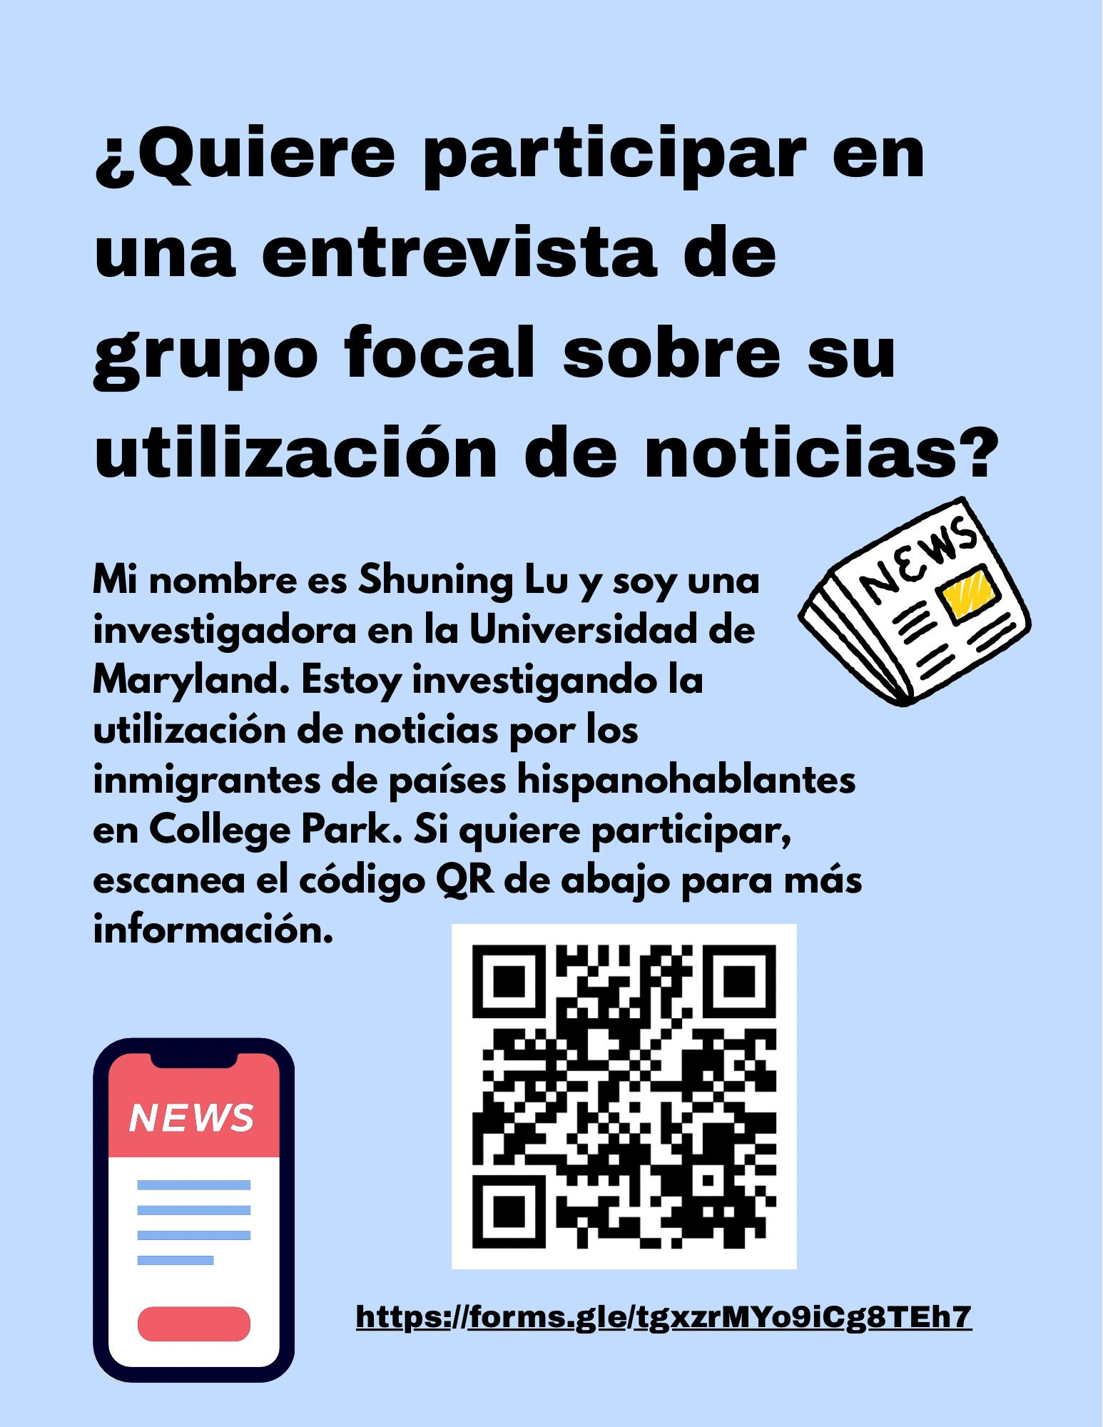
UMD Focus Group
University of Maryland project to investigate the news consumption habits of immigrants from Spanish-speaking countries in College Park.

Slide 28

Our Next Meeting: October 8th, 2026
… and we’re so excited to see you then!

