Slide 1
NCPCA
October Meeting
October 8th, 2026

Slide 2
Agenda
7:30 - Consent to Record, Call to Order, Agenda Approval, Minutes Approval
7:35 - Officer Reports
7:50 - BPAC Edgewood Road Bike Lane Project Presentation & Discussion
8:10 - Hollywood Commercial District Placemaking Updates & Discussion
8:10 - District 21 Updates w/ Senator Jim Rosapepe
8:30 - Unscheduled Motions and Announcements
8:40 - Motion to Adjourn

Slide 3
Motion to Approve
Minutes
I move to approve the September minutes as posted on the NCPCA website and provided to members before this meeting.

Slide 4

President Report
NCPCA Coffee Socials - Previous meeting was this past Sunday, October 4th. Next meeting: Sunday, November 8th.
Debut of Agenda Preview for dues paying active members. Become an active member here.
Website updates - Revised layout, addition of NCPCA Initiatives. See for yourself here.
Open Committee Positions: Developments Director, Director of Communications
Please send any general inquiries to NCPCivic@gmail.com

Slide 5
Vice President Report
Good Neighbor Day is on October 24th
  Lots of volunteer opportunities
  Projects include: invasive species removal, native tree and meadow plantings, community clean ups, and more
  https://communityengagement.umd.edu/good-neighbor-day/
Email us any questions, concerns, or needs! Help us make this meeting the most meaningful it can be.
NCPCA Association (ncpcivic@gmail.com)

Slide 6
Treasurer Report
SECU Savings Summary September, 2026
Starting Balance: $ 347.42
Total Deposits: $ 0
Interest Income $ 0.10
Other $ 0
Total Withdrawals: $ 0
Ending Balance: $ 347.52
SECU Checking Summary Period
Starting Balance $ 936.30
Total Withdrawals: $ 13.39
Bluehost $
Mailchimp $13.39
Other
Total Deposits $ 9.88
Transfers from Stripe: $9.88
Other
Ending Balance: $ 932.79
SECU Checking Account*
Available Balance $932.79
SECU Savings Account*
Available Balance | $347.52
Interest Paid (Sept ‘26) | $0.10
Dues Deposited | $0
*As of 7:00PM EST 2/12/2025

Slide 7
Secretary Report
State your name when speaking. If on Zoom, enter your first and last name in the chat.
NCPCA Update email:
  Sept 14: 209 recipients, 84 opened, 23 clicked

Slide 8
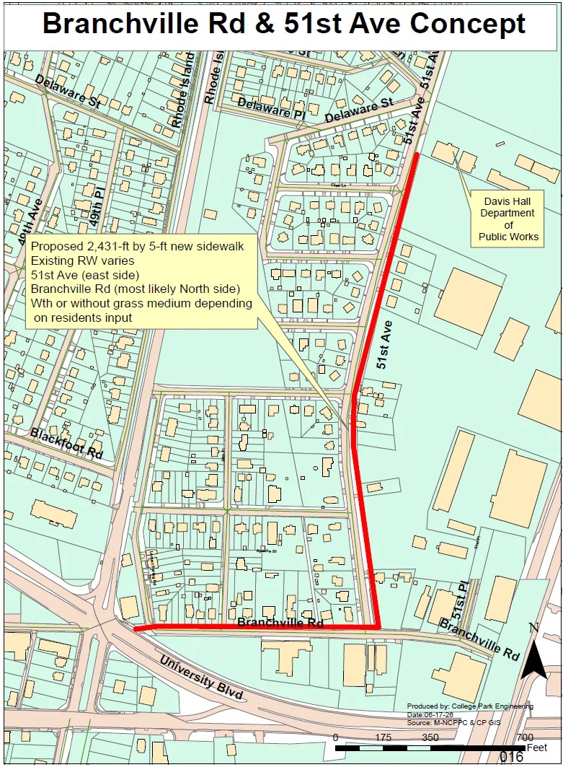
Developments Committee Director Report
On 10/6/26, City Council considered funding to start the design of the Branchville Road - 51st Avenue Sidewalk Project
After a public hearing on 9/21/26, City of College Park will move forward to acquire property at 4916 Tecumseh Ave.
US 1 (Baltimore Avenue) from MD 193 (University Boulevard) to Sunnyside Ave project
  Coordination with stakeholders continues as design progresses utilizing feedback from the public meeting and other outreach.

Slide 9
Developments Committee Director Report
Additional Resources:
Department of Planning & Community Development
City Projects
College Park Development Dashboard

Slide 10

Events Committee Director Report
North College Park Events
Hollywood Farmers Market
Saturday, 10am-2pm, Mom’s Parking Lot
  Food & produce vendors
  Arts & crafts
  Music
  Local businesses

Slide 11
Events Committee Director Report
North College Park Events
NCPCA Potluck Thursday, December 11th, 8:30pm, Davis Hall
Continuing our annual tradition of celebrating North College Park during the holiday season. We’ll have food, drinks, and light refreshments. Swing by, say hi, grab some food, and mingle with members of our wonderful community.

Slide 12

City Events
CANCELLED
Branchville Fire Dept. Open House - Sunday, October 11th, 11:00 am - 3:00 pm
Free admission; fun for the whole family
Kids activities
Fire truck rides
Live fire demos
Safety handouts
Vendor booths & food

Slide 13

City Events
CANCELLED
Bull Roast Fundraiser - Saturday, October 24th, 1:00 pm - 6:00 pm
Hosted by Branchville Ladies Auxillary
Held at Branchville Fire Company
$60 admission
Silent auction
50/50 raffles
Liquor wheel
Extensive food menu
Reserve your tickets at
branchvilleco11aux@gmail.com

Slide 14

City Events
Rave at the Grave - Friday, October 23rd, 6:00 pm - 9:00 pm, Duvall Field
Registration Required - Register Here
21+ only
Costume Contest
Food Trucks
Beer
Live Music By Uncle Jessie
Free Admission with registration

Slide 15
City Events
Winter Wonderland - Saturday, December 5th, 3:00 pm -7:00 pm, City Hall Plaza
Celebrate the holiday season at Winter Wonderland, the City of College Park’s annual Holiday Market and Tree Lighting! Join us on the Plaza at City Hall for an afternoon of holiday activities, entertainment, and festive fun for the community. Browse the Holiday Market featuring arts and crafts vendors and enjoy the celebration leading up to the annual tree lighting.
Winter Wonderland will take place on Saturday, December 5, 2026, from 3:00 to 7:00 p.m. on the Plaza at City Hall. Admission is free.
Interested in being a vendor? Applications are being accepted through October 1, 2026. Apply to be a vendor.
Check back soon for the complete event schedule!

Slide 16
City Events
Spring Street Fair - Sunday, May 17, 12:00 pm - 4:00 pm at Davis Hall
Join us for a vibrant afternoon of fun, food, and creativity at the second annual Spring Street Fair in College Park!
On Sunday, May 17th, from 12:00 PM to 4:00 PM, celebrate the season with your community at 9217 51st Ave, College Park, MD 20740.
This family-friendly event will feature a variety of exciting activities for all ages!

Slide 17
City Events
Social Activities for Older Adults Launched by WISE Connect
From coffee meetups to board games to art sessions, this group is free to join and welcomes you!
WISE Connect (www.wisecities.us) was founded by UMD alumni to foster connection, engagement, and fulfillment all life long. This year, the City of College Park is partnering with WISE Connect to offer social and recreational activities for residents over age 55.
The initiative engages local businesses to host the group, offering discounts and age-friendly setups. Participating businesses starting September include Proteus Brews, The Greene Turtle, The Board & Brew, Sardi's, Dog Haus Biergarten, Shop Made in MD, Bowlero, Ledo Pizza, with more to come. Have a favorite spot to meet? Let the team know!
Social connection is key to good health! Come meet new people, get special discounts, explore new places, and have fun! Rides to events will be arranged as needed to ensure transportation is not a barrier to participating.
The calendar of upcoming events can be found at https://wiseconnect.us/ or in the Facebook group at https://www.facebook.com/groups/cpwiseevents, as well as in the attached PDF.
To sign up or ask questions, contact Marie Brodsky by email (marie@wiseconnect.us) or phone (571-354-6626).
WISE Events Portal - College Park

Slide 18
Events Committee Director
Position is currently vacant.
Send email to NCPCivic@gmail.com if interested. Include a small blurb about your experience and why you’re interested in filling the vacancy.

Slide 19
BPAC Edgewood Road Bike Lane Project Presentation & Discussion
(Presented by the College Park Department of Public Works & Department of Planning & Community Development)

Slide 20
District 21 Updates
(Presenter: Senator Jim Rosapepe - District 21)

Slide 21
Motion
I move that . . .

Slide 22
Unscheduled Motions and Announcements

Slide 23
PG County Announcements
County Health Department Follow-Up
After the September meeting, I sent over the group’s questions to the County Health Department regarding rabies. They shared that there is currently no increased risk of rabies in the County. In addition, Prince George’s County lacks the ground and funding to participate in the same rabies vaccination via helicopter as Anne Arundel County does.
View their full statement: tinyurl.com/PGCountyRabiesInfo.
Upcoming General Election
The General Election is on November 3, 2026. Early voting will take place from October 22 to October 29. Polling locations will be open from 7 AM to 8 PM during both early voting and on Election Day.
Find your assigned polling place at voterservices.elections.maryland.gov/PollingPlaceSearch.
If you need to register to vote, confirm your registration, request a mail-in ballot, update any information, or see what candidates will be on the ballot, visit the Maryland State Board of Elections (SBE) website at elections.maryland.gov. You can also register to vote at your polling place on election day. Mail-in ballots must be postmarked or placed in a designated ballot drop box by 8 PM on November 3 to be counted.
Division I PGPD Coffee Club
The Division I Police’s Coffee Club is a place where citizens and police can work together to enhance our community and develop solutions to neighborhood challenges in the County.
This event is held online on the 2nd and 4th Wednesdays at 9 AM via Zoom.
  Meeting ID: 833 9609 4990, Password: 720306
The next meeting is on Wednesday, October 14, 2026, at 9 AM.

Slide 24
PG County Announcements
Educational Facilities Master Plan Listening Tour
Prince George’s County Public Schools (PGCPS) is developing a new Educational Facilities Master Plan (EFMP), a 10-year roadmap that will help guide decisions about our school buildings and other facilities. The plan will consider enrollment and population trends, building conditions, and the changing needs of our students and communities to help establish a long-term vision for PGCPS facilities, helping the district make strategic decisions about where and how to prioritize resources over time.
PGCPS will host a Community-Wide EFMP Listening Tour, with a session in each of the district’s nine Board of Education districts.
The District 2 meeting will be on Thursday, December 3, from 6:00 PM to 7:30 PM at Eleanor Roosevelt High School, 7601 Hanover Parkway, Greenbelt, 20770.
Register at https://tinyurl.com/D2EFMPTour.
Join our District 1 eNewsletter
We will email you about twice a month to update you on local happenings and, on occasion, alert you to important county news. We also share a monthly Senior eNewsletter.
Opt-in to receive our eNewsletters via email: tinyurl.com/D1eNewsletterOptIn.

Slide 25

Our Next Meeting: November 12th, 2026
… and we’re so excited to see you then!

