Slide 1
NCPCA
November Meeting
November 13th, 2025

Slide 2
Agenda
7:30 - Consent to Record, Call to Order, Agenda Approval, Minutes Approval
7:35 - Officer Reports
7:50 - Ranked Choice Voting Discussion & Vote
8:05 - Survey Results & Dues Vote
8:20 - Unscheduled Motions and Announcements
8:30 - Motion to Adjourn

Slide 3
Motion to Approve
Minutes
I move to approve the October minutes as posted on the NCPCA website and provided to members before this meeting.

Slide 4

President Report
NCPCA Coffee Socials - Sunday before the monthly meeting at Proteus Brews.
Development and Events committee vacancies.
Please send any interest for open positions or general inquiries to NCPCivic@gmail.com

Slide 5
President Report
College Park Community Corner
Childcare Task Force
Established January 21, 2025.
Charge is to discuss and identify issues surrounding cost and availability of childcare in College Park.
Nine voting member. Each district represented.
Staff Liaison: Bill Gardiner
Email: bgardiner@collegeparkmd.gov

Slide 6
Vice President Report
Continue checking your email for NCPCA updates.
Email us any questions, concerns, or needs! Help us make this meeting the most meaningful it can be.
NCPCA Association (ncpcivic@gmail.com)

Slide 7
Treasurer Report
Activities
MailChimp monthly upgrade: $13
Recurring charge: Annual Zoom Account renewal is $159.90 and renewed on 11/8
NCPCA Board would like to eliminate membership dues
Ongoing Reminder: ~$1000 of money in checking account is earmarked for Welcome Wagon activities
  The NCPCA Board is reviewing the language of the grant to ensure we can use it for community events
Holiday Tree Decorating - find a date!
  Coffee and hot cocoa from Proteus
New Treasurer - Seeking a replacement to start training in the new year
SECU Checking Account*
Available Balance | $1,182.76
Recent transactions: mailchimp, zoom, dues
SECU Savings Account*
Available Balance | $336.43
Interest Paid YTD | $0.99
Recent Transactions
Interest Credits 10/10 | $0.10
*As of 7:00PM EST 11/13/2025

Slide 8
Secretary Report
Please be sure to state your name when addressing the membership, putting forward a motion, or seconding a motion to facilitate note-taking.
For those on Zoom: Please enter your full name into the chat to facilitate recording attendance.

Slide 9
Developments Committee Director Report
On Cherry Hill, roadway paving has been completed on 47th Avenue and Austin Court by WSSC’s contractor. They returned to finish Kiernan Road and Park Drive. The City will continue to refrain from enforcing permit parking restrictions on 47th Avenue to accommodate displaced vehicles. Parking restriction signage has been updated by WSSC.
Additionally, the paving project on Indian Lane, Erie Street, Cree Lane, and 51st Avenue was rescheduled for the week of 11/3 due to anticipated inclement weather next week
Notes:
Hollywood Rd sidewalk - I think still some striping to do
PSA - Pedestrians walking in bike lane along northbound Rhode Island Ave

Slide 10
Developments Committee Director Report
Position is currently vacant.
Send email to NCPCivic@gmail.com if interested. Include a small blurb about your experience and why you’re interested in filling the vacancy.
Department of Planning & Community Development
City Projects
Notes:
Hollywood Rd sidewalk - I think still some striping to do
PSA - Pedestrians walking in bike lane along northbound Rhode Island Ave

Slide 11

Events Committee Director Report
North College Park Events
Hollywood Farmers Market - Saturday, 10am-2pm, Mom’s Parking Lot
  Food & produce vendors
  Arts & crafts
  Music
  Local businesses

Slide 12
Events Committee Director Report
North College Park Events
NCPCA Potluck Thursday, December 11th, 8:30pm, Davis Hall
Continuing our annual tradition of celebrating North College Park during the holiday season. We’ll have food, drinks, and light refreshments. Swing by, say hi, grab some food, and mingle with members of our wonderful community.

Slide 13
City Events
Winter Wonderland Holiday Market and Tree Lighting - Saturday, December 6th, 2:00pm - 8:00pm
Come enjoy live music, vendors, and celebrate the holiday season! This is a free community event and more information will be posted once made available.
Public Safety Meeting - Monday, December 1st, 7:00pm, Davis Hall
Discuss City-wide crime statistics, incidents of public interest, and other safety related topics with elected officials and police.

Slide 14
City Events
Social Activities for Older Adults Launched by WISE Connect
From coffee meetups to board games to art sessions, this group is free to join and welcomes you!
WISE Connect (www.wisecities.us) was founded by UMD alumni to foster connection, engagement, and fulfillment all life long. This year, the City of College Park is partnering with WISE Connect to offer social and recreational activities for residents over age 55.
The initiative engages local businesses to host the group, offering discounts and age-friendly setups. Participating businesses starting September include Proteus Brews, The Greene Turtle, The Board & Brew, Sardi's, Dog Haus Biergarten, Shop Made in MD, Bowlero, Ledo Pizza, with more to come. Have a favorite spot to meet? Let the team know!
Social connection is key to good health! Come meet new people, get special discounts, explore new places, and have fun! Rides to events will be arranged as needed to ensure transportation is not a barrier to participating.
The calendar of upcoming events can be found at https://wiseconnect.us/ or in the Facebook group at https://www.facebook.com/groups/cpwiseevents, as well as in the attached PDF.
To sign up or ask questions, contact Marie Brodsky by email (marie@wiseconnect.us) or phone (571-354-6626).
WISE November Events Calendar - College Park

Slide 15
Events Committee Director
Position is currently vacant.
Send email to NCPCivic@gmail.com if interested. Include a small blurb about your experience and why you’re interested in filling the vacancy.

Slide 16
Ranked Choice Voting Discussion & Vote

Slide 17
Ranked Choice Voting Discussion & Vote
“Elections in College Park as they are currently do not reflect the way that we make decisions every day. How we vote in our elections does not give people the option to express their full preferences. This is the root problem we want to solve.
● Most directly, since 2020, 50% of College Park’s City elections have had enough candidates to use ranked choice voting to ensure that results truly represent voter preference.
We need a system that
1) Gives voters more power
2) Is more fair
3) Is easy to use
Ranked Choice Voting is that system. That’s why I support it. That’s why I am asking other NCPCA members to support it as well.”
-Andrew Stinavage, NCPCA Member

Slide 18
Survey Results & Dues Vote

Slide 19
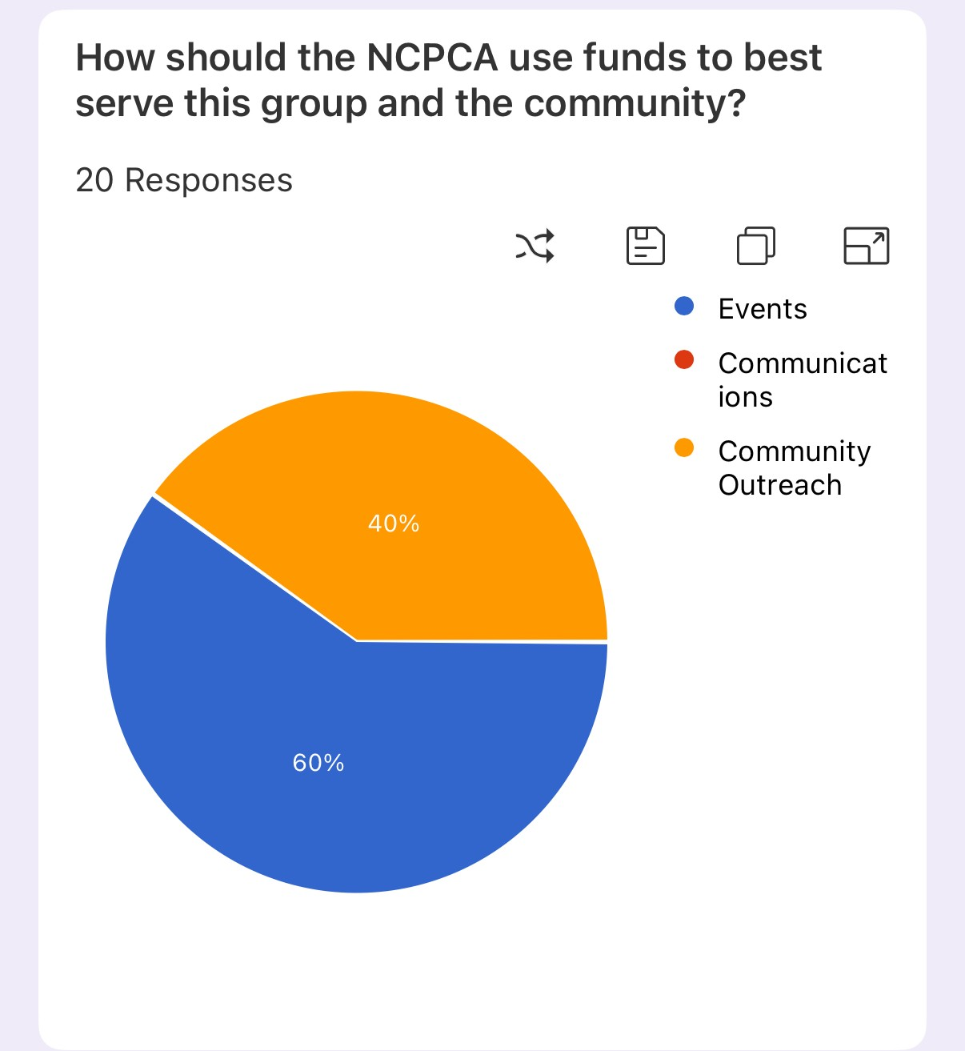
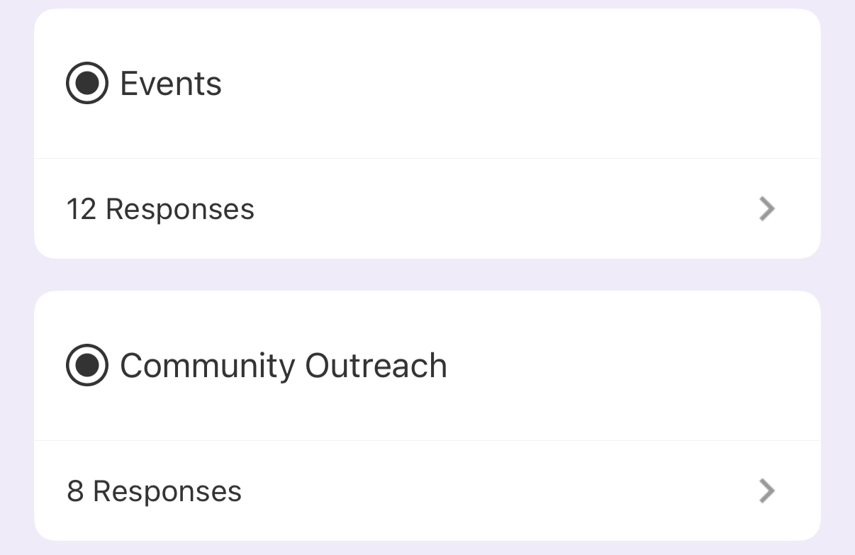

Slide 20
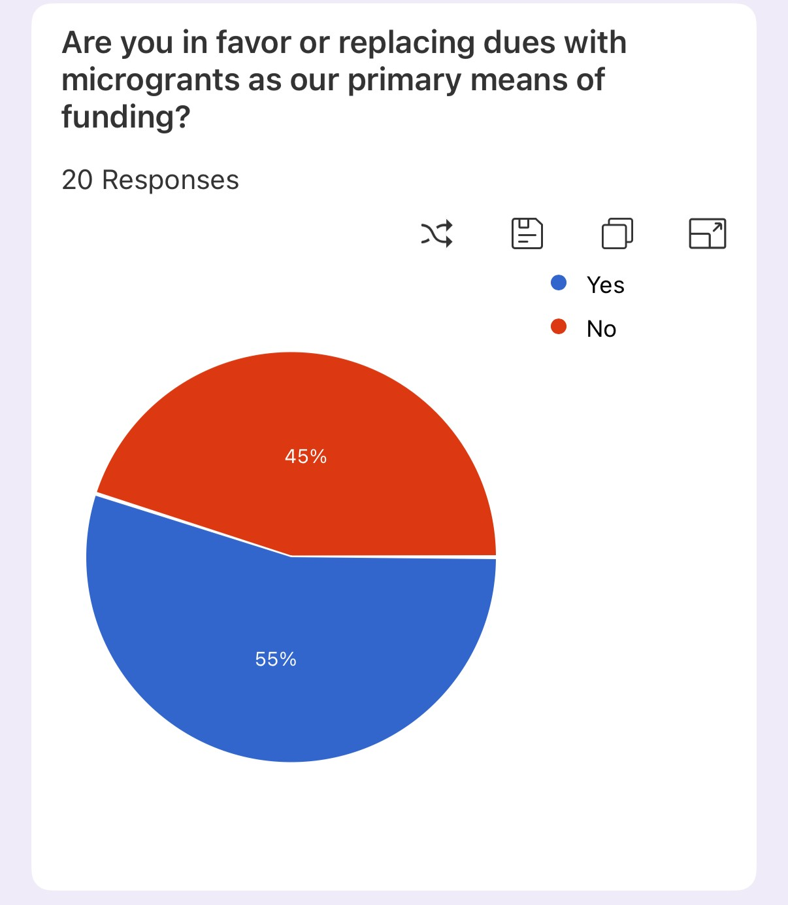
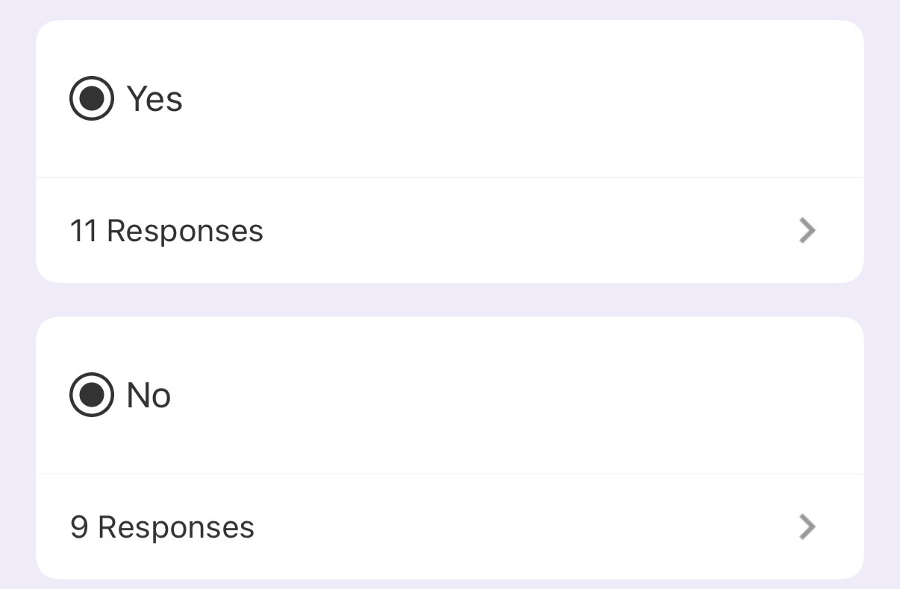

Slide 21
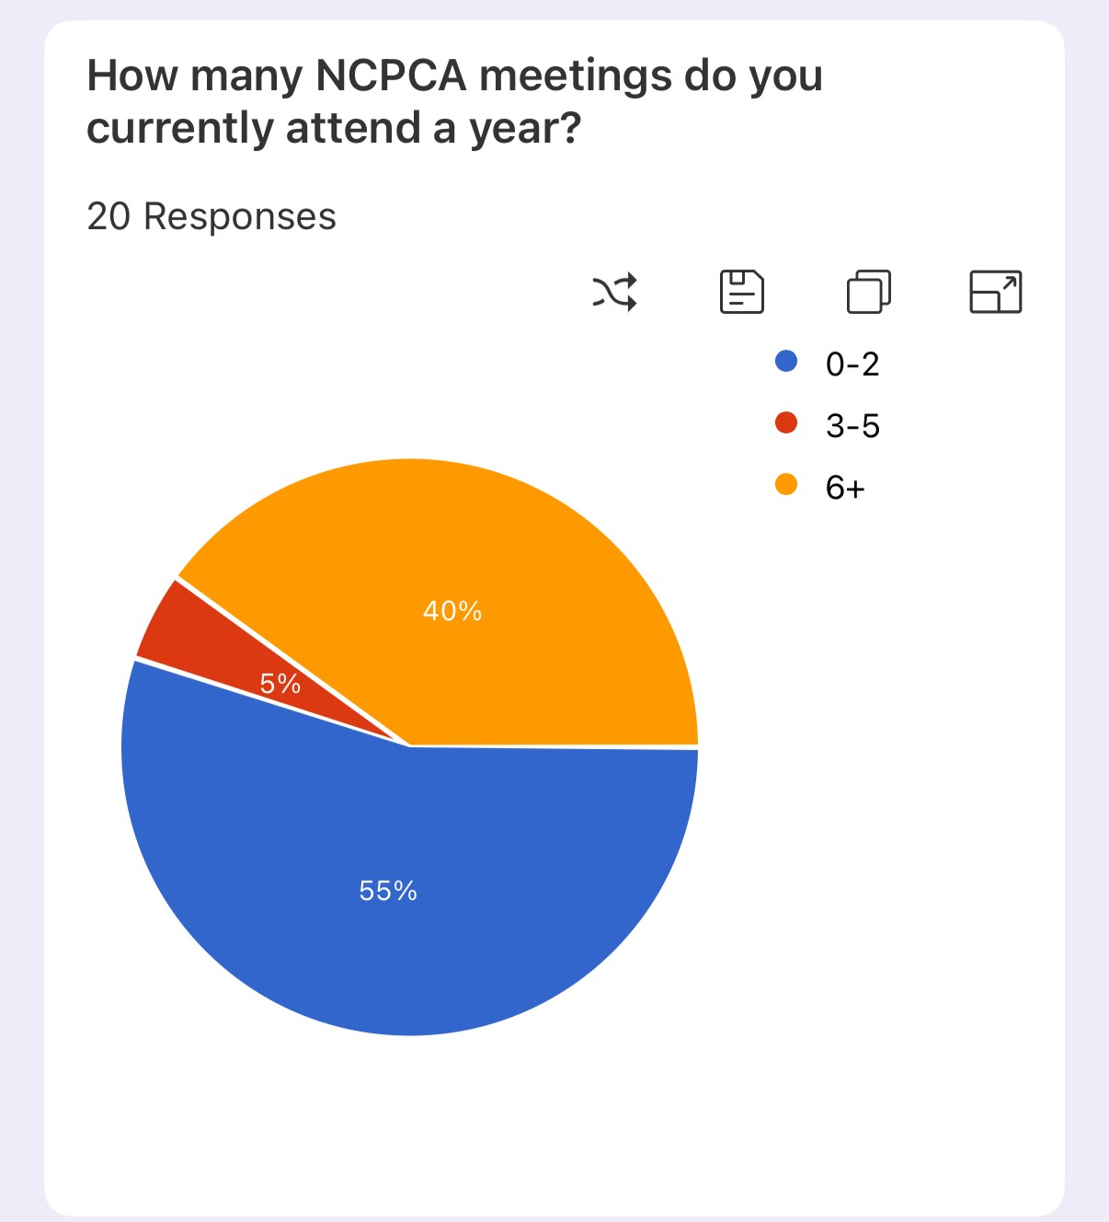
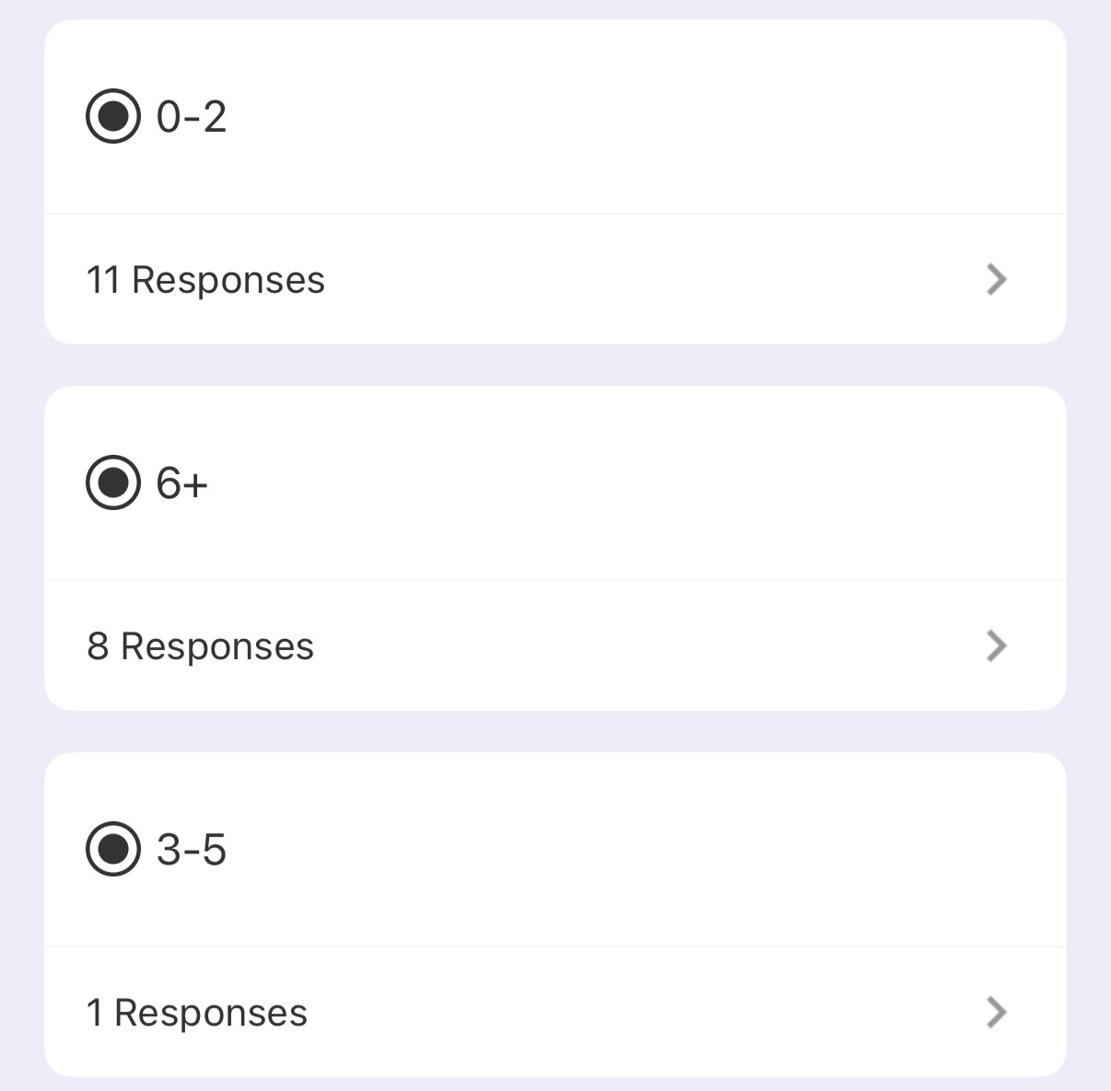

Slide 22
Motion
I move that . . .

Slide 23
Unscheduled Motions and Announcements

Slide 24

Our Next Meeting: December 11th, 2025
… and we’re so excited to see you then!

