Slide 1
NCPCA
December Meeting
December 11th, 2025

Slide 2
Agenda
7:30 - Consent to Record, Call to Order, Agenda Approval, Minutes Approval
7:35 - Officer Reports
7:50 - Shoppers Food Vacancy & Potential Replacements
8:05 - Unscheduled Motions and Announcements
8:20 - Motion to Adjourn
8:30 - NCPCA Holiday Potluck (In-Person)

Slide 3
Motion to Approve
Minutes
I move to approve the November minutes as posted on the NCPCA website and provided to members before this meeting.

Slide 4

President Report
NCPCA Coffee Socials - Sunday before the monthly meeting at Proteus Brews. Cancelled for December. Will resume January 4th.
Treasurer, Development, and Events committee vacancies.
Please send any interest for open positions or general inquiries to NCPCivic@gmail.com

Slide 5
President Report
College Park Community Corner
Affordable Housing Task Force
Established April 8, 2025.
Several charged aimed at addressing housing availability and affordability throughout the City.
Ten voting members with one member of the Age-Friendly Livable Community Work Group.
Final report due to City December 31st.
Staff Liaison: Moira Abernathy
Email: mabernathy@collegeparkmd.gov

Slide 6
Vice President Report
Continue checking your email for NCPCA updates.
Email us any questions, concerns, or needs! Help us make this meeting the most meaningful it can be.
NCPCA Association (ncpcivic@gmail.com)

Slide 7
Treasurer Report
Activities
MailChimp monthly upgrade: $13
New Treasurer - Seeking a replacement to start training in the new year
SECU Checking Account*
Available Balance | $1,182.76
Recent transactions: mailchimp
SECU Savings Account*
Available Balance | $336.53
Interest Paid YTD | $1.09
Recent Transactions
Interest Credits 11/30 | $0.10
*As of 7:00PM EST 12/11/2025

Slide 8
Secretary Report
Please be sure to state your name when addressing the membership, putting forward a motion, or seconding a motion to facilitate note-taking.
For those on Zoom: Please enter your full name into the chat to facilitate recording attendance.

Slide 9
Developments Committee Director Report
WSSC plans to repair a water service at 4714 Hollywood Road 12/10/25 if weather conditions allow. Work will be pushed one day if there is inclement weather. There may be temporary traffic impacts as work is completed.
Notes:
Hollywood Rd sidewalk - I think still some striping to do
PSA - Pedestrians walking in bike lane along northbound Rhode Island Ave

Slide 10
Developments Committee Director Report
Position is currently vacant.
Send email to NCPCivic@gmail.com if interested. Include a small blurb about your experience and why you’re interested in filling the vacancy.
Department of Planning & Community Development
City Projects
Notes:
Hollywood Rd sidewalk - I think still some striping to do
PSA - Pedestrians walking in bike lane along northbound Rhode Island Ave

Slide 11

Events Committee Director Report
North College Park Events
Hollywood Farmers Market - Saturday, 10am-2pm, Mom’s Parking Lot
Food & produce vendors
Arts & crafts
Music
Local businesses

Slide 12
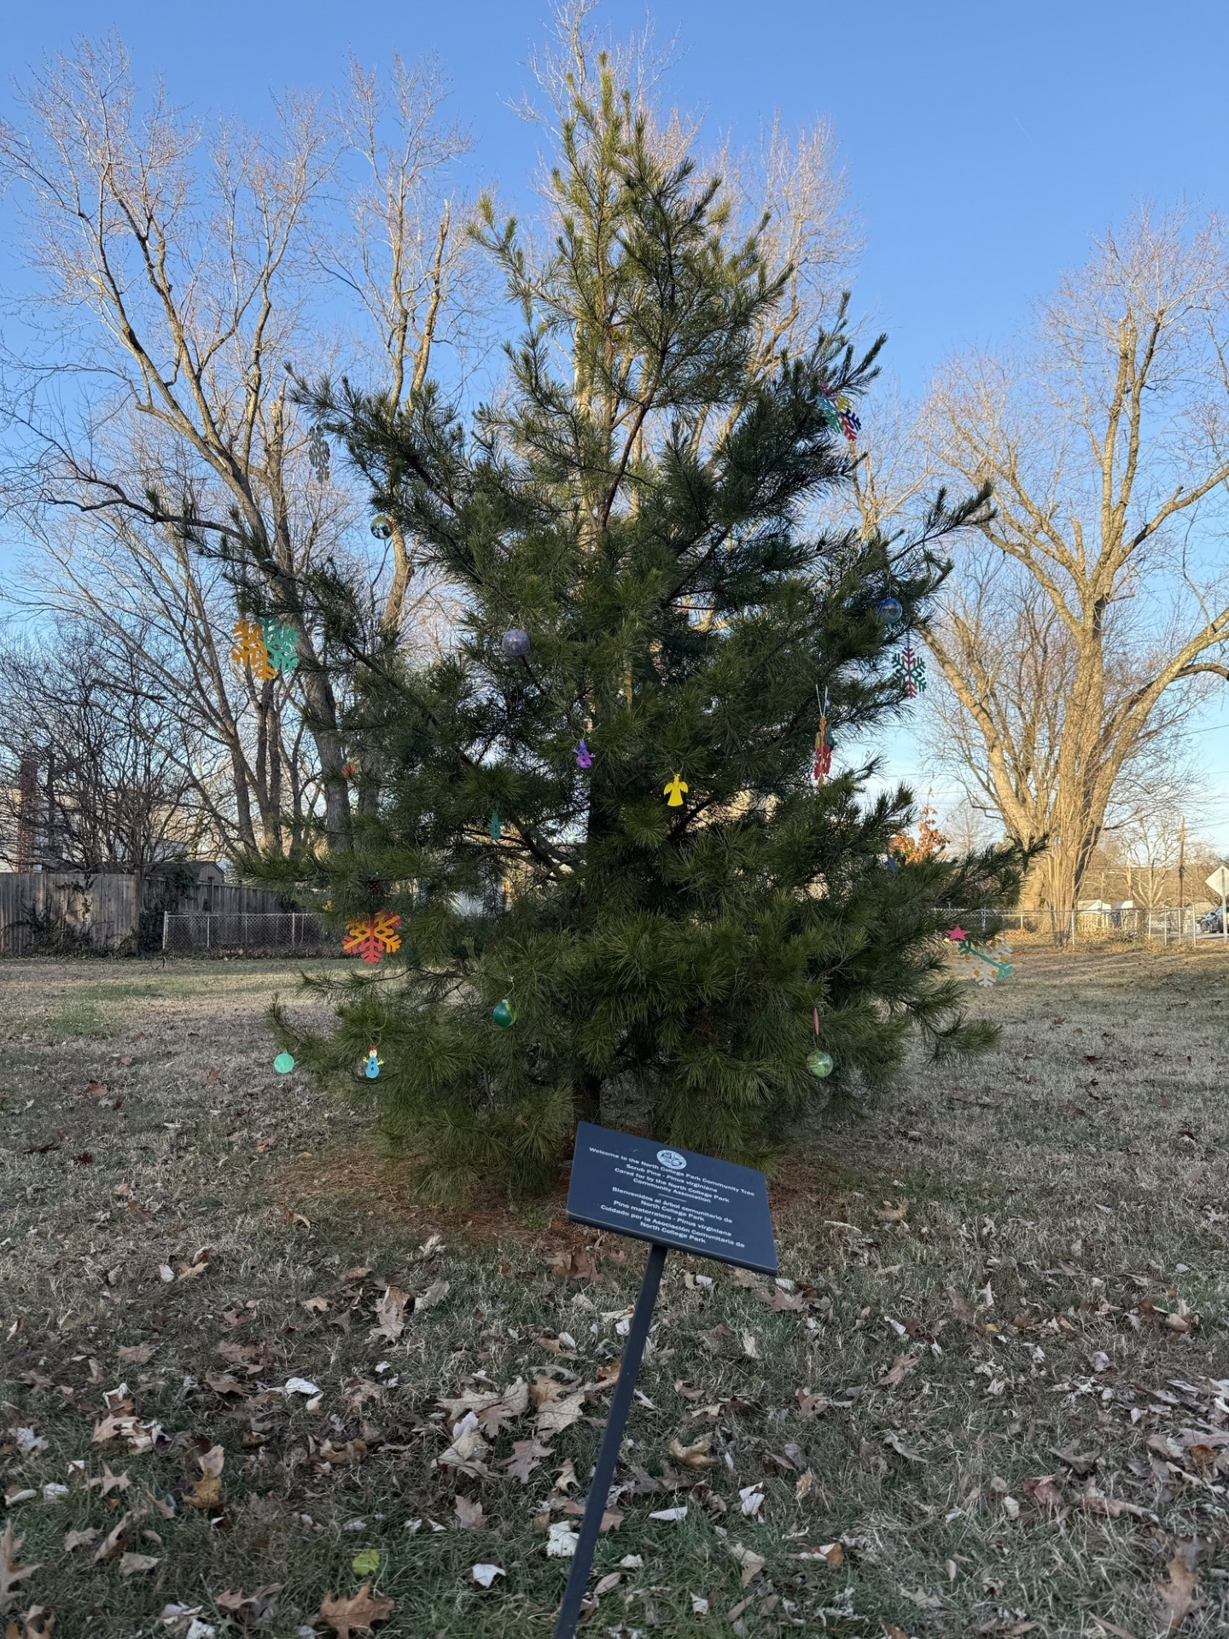
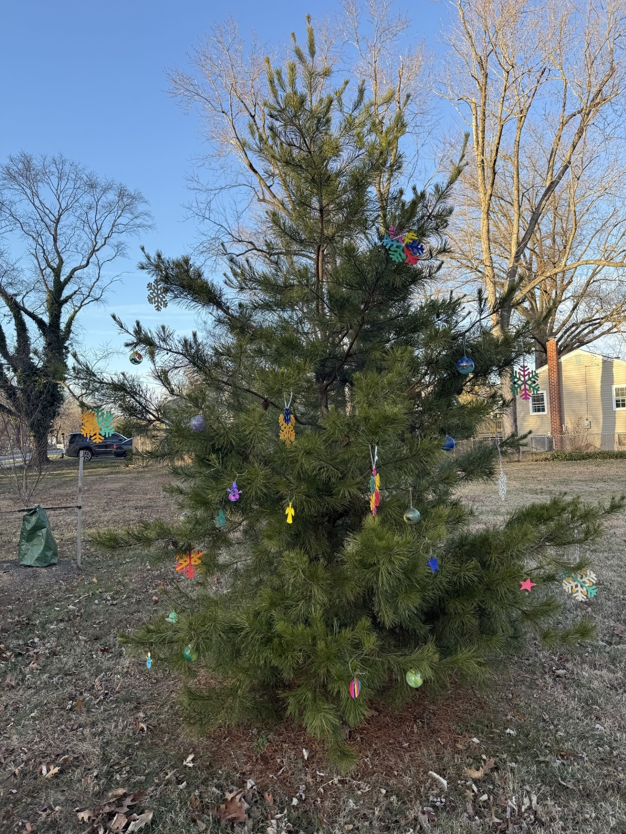
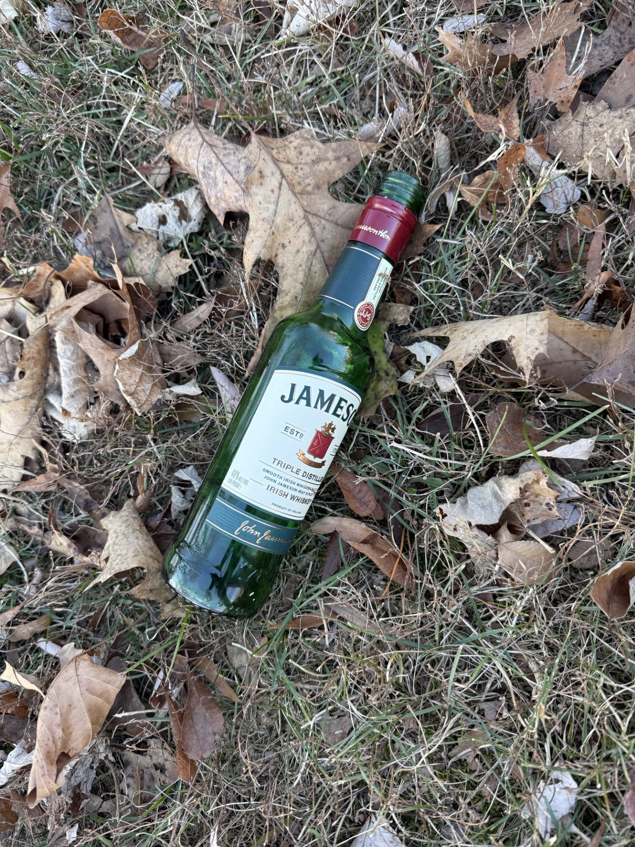
Events Committee Director Report
North College Park Community Tree Decoration
A special thanks to the Seniors, Dave Turley, and our wonderful community.

Slide 13
Events Committee Director Report
North College Park Events
NCPCA Potluck Thursday, December 11th, 8:30pm, Davis Hall
Continuing our annual tradition of celebrating North College Park during the holiday season. We’ll have food, drinks, and light refreshments. Swing by, say hi, grab some food, and mingle with members of our wonderful community.

Slide 14
City Events
Lunar New Year Celebration - Sunday, February 1st, 10:00 am - 1:00 pm at City Hall
Celebrate the vibrant culture and contributions of our Asian American community. This event will feature traditional music, dances, martial arts, drums, craft, child friendly activities, etc.

Slide 15
City Events
Social Activities for Older Adults Launched by WISE Connect
From coffee meetups to board games to art sessions, this group is free to join and welcomes you!
WISE Connect (www.wisecities.us) was founded by UMD alumni to foster connection, engagement, and fulfillment all life long. This year, the City of College Park is partnering with WISE Connect to offer social and recreational activities for residents over age 55.
The initiative engages local businesses to host the group, offering discounts and age-friendly setups. Participating businesses starting September include Proteus Brews, The Greene Turtle, The Board & Brew, Sardi's, Dog Haus Biergarten, Shop Made in MD, Bowlero, Ledo Pizza, with more to come. Have a favorite spot to meet? Let the team know!
Social connection is key to good health! Come meet new people, get special discounts, explore new places, and have fun! Rides to events will be arranged as needed to ensure transportation is not a barrier to participating.
The calendar of upcoming events can be found at https://wiseconnect.us/ or in the Facebook group at https://www.facebook.com/groups/cpwiseevents, as well as in the attached PDF.
To sign up or ask questions, contact Marie Brodsky by email (marie@wiseconnect.us) or phone (571-354-6626).
WISE December Events Calendar - College Park

Slide 16
Events Committee Director
Position is currently vacant.
Send email to NCPCivic@gmail.com if interested. Include a small blurb about your experience and why you’re interested in filling the vacancy.

Slide 17
Shoppers Food Vacancy & Potential Replacements

Slide 18
Shoppers Food Vacancy & Potential Replacements
Closed November 8, 2025 after serving North College Park for years.
Many reasons why, but owner UNFI has expressed a desire focus on distribution rather than retail grocery sales.
Closed many additional locations in the areas surrounding PG County.
The closure of Shoppers not only adversely impacts food availability in the immediate community, but creates a significant void in eliminating the primary “middle” grocery option in North College Park.
Remaining grocery focused stores (not including convenience stores) in the area within 1 mile of Davis Hall are: Lidl, Mom’s Organic, Mundo Latino Market. Two of these three options are smaller, more niche-based grocers.
The need for the city to replace Shoppers with another anchor grocer to stabilize affordable food options for the community is paramount in ensuring North College Park has adequate food availability for its residents.
Are there any obstacles in securing another grocer? What discussions has the city had with property management at College Park Marketplace? Have there been any proposed new tenants?

Slide 19
Motion
I move that . . .

Slide 20
Unscheduled Motions and Announcements

Slide 21

Our Next Meeting: January 8, 2026
… and we’re so excited to see you then!

